Slide 1
Performance Measures: The Minnesota Experience
PMIWG Development Subcommittee
Kansas City NEUAC
June 18, 2014
Michael Schmitz, Program Analyst
Minnesota Energy Assistance Program

Slide 2
Performance Measures – MN
Background on data collection in MN
Performance measures pilot test results
How we use the data
What has worked for MN

Slide 3
Background on data collection in MN
MN targets energy assistance benefits to households with the highest energy burdens by basing the primary benefit amount (primary heat) on the following data:
Household Income
Household Size
Fuel Type
Annual Fuel Cost

Slide 4
Background on data collection in MN
Income, household size, and fuel type are collected in our application
Fuel cost and consumption:
Supplied directly by energy vendors
800+ vendors statewide
In FFY2013 - complete data for more than 2/3 of our households
Ten largest vendors cover 80% of MN’s LIHEAP households

Slide 5
Performance Measures Pilot Test Results
The pilot test
Took approximately 5 hours to gather the data
Should take us 2-3 hours in the future
Challenges included:
Translating our local terms into the official performance measures terms
There was some data we did not currently collect

Slide 6
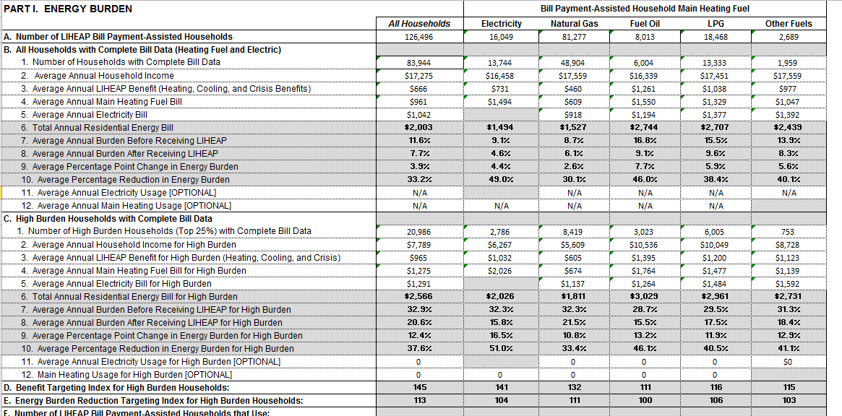
Performance Measures Pilot Test Results

Slide 7
Performance Measures Pilot Test Results
We found:
Average Annual LIHEAP Household Income: $17,275
Average Total Annual Residential Energy Bill: $2,003
Average % Reduction in Energy Burden: 33.2%

Slide 8
Performance Measures Pilot Test Data - MN
For households in the top 25% of energy burden, we found:
45% higher average total benefits
13% greater energy burden reduction
For fuel oil and propane households, we did not target the highest burden households as well as we did for other fuel types.

Slide 9
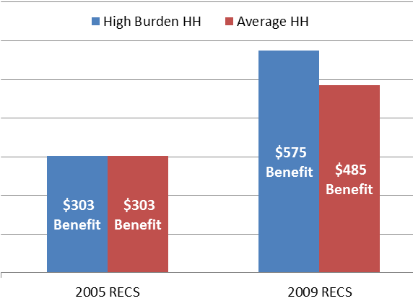
Section 4: Explaining Energy Burden Measure Data What are we reporting? Why does it matter?
Measure 2: Benefit Targeting Index Example
In 2005, high burden households received the same benefit as the average household.
[Index Score: 100]
In 2009, high burden households received a benefit 18.6% higher than the average household.
[Index Score: 118.6]
Does the LIHEAP program furnish higher benefits to high burden households?
Not in 2005. But, in 2009 the program did pay higher benefits to high burden households.

Slide 10
Performance Measures Pilot Test Results
In MN: Benefit Targeting Index Results
In 2013, high burden households received a benefit 45% higher than the average household.
[Index Score: 145]

Slide 11
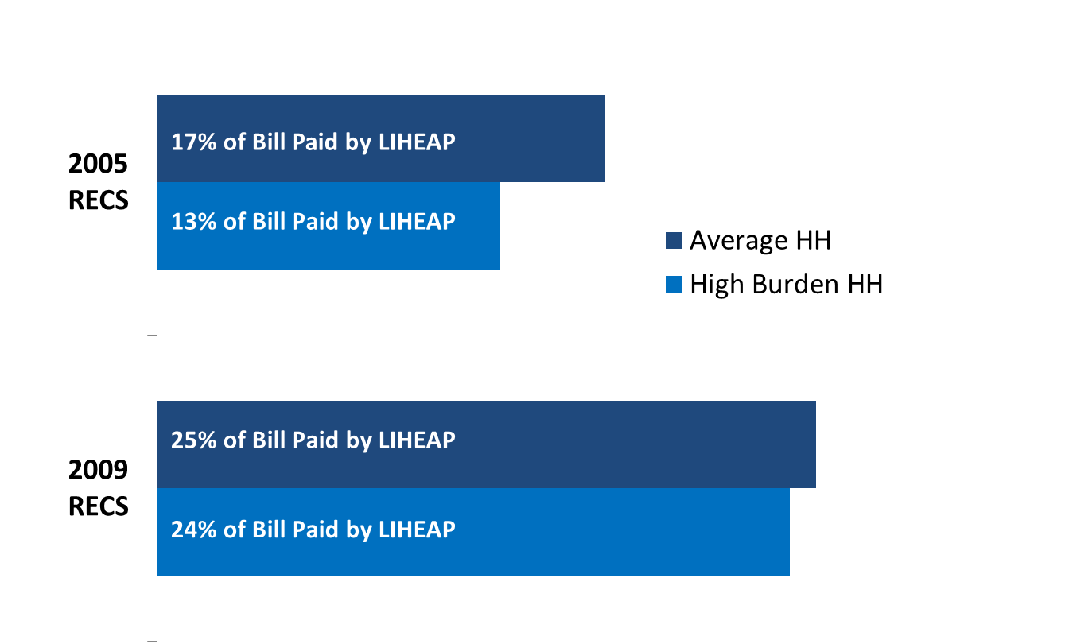
Section 4: Explaining Energy Burden Measure Data What are we reporting? Why does it matter?
Measure 3: Burden Reduction Targeting Index Example
In 2005, high burden households had 13% of their annual home energy bill paid, compared to the average of 17%.
[Index Score: 76]
In 2009, high burden households had 24% of their annual home energy bill paid, compared to the average of 25%.
[Index Score: 96]
Does LIHEAP pay a larger share of the home energy bill for high burden households?
No. In both 2005 and 2009, high burden households had a lower percentage of their home energy bill paid by the program than the average household. But, the program improved on this measure between 2005 and 2009.

Slide 12
Performance Measures Pilot Test Results
In MN: Burden Reduction Targeting Index Results
In 2013, high burden households had 37.6% of their annual home energy bill paid, compared to the average of 33.2%.
[Index Score: 113]

Slide 13
Performance Measures Pilot Test Results
What else we do with the data…
Project household need and plan for the upcoming year
Measure how well we’re targeting by:
Geographic location
Presence of elderly, disabled, or children <5

Slide 14
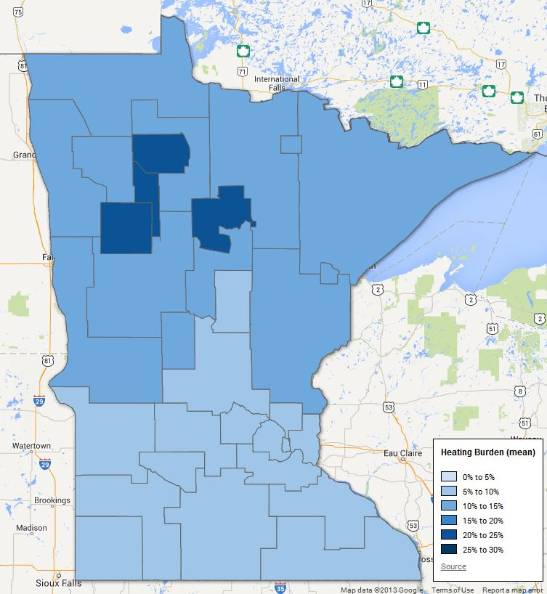
Map: Energy Burden
(by local agency service area)

Slide 15
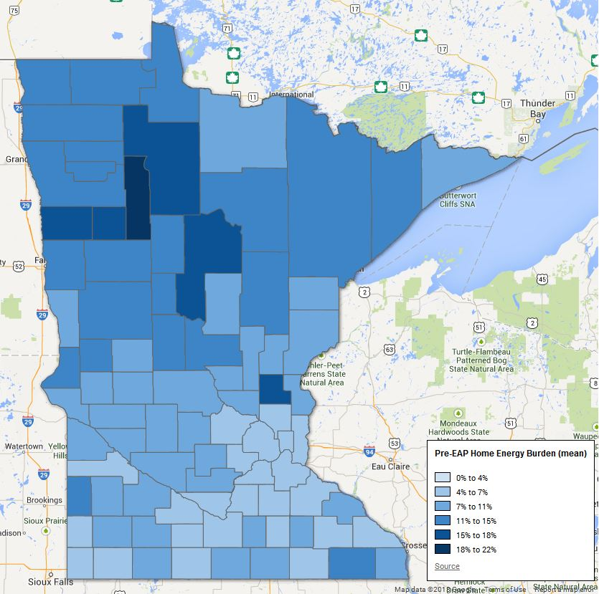
Map: Energy Burden
(by county)

Slide 16
Map:
Pre-LIHEAP Benefit Energy Burden

Slide 17
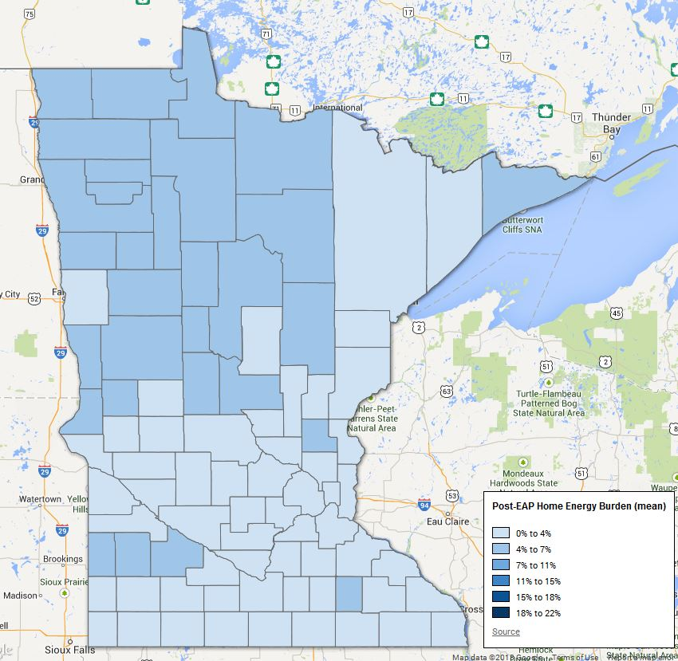
Map:
Post- LIHEAP Benefit Energy Burden

Slide 18
What has worked for MN
From 2004-2005, MN successfully developed and launched a new program database system called eHEAT
electronic Home Energy Automated Technology
eHEAT centralized data collection and payments, increasing efficiency for both local providers and energy vendors, benefitting LIHEAP participants

Slide 19
What has worked for MN
Recognize MN may be in a somewhat unique position – our system has been running for nearly a decade
How did we got vendors to provide data?
Have been gathering energy cost data since early ‘80s
Included energy vendors in designing data system in 2000s
Vendors were instrumental in centralizing payments, increasing consistency and accuracy
Notes:
Recognize MN may be in a somewhat unique position – our system has been running for nearly a decade
How did we got vendors to provide data?
Have been gathering energy cost data since early ‘80s
Initially decentralized to local providers
Gathered by phone, dedicated computer, spreadsheet
Included energy vendors in designing data system in 2000s
New technology made it easier
Compliance was much less prior
Vendors were instrumental in centralizing payments, increasing consistency and accuracy

Slide 20
What has worked for MN
While at first glance energy vendors may have little incentive to provide cost information…
Enables MN EAP to more effectively serve households based on their actual need
This directly impacts vendor collections and disconnection costs
Energy cost varies widely
If benefit is based on average costs, some households get more than they need, while others less, even if you’re having the same average impact
Notes:
In MN, for example:
Natural Gas average annual cost ~ $600, while the standard deviation is ~ $300! That means, statistically speaking, about 68% of households fall between $300 & $900. That’s a very wide range.
Fuel oil average annual cost ~ $1,800, while standard deviation is ~ $1,100!

Slide 21
What has worked for MN
While at first glance energy vendors may have little incentive to provide cost information…
MN accommodates different ways of providing consumption
Local providers enter into eHEAT from phone call from vendor
Energy vendors enter directly in eHEAT
Single entry screen
Multiple entry screen
Batch screen
If vendors don’t provide cost data, we use a “backup matrix” -RECS fuel cost data, income, housing type, and fuel type

Slide 22
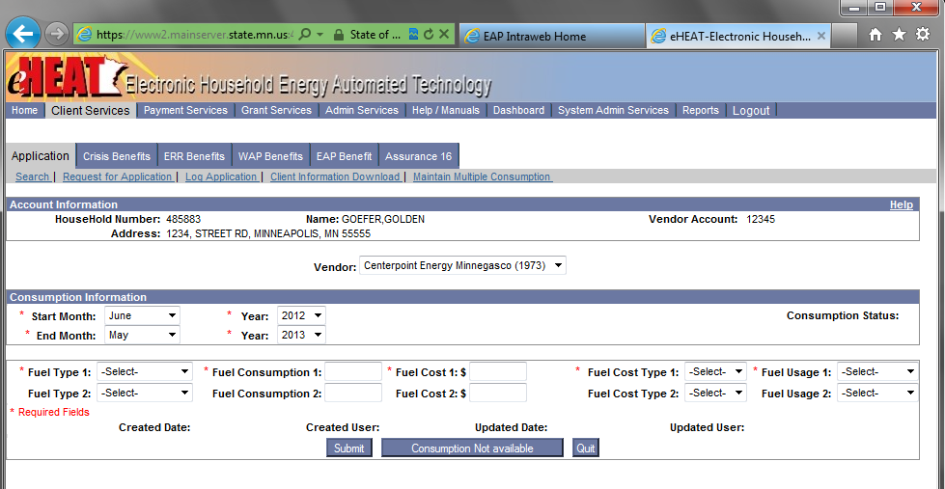
What has worked for MN
Single Entry Screen (simulated data shown below)

Slide 23
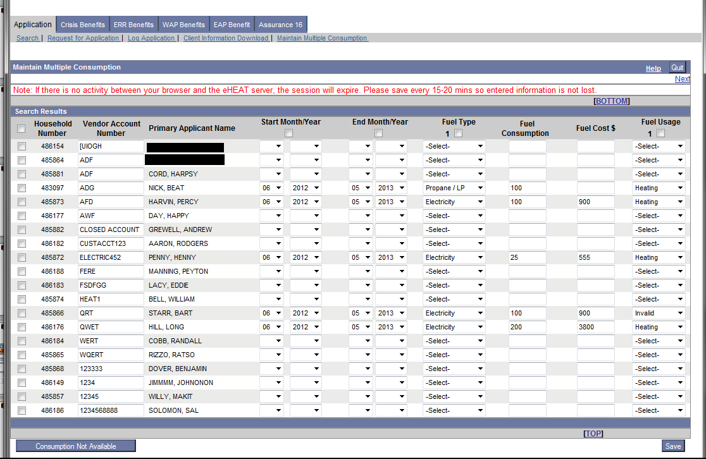
What has worked for MN
Multiple Entry Screen (simulated data shown below)

Slide 24
Goals of the Performance Measurement Pilot
Feasibility Assessment – Can grantees that have these data prepare this report?
Technical Assistance – What do other grantees need to know as they start to collect, process, and report on these data?
Value – How useful are these performance measures in helping grantees to assess their program performance?
24

Slide 25
Performance Measures – MN
Feasibility:
With the data we were already collecting we are able to report with minimal adjustments
Technical Assistance:
Work closely with energy vendor stakeholders; find out what they need and identify the existing obstacles to obtaining energy cost data
Consider using the data to determine benefit amounts
Larger investments upfront will pay off down the road
Value:
The performance measures help us understand if benefits are targeted to LIHEAP households with the highest energy burdens
Once you have the data there are numerous other potential applications

Slide 26
Performance Measures – MN
If you have questions or would like to discuss our approach, please feel free to contact me:
Michael Schmitz, Program Analyst
Office of Energy Assistance Programs
Minnesota Department of Commerce
michael.schmitz@state.mn.us
651-539-1812

