Slide 1
Putting LIHEAP Performance Measures
Into Practice
2017 National Energy and Utility Affordability Conference
Melissa Torgerson
VERVE Associates LLC
Kevin McGrath
APPRISE Incorporated
Jennifer Lee
Alabama Department of Economic and Community Affairs

Slide 2
Putting LIHEAP Performance Measures into Practice
Session Objectives
By the end of this workshop, attendees will have a better understanding of:
The LIHEAP Performance Management implementation timeline, including progress to date.
The types of data and information states are gleaning from LIHEAP Performance Measures.
The ways LIHEAP grantees are using data to analyze and make decisions about their programs.
Ongoing efforts to improve collection, reporting, and use of data for Performance Management among grantees (and their partners).
Where to find additional resources related to LIHEAP Performance Management.

Slide 3
Putting LIHEAP Performance Measures into Practice
Background
Both the development and design of LIHEAP Performance Measures are rooted in the LIHEAP Statute:
Section 2605(b) of the Low Income Home Energy Assistance Act of 1981 (42 U.S.C. §8624(b)) as amended by Sec. 311(b) of the Human Services Amendments of 1994 (Public Law 103-252) requiring HHS to develop, in consultation with LIHEAP grantees, model performance goals that measure the success of each State’s LIHEAP activities.
Section 2610(b)(2) of the Low Income Home Energy Assistance Act of 1981 (42 U.S.C. §8629(b)(2)) requiring that HHS annually report to Congress on the impact LIHEAP is making on recipient and income eligible households.
Section 2605(b)(5) of the Low Income Home Energy Assistance Act of 1981 (42 U.S. C. §8624(b)(5)) requiring LIHEAP grantees to provide, in a timely manner, that the highest level of energy assistance will be furnished to those households that have the lowest incomes and the highest energy costs or needs in relation to income, taking into account family size.

Slide 4
Putting LIHEAP Performance Measures into Practice
Background
  LIHEAP Performance Measurement Timeline
2008-2010 | Performance Management Work Group (PMWG) develops Performance Measurement Recommendations.
2010-2012 | Performance Management Implementation Work Group (PMIWG) transforms PMWG recommendations into Performance Measures.
2012-2014 | Development of OLDC and Performance Measurement Website. OMB Approves PMIWG recommendations.
2014-2016 | PMIWG works with OCS and APPRISE Team on guidance and support. Grantees work on building systems to collect and report new data.
2017 | Grantees required to report LIHEAP Performance Measures data for FY 2016. Grantees start using data for Performance Management.

Slide 5
Putting LIHEAP Performance Measures into Practice
Background
  As of June 2017:
  42 grantees submitted Performance Management data for FY 2016.
  Many grantees are actively working with vendors to increase the amount of data included in their Performance Data Forms.
  APPRISE will continue providing training and technical assistance to improve the quantity, accuracy, and reliability of data for FY 2017 LIHEAP reporting.

Slide 6
Putting LIHEAP Performance Measures into Practice
Background
  From Performance Measures to Performance Management
Summer 2013 | Performance Management Website Published for Grantees
Fall 2014 | OMB Approval of LIHEAP Performance Measures
Summer 2015 | PMIWG Launches LIHEAP Virtual Library and Data Warehouse Advanced Search Initiatives
Winter 2016 | Publication of LIHEAP Virtual Library and Data Warehouse Advanced Search Capabilities
Spring 2016 | Regional Training on Performance Management Techniques
Summer 2016 | NEUAC Presentation on FY 2015 Performance Measures Reports
Winter 2017 | Performance Management Website Goes Public
Spring 2017 | T&TA on Using LIHEAP Performance Management Data Reported by Grantees
FY 2018 | LIHEAP Model Plans Designed by Grantees with Performance Management in Mind

Slide 7
Putting LIHEAP Performance Measures into Practice
Session Overview
During the remainder of this session:
Kevin McGrath (APPRISE) will highlight some results from FY 2016 LIHEAP Performance Measure data, and discuss where states are “going” in terms of using their data for performance management.
Jennifer Lee (Alabama Department of Economic and Community Affairs) will share Alabama’s experience with collecting, reporting, and using LIHEAP Performance Measure data for performance management.
We will conclude the session by reviewing some of the steps being taken to increase the use of Performance Measures data in LIHEAP performance management.

Slide 8
Putting LIHEAP Performance Measures into Practice
What have we learned from Performance Measures Data reported for FY 2016?
Kevin McGrath
APPRISE Incorporated

Slide 9
Presentation Outline
Overview of reporting for FY 2016
Examples of reported data for FY 2016
How grantees are using the data
Tools and resources available to help grantees get there

Slide 10
Overview of reporting for FY 2016
Reporting Results (as of 6/20/2017)
42 / 51 grantees have submitted usable PM data for FY 2016
  Even more on path to report for FY 2017
21 grantees have submitted final PM data for FY 2016
The reported data tell a lot of new information about their clients
  Income, bill, and burden differences across groups
Data collected helping grantees understand effectiveness of benefit determination procedures

Slide 11
Overview of reporting for FY 2016
Reporting Challenges
7 states unable to report baseload electric data
  Can examine main heating fuel burden, but not total energy burden
  Important because many delivered fuel clients use supplemental electric heat, and because cooling (part of home energy) is an electric use
9 states unable to report complete delivered fuel data
  Incomplete analysis of clients across heating fuel types
7 states with high prevalence of “zero income” households
  Average income < average total energy bill; difficult to interpret outcomes

Slide 12
Examples of reported data for FY 2016:
Prevention/Restoration Measures
Don’t forget the little guy (at the end of the report)!
  A lot of attention paid to energy burden targeting measures BUT
  Prevention/restoration measures tell a lot about impact of program
Questions to examine:
  Does the program effectively prevent home energy service loss? Are there policy decisions to keep in mind?
  Are there differences across fuel type? Are there external factors to consider?

Slide 13
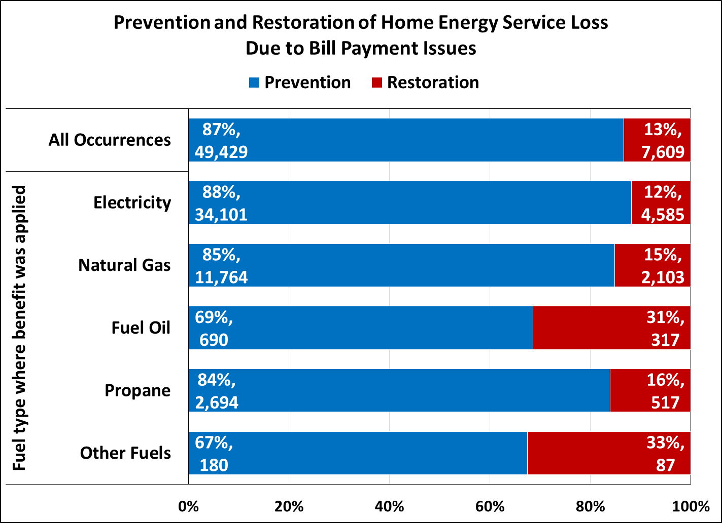
Examples of reported data for FY 2016:
Prevention/Restoration Measures
Example: Minnesota, Prevention/Restoration Due to Bill Payment Issues
Focus on preventing service loss
Some variation by fuel type, but aligned with expectations and external factors
  Shutoff rules for utilities
  Nature of delivered fuel use

Slide 14
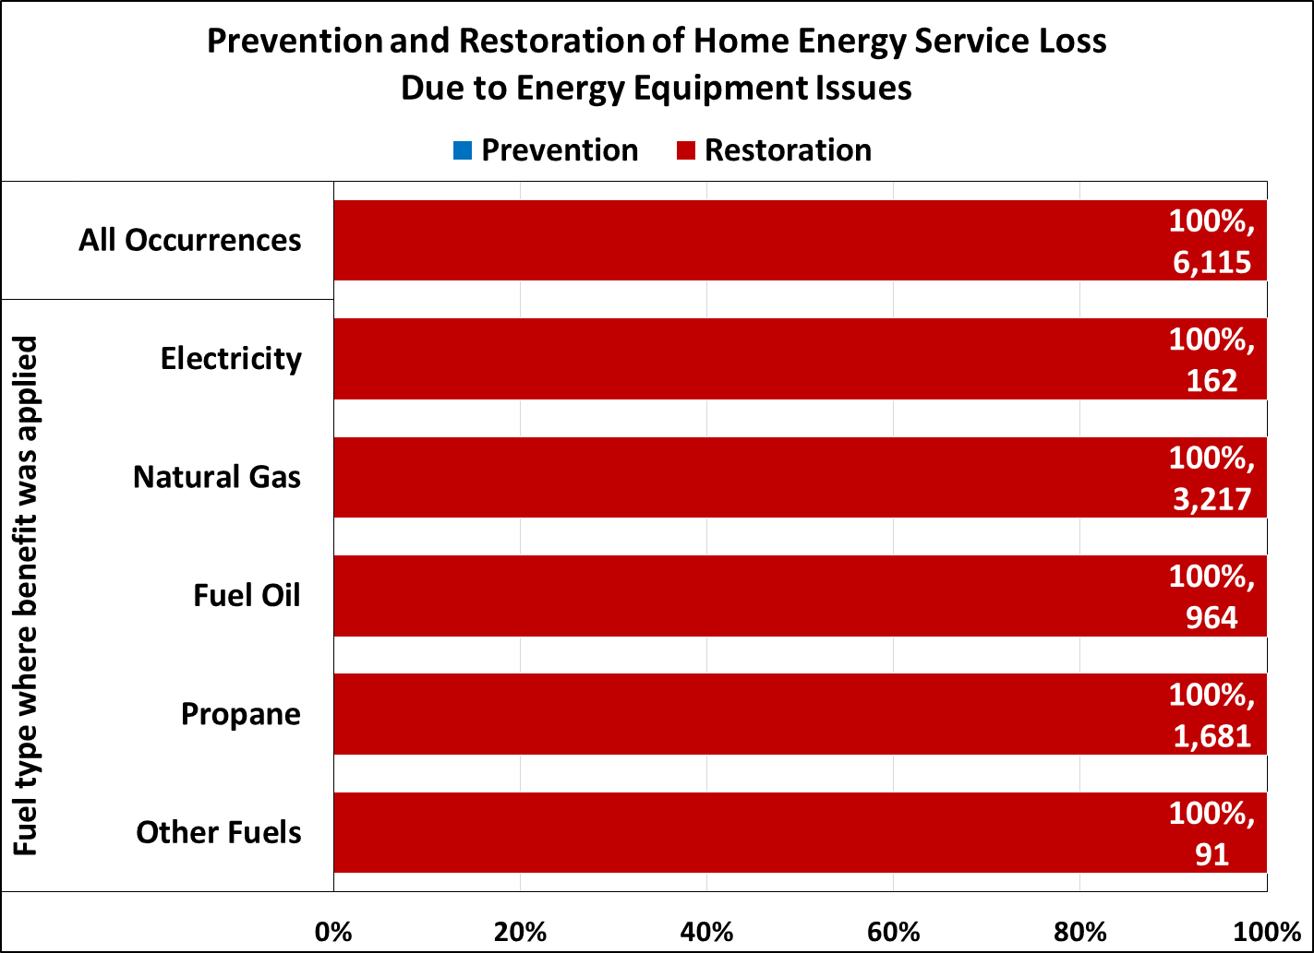
Examples of reported data for FY 2016:
Prevention/Restoration Measures
Example: Minnesota, Prevention/Restoration Due Energy Equipment Issues
Focus on restoring service loss
Policy decision made to focus on repairing/replacing inoperable equipment

Slide 15
Examples of reported data for FY 2016:
Energy Burden Targeting Measures
Remember, it’s not just about the targeting indexes!
Performance Data Form gives you a lot more information:
  Average income, bills (heating, baseload electric, total), total benefits, and burden (pre/post)
  Average households, high burden households
  Across fuel types
Start by understanding these data, then examine the indexes

Slide 16
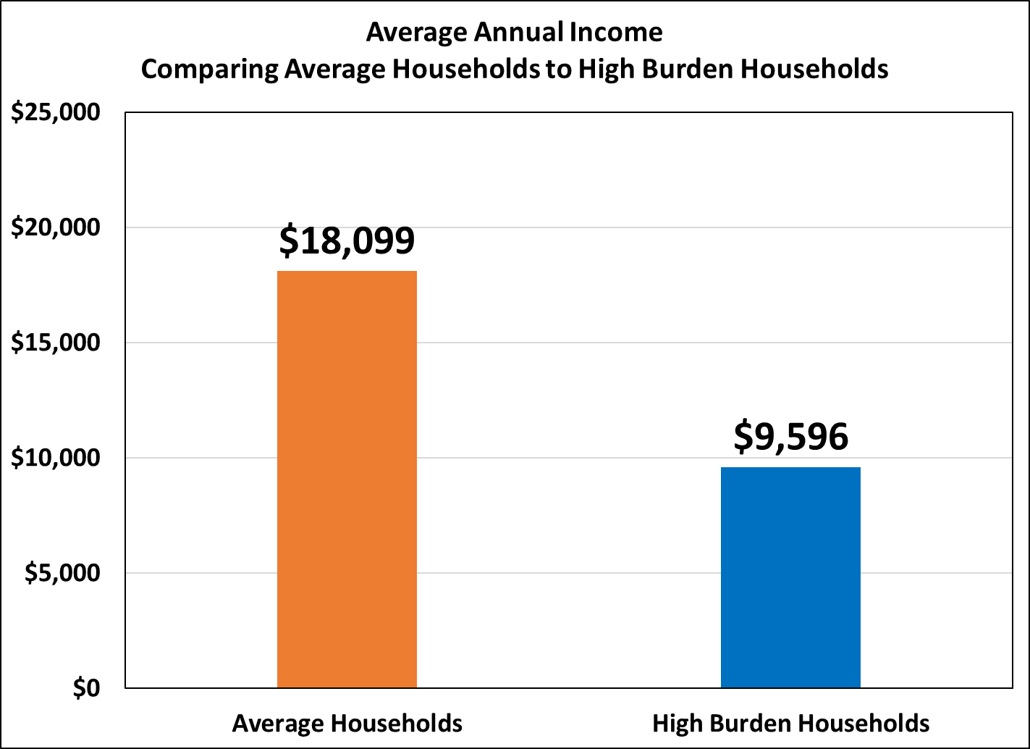
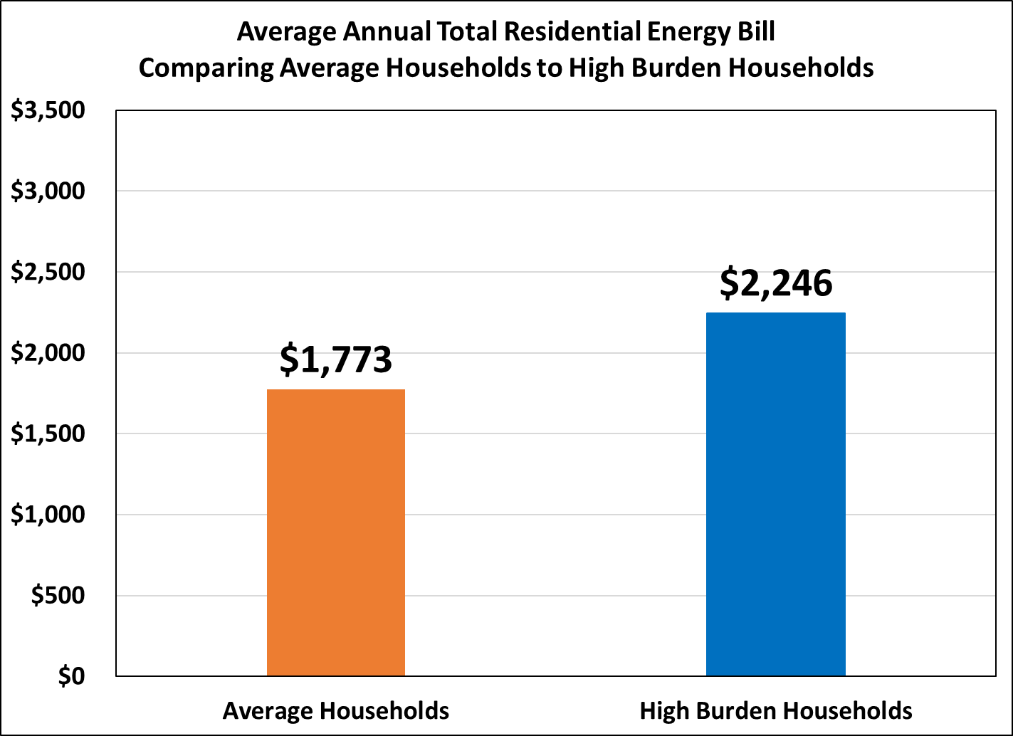
Examples of reported data for FY 2016:
Energy Burden Targeting Measures
Example: Wisconsin, Comparing Average Recipients to High Burden Recipients

Slide 17
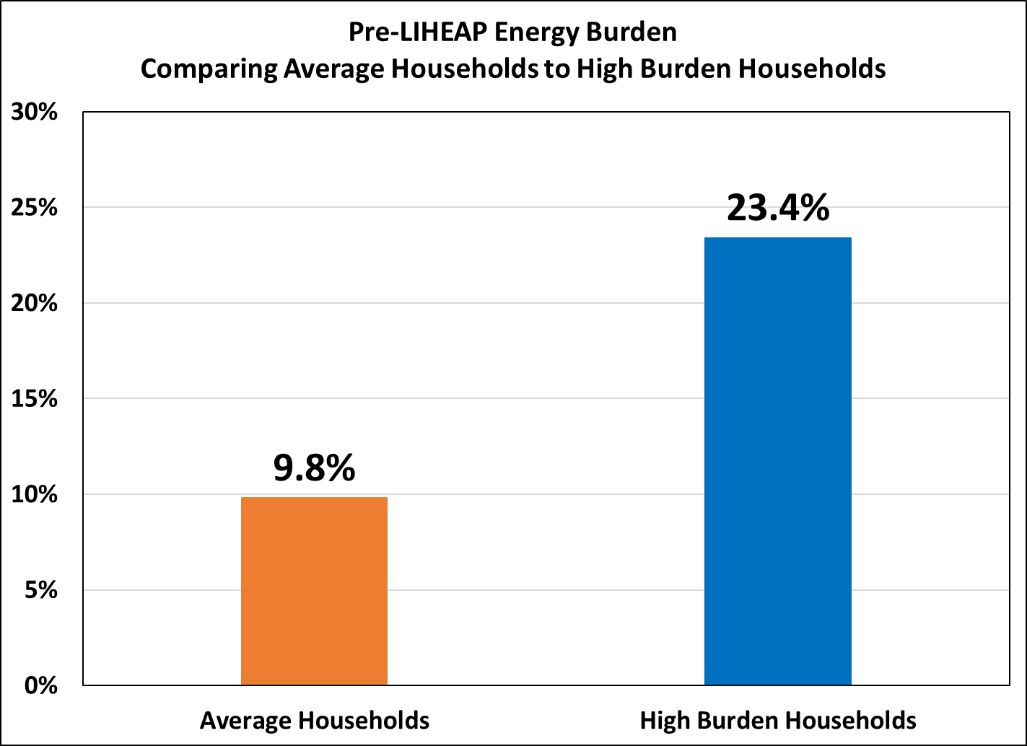
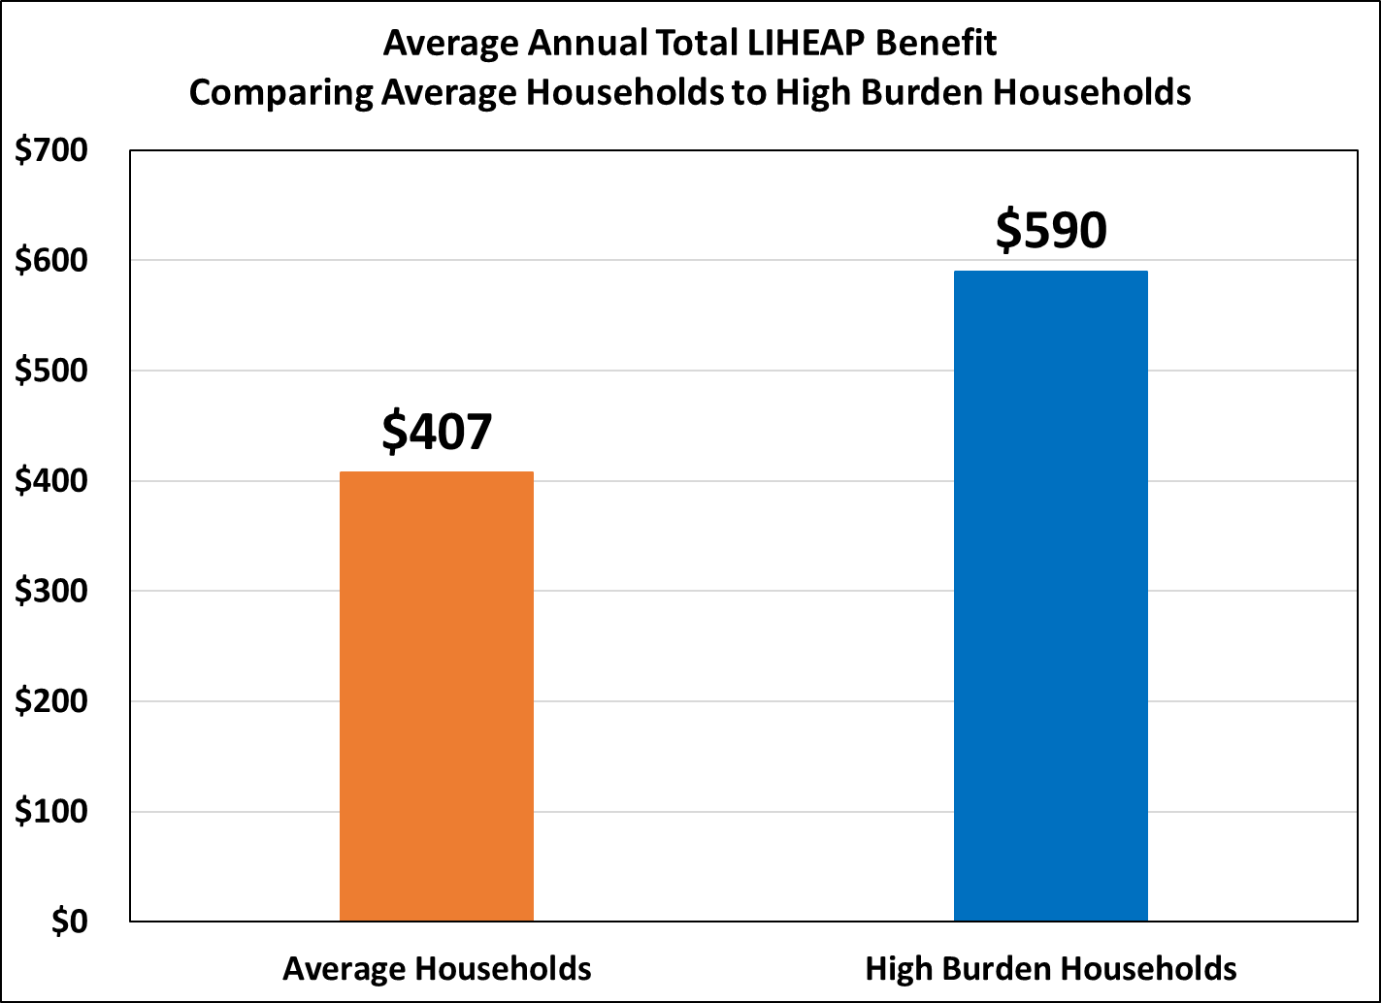
Examples of reported data for FY 2016:
Energy Burden Targeting Measures
Example: Wisconsin, Comparing Average Recipients to High Burden Recipients

Slide 18
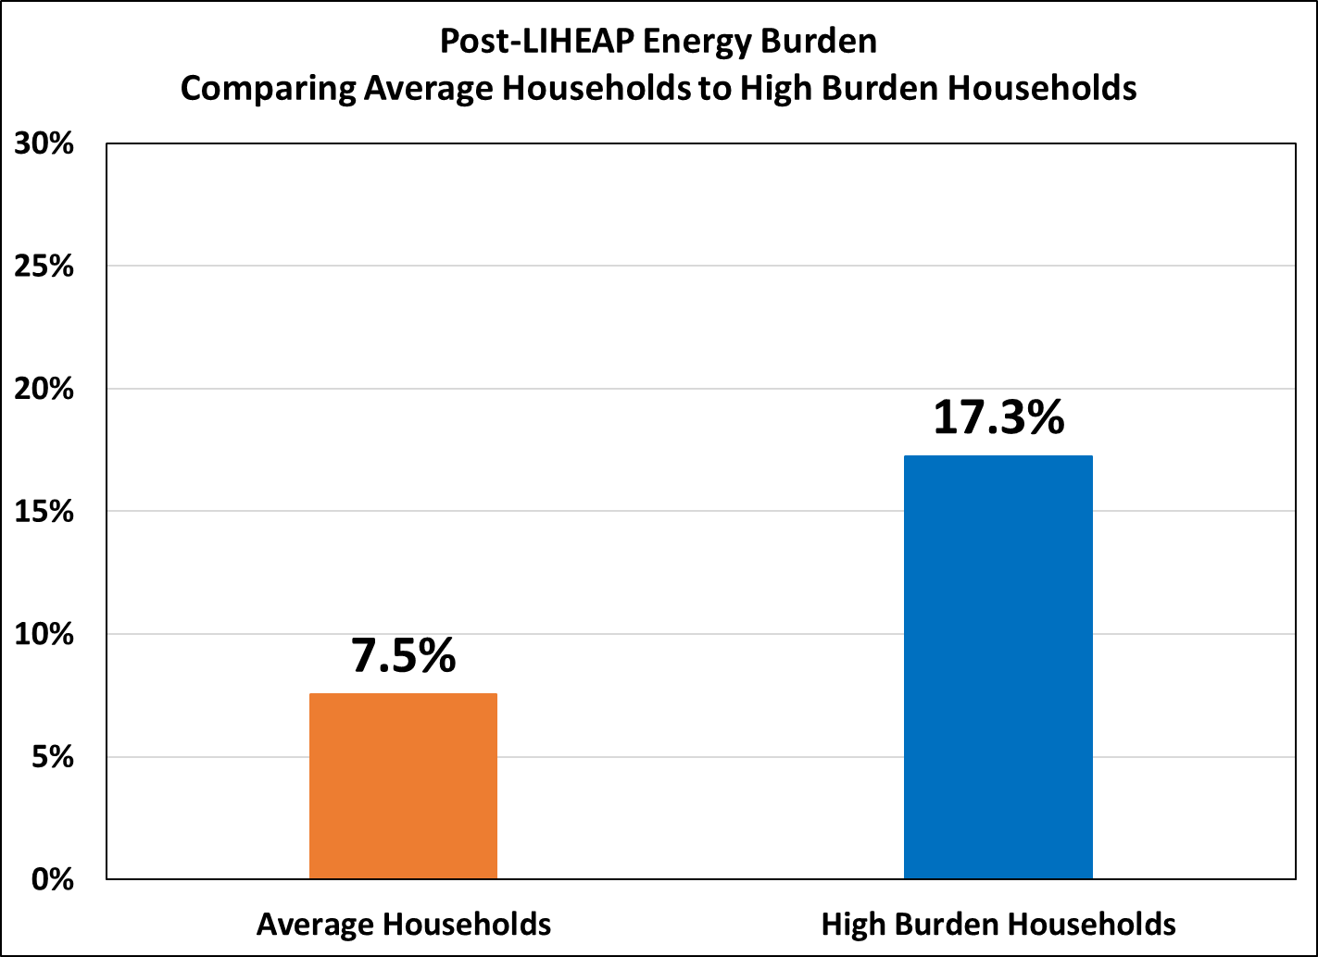
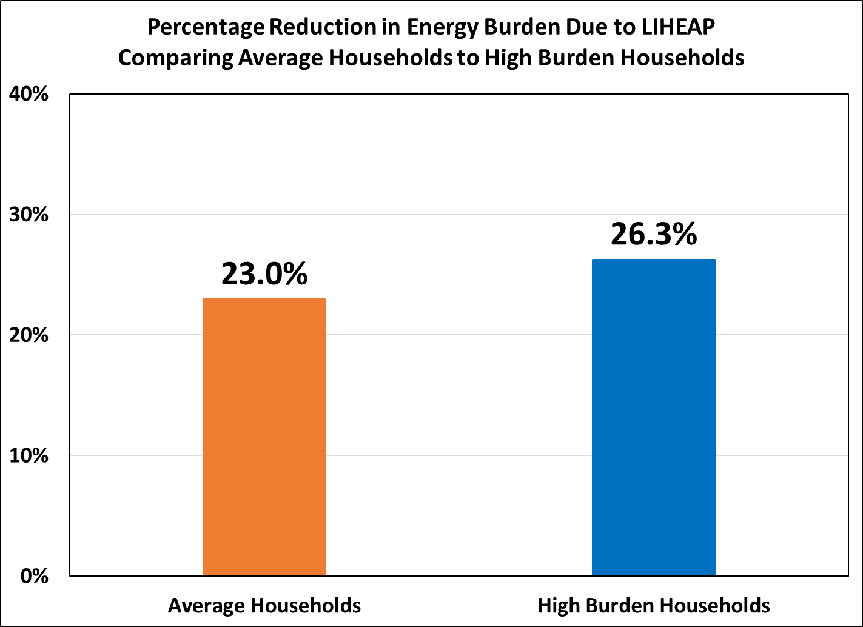
Examples of reported data for FY 2016:
Energy Burden Targeting Measures
Example: Wisconsin, Comparing Average Recipients to High Burden Recipients

Slide 19
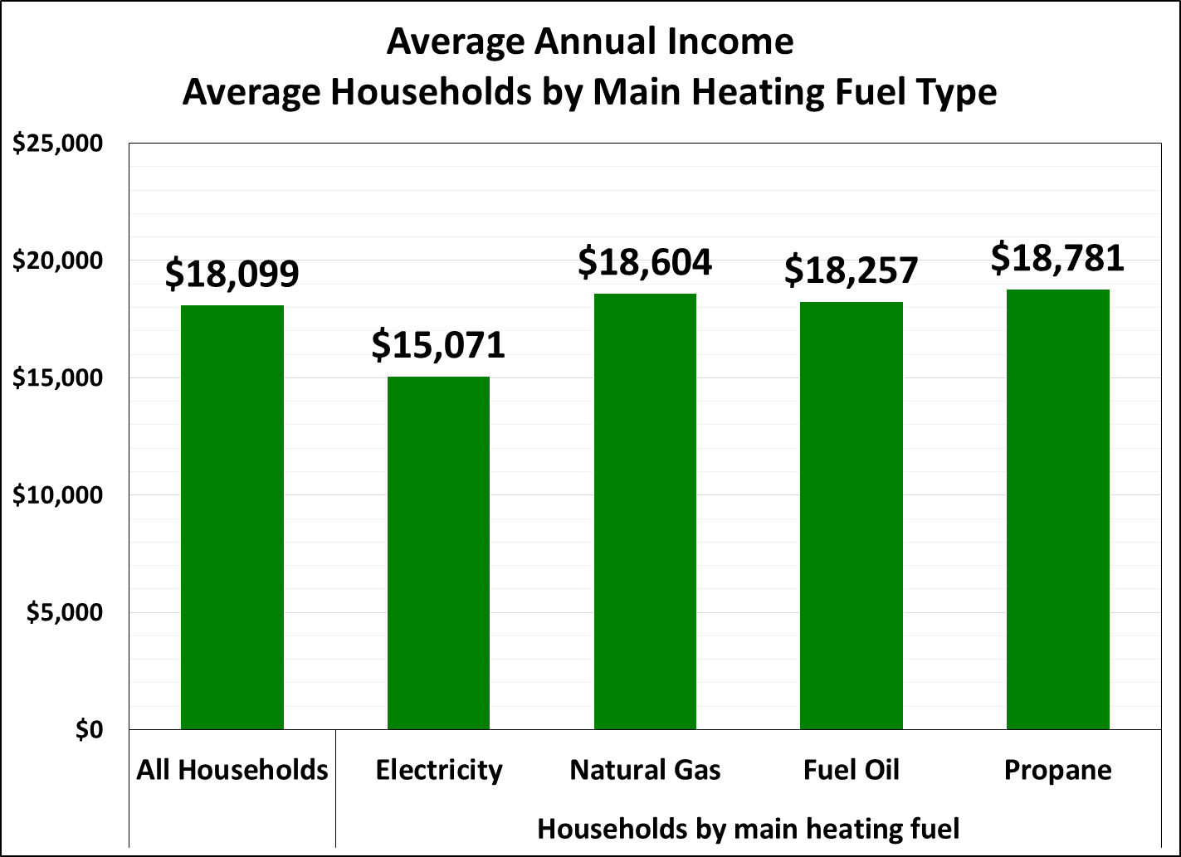
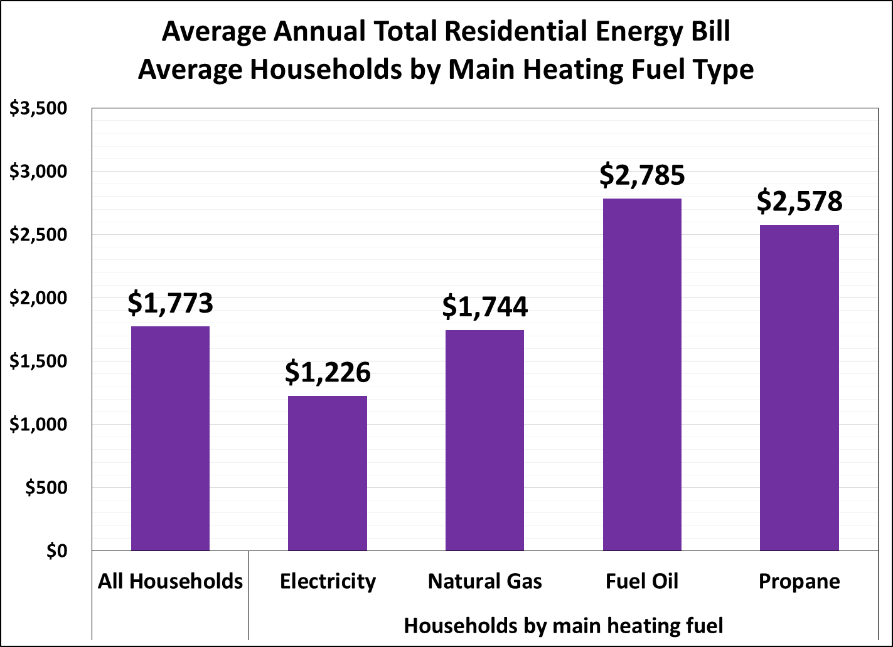
Examples of reported data for FY 2016:
Energy Burden Targeting Measures
Example: Wisconsin, Average Households, Income & Bills Across Fuel Type

Slide 20
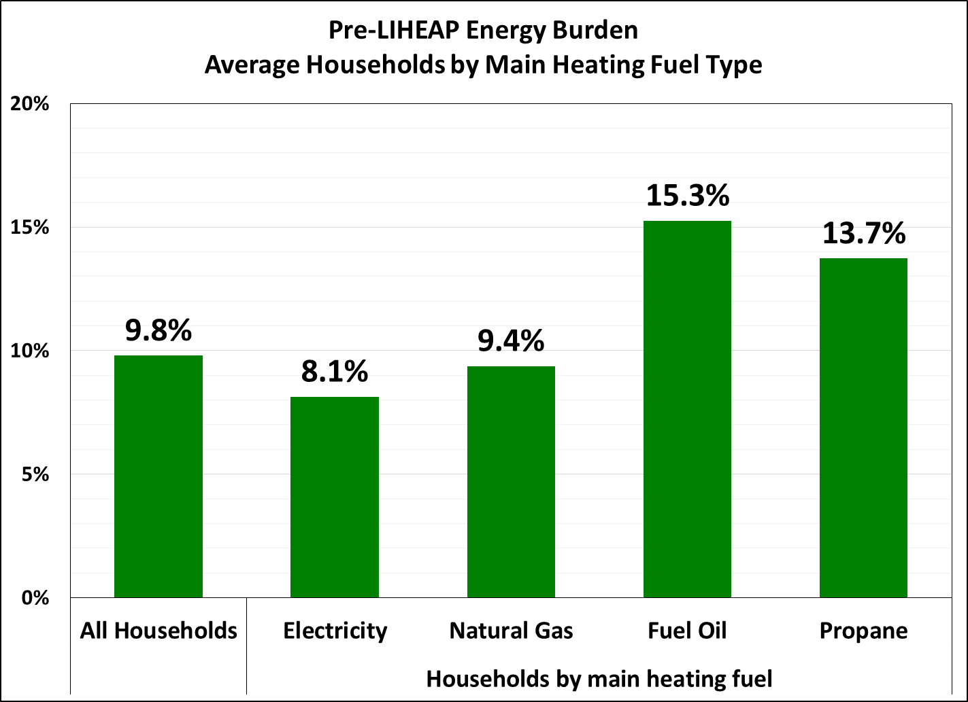
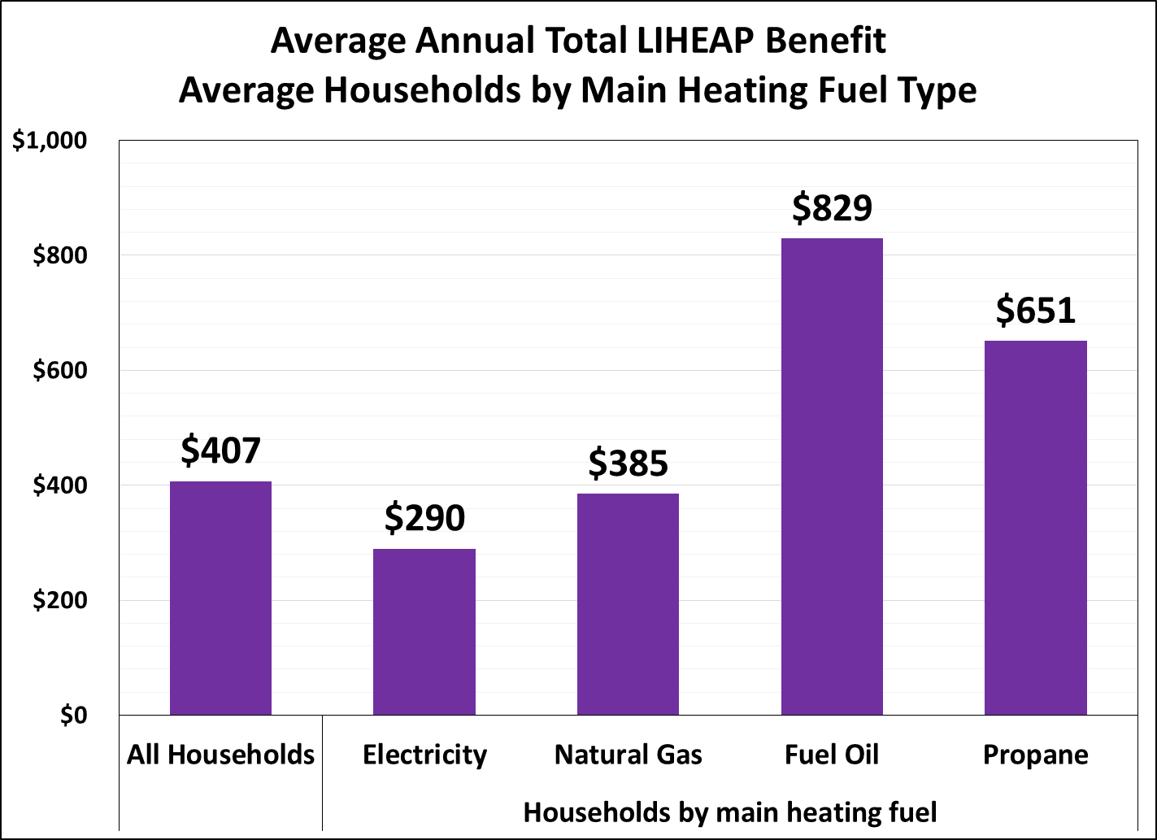
Examples of reported data for FY 2016:
Energy Burden Targeting Measures
Example: Wisconsin, Pre-LIHEAP Burden & Benefits Across Fuel Type

Slide 21
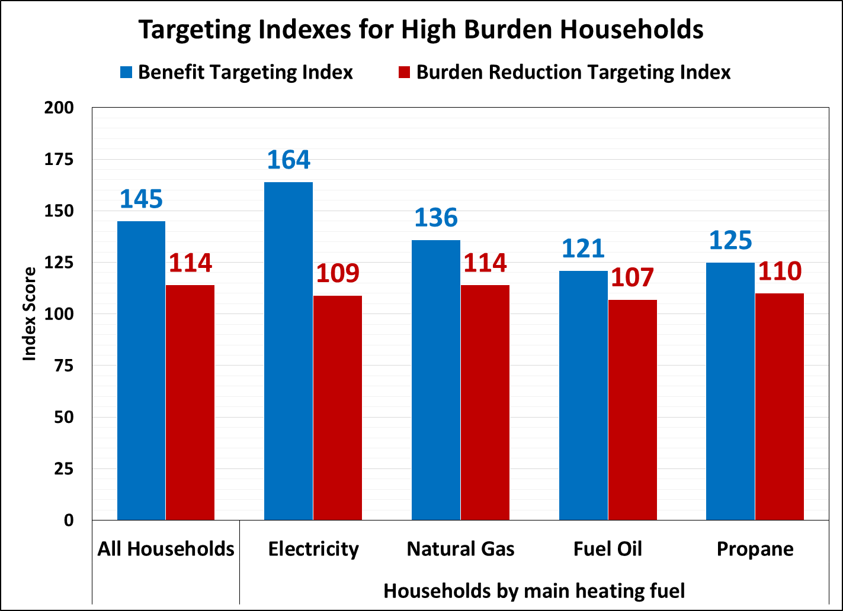
Examples of reported data for FY 2016:
Energy Burden Targeting Measures
Example: Wisconsin, Targeting Index Results
Benefit Targeting Index Score of 145 = 45 percent higher benefit to high burden households than average households
Burden Reduction Targeting Index Score of 114 = 14 percent greater share of energy burden covered/bill paid for high burden households than average households

Slide 22
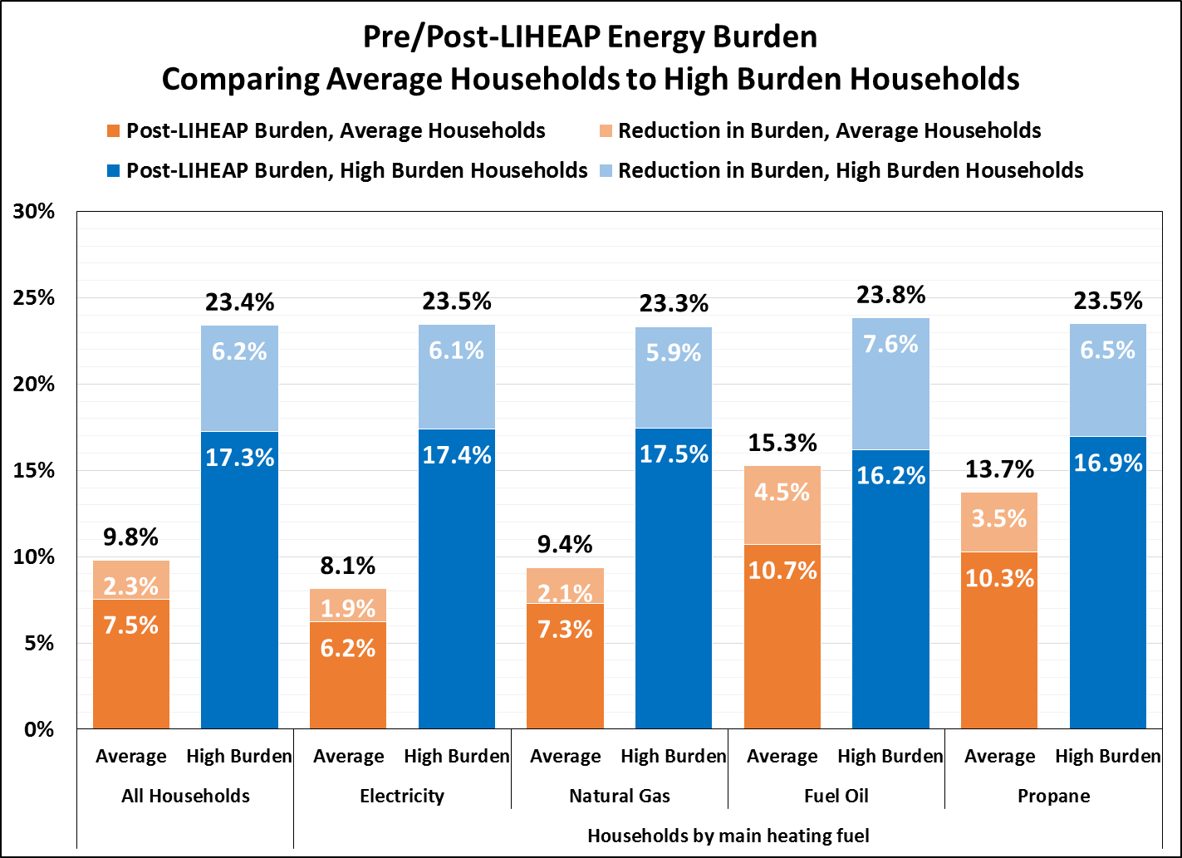
Examples of reported data for FY 2016:
Energy Burden Targeting Measures
Example: Wisconsin, Pre/Post-LIHEAP Energy Burden

Slide 23
How grantees are using the data:
Using data to update benefit matrixes
Remember, these data are not just for purposes of reporting. They are useful to your program!
For example, how might you use these data to examine benefit determination procedures?
Q: Does the variation by fuel type in benefit matrix make sense?
R: Use the Performance Data Form to check current assumptions and consider changes, if necessary

Slide 24
How grantees are using the data:
Using data to update benefit matrixes
Example: Iowa
FY 2017 LIHEAP PAYMENT MATRIX*
FUEL TYPE | POINTS
Natural Gas | 4
Electric | 4
Liquid Petroleum | 5
Fuel Oil | 5
Wood/Coal/Corn | 2
*Just shows the fuel type component, not income or other factors

Slide 25
How grantees are using the data:
Using data to update benefit matrixes
Example: Iowa
Previous slide shows one that Iowa may have some issues with their benefit matrix
Electric Main Heat – Benefit is 34% of Total Expenditures ($403 / $1,194)
Natural Gas Main Heat – Benefit is 27% of Total Expenditures ($465 / $1,711)
Propane Main Heat – Benefit is 25% of Total Expenditures ($538 / $2,181)
This is NOT the only way to think about benefits. But, it is one way.

Slide 26
How grantees are using the data:
Using data to update benefit matrixes
Example: Iowa
Currently, benefit matrix assigns additive points based on fuel type.
Alternative approach would be to develop fuel type adjustment factors and multiply the points assigned based on income:
  Electric main heat adj. factor = $1,194 / $1,194 = 1.0
  Natural gas main heat adj. factor = $1,711 / $1,194 = 1.4
  Propane main heat adj. factor = $2,181 / $1,194 = 1.8

Slide 27
How grantees are using the data:
Using data to update benefit matrixes
Example: Iowa
Just using <=75% HHSPG as income level & points for fuel type:
Income = 8 points
Fuel type (current is additive with income points; alternative is multiplicative)
  Electric: current = 4 points; alternative = 1.0 points
  Natural Gas: current = 4 points; alternative = 1.4 points
  Propane: current = 5 points; alternative = 1.8 points
$50 per point
Main Heating Fuel | Benefits Using Current Proc. | Benefit Using Alternative Proc. | Group Ave. Total Energy Bill
Electric | $600 | $400 | $1,194
Natural Gas | $600 | $560 | $1,711
Propane | $650 | $720 | $2,181

Slide 28
How grantees are using the data:
Looking beyond the benefit matrix
Example: Mississippi
Reviewed their benefit matrix, which is designed to provide the highest benefits to:
  Lowest income, adjusted for household size (good!)
  Highest priced fuels (good!)
But the Performance Measures data did not demonstrate this variation to the extent expected. Why?
Looked beyond the matrix to program delivery:
  Clients receive benefits according to the bill amount presented at application
  Clients who come for assistance once during year are unlikely to receive the maximum benefit
  Change in program delivery may improve index scores

Slide 29
How grantees are using the data:
Total residential energy or main heating analysis?
Example: Alaska
For reporting, grantees are to report both the average main heating fuel bill & baseload electric bill by fuel type
  Targeting index scores are calculated using total residential energy bill
But, many states design their benefit matrixes factoring in just heating costs
In these cases, it’s perfectly reasonable to examine main heating fuel burden (in addition to total energy burden completed for reporting)
  Is the program effectively targeting main heating fuel burden? Does it also target total energy burden?
  Do the data indicate that non-electric heaters might be using supplemental heating sources? Should the benefit matrix account for this?

Slide 30
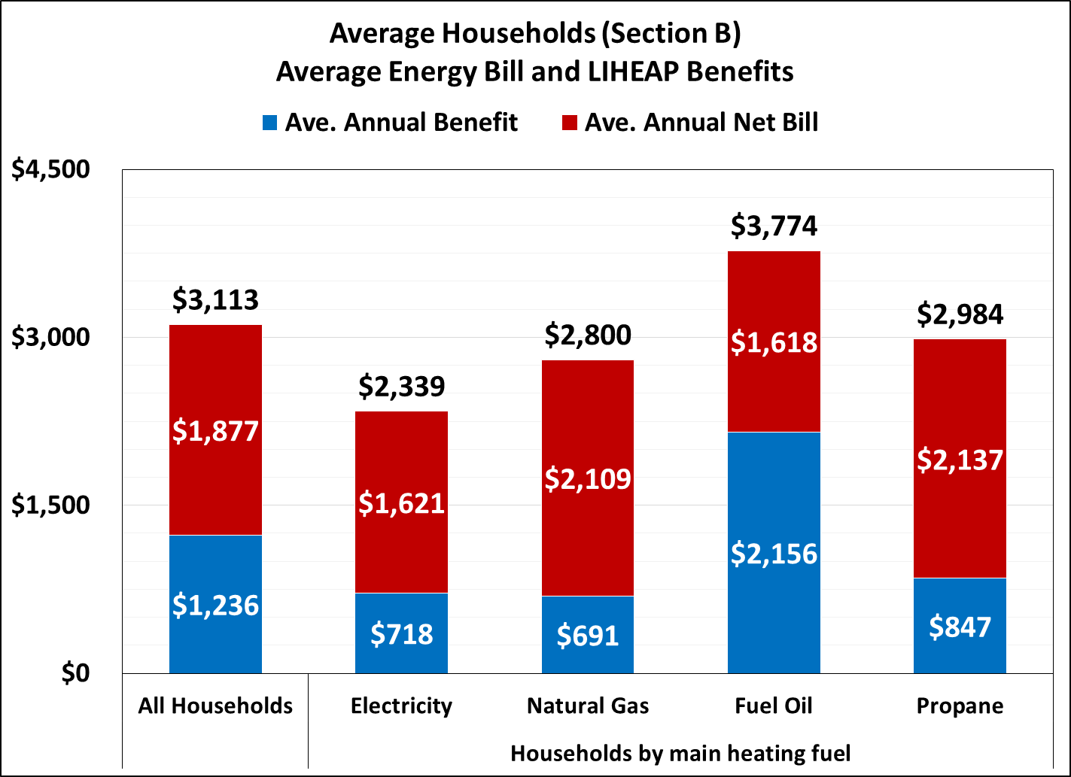
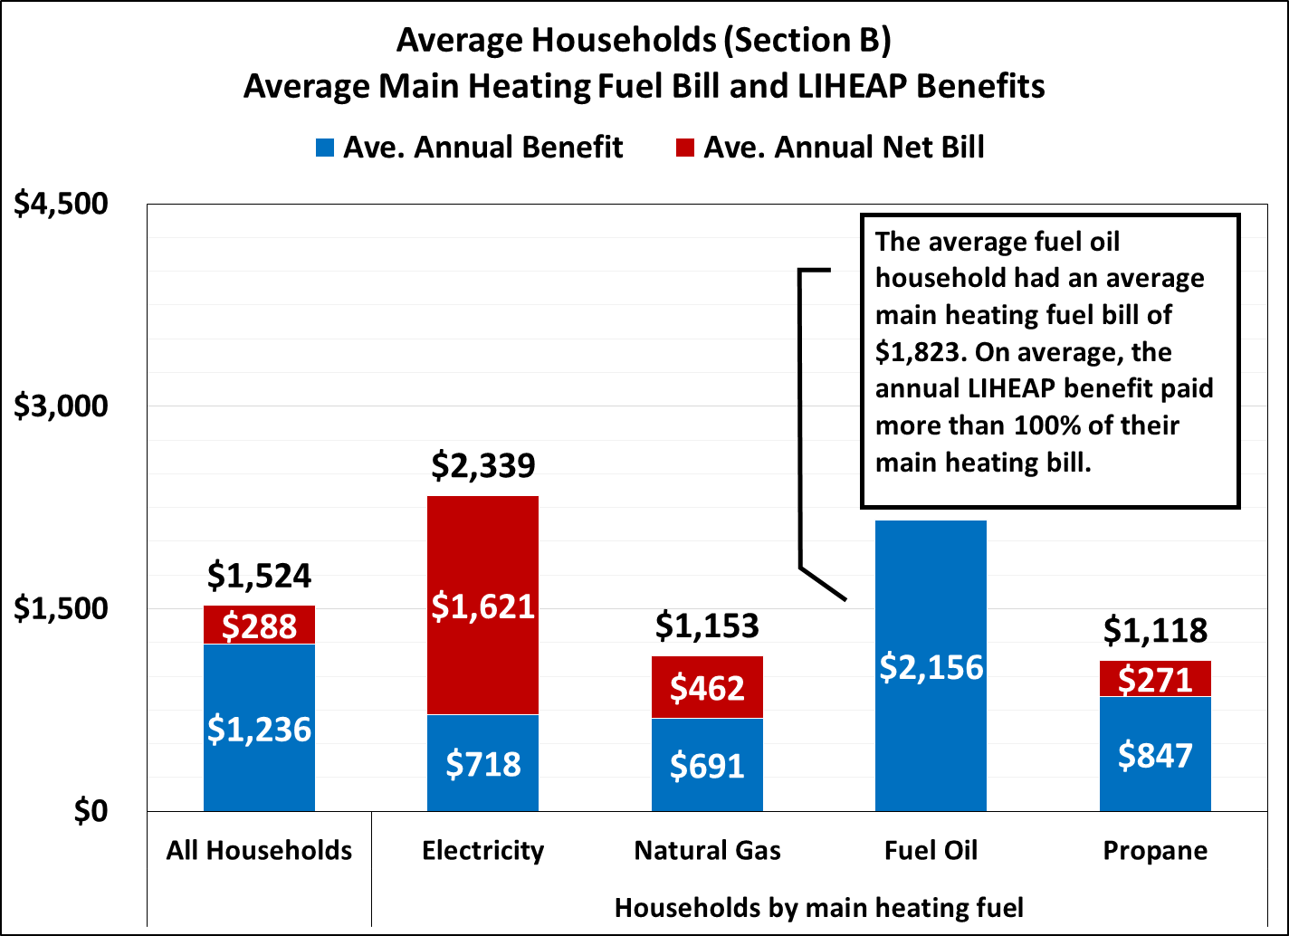
How grantees are using the data:
Total residential energy or main heating analysis?
Example: Alaska
Analysis of Total Residential Energy Bill
Analysis of Main Heating Fuel Bill
The average household had a total energy bill = $3,113. LIHEAP helped pay $1,236 of that bill, leaving $1,877 to be paid by the average household and other sources.
The average household had a main heat bill = $1,524. LIHEAP helped pay $1,236 of that bill, leaving $288 to be paid by the average household and other sources.

Slide 31
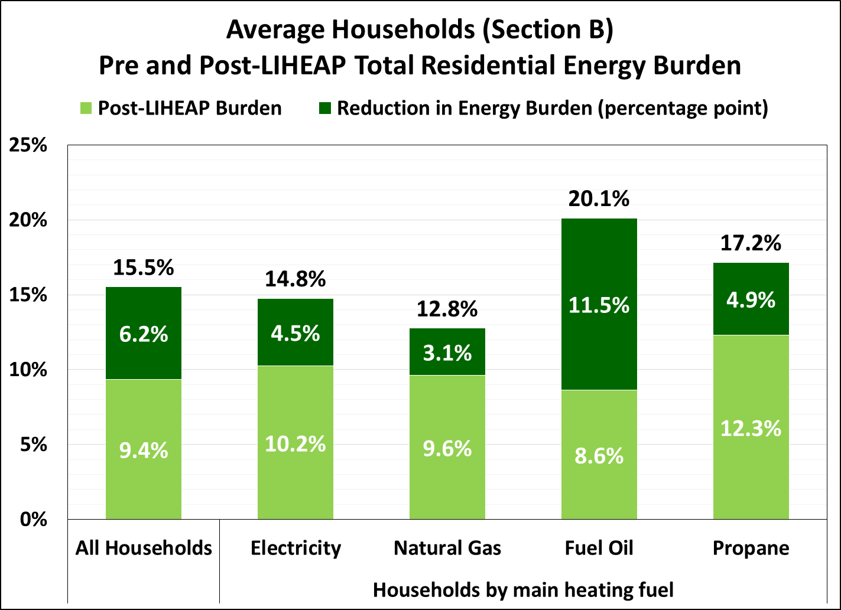
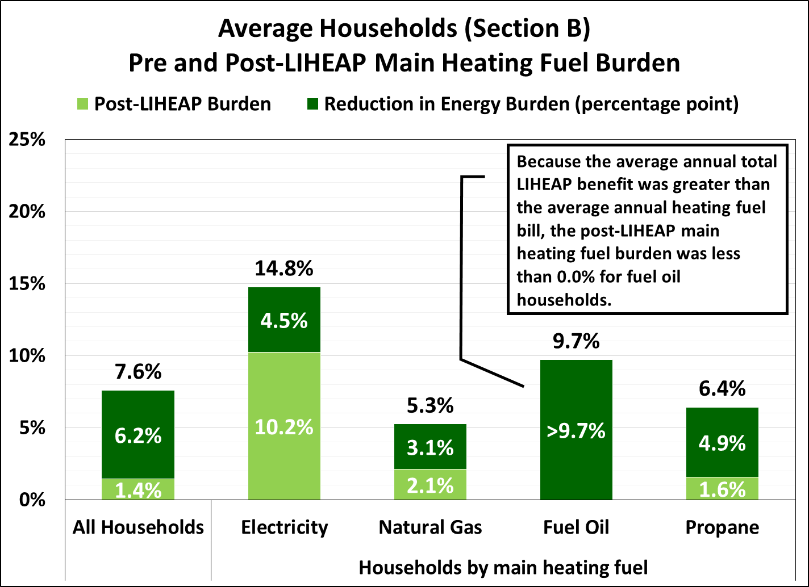
How grantees are using the data:
Total residential energy or main heating analysis?
Example: Alaska
Analysis of Total Residential Energy Burden
Analysis of Main Heating Fuel Burden
Before receiving LIHEAP, the average household had a total residential energy burden of 15.5%. After LIHEAP, it was 9.4%.
Before receiving LIHEAP, the average household had a main heating fuel burden of 7.6%. After LIHEAP, it was 1.4%.

Slide 32
How grantees are using the data:
Combined impact of LIHEAP + other EA programs
The reported Performance Measures data are specific to LIHEAP.
  However, many grantees have ratepayer and other energy assistance programs that are combined with LIHEAP or operate in tandem.
  And, many of these grantees have IT systems that allow for combined analysis of LIHEAP plus other energy assistance programs.
For a more complete picture of energy burden faced by recipients, grantees might want to examine the Performance Measures by combining their LIHEAP program data with other program data.
APPRISE will be looking into this topic in the near future.

Slide 33
Tools & resources available
Over the past few years, many resources have been developed by the PMIWG, APPRISE, and others to assist grantees in completing and understanding their Performance Measures data, including (links at end of presentation slides):
LIHEAP Performance Management Website, including the Data Warehouse
LIHEAP Virtual Library
Training webinars
National training presentations and curriculum
Performance Management Integration Guide
Other resources
We strongly encourage you to use these resources and, if there’s something missing, let us know. APPRISE is available to assist grantees examine special issues or topics unique to your state.

Slide 34
Putting LIHEAP Performance Measures into Practice
The Alabama Perspective
Jennifer Lee
Alabama Department of Economic and Community Affairs

Slide 35
Putting LIHEAP Performance Measures into Practice: Alabama’s Perspective
How Alabama currently determines LIHEAP benefits
Our data collection approach
Overview of 2016 Performance Measures results
What did we learn and where are we headed?

Slide 36
Putting LIHEAP Performance Measures into Practice: Alabama’s Perspective
Our Program Components
General Heating/Crisis Heating* (October-May)
General Cooling/Crisis Cooling* (June-September)
*Alabama defines a crisis as a situation where a household member’s health and/or well-being would likely be endangered if LIHEAP assistance is not provided.
Weatherization

Slide 37
Putting LIHEAP Performance Measures into Practice: Alabama’s Perspective
How do we determine general LIHEAP benefits?
All subgrantees use a state-wide database to determine eligibility and LIHEAP benefit (CSBG and Weatherization also uses system).
Currently, Alabama does not include energy expenditure data to determine LIHEAP benefit.
Benefit matrix takes into account the household size, household gross monthly income and fuel type.
Subgrantees may provide an additional $50 benefit to high energy user households.

Slide 38
Putting LIHEAP Performance Measures into Practice: Alabama’s Perspective
Data Collection Approach
Because we had not collected energy expenditure data in the past, we had to develop a process to collect it.
Alabama is primarily an electric-heat state with some natural gas, propane, fuel oil and wood households.
  Helpful tool - LIHEAP Clearinghouse developed a tool that shows Energy Expenditure data by state (based on 2014 LIHEAP Allocation Formula).

Slide 39
Putting LIHEAP Performance Measures into Practice: Alabama’s Perspective
Low-income Heating/Cooling Expenditures by Fuel Type
State Name | Alabama
Percent of Total Expenditures on EL-HEAT | 30.63%
Percent of Total Expenditures on EL-COOL | 40.25%
Percent of Total Expenditures on NG | 19.78%
Percent of Total Expenditures on FUEL OIL/KEROSENE | 0.51%
Percent of Total Expenditures on LPG | 7.65%
Percent of Total Expenditures on COAL | 0.00%
Percent of Total Expenditures on WOOD | 1.18%
TOTAL HEAT + COOL Expenditures | $384,891,090
TOTAL PERCENT | 100.00%
Natural Gas % + Total Electric % | 90.65%
Will the state need to go beyond Gas and Electric vendors to collect data? | NO

Slide 40
Putting LIHEAP Performance Measures into Practice: Alabama’s Perspective
Based on that, we identified our top 10 vendors for electric and natural gas (only) and began a dialogue.
We conducted the data exchange in November/December 2016 and the following vendors participated:
  1. Alabama Power Company - largest regulated vendor
  2. Alagasco - second largest regulated vendor
  3. City of Huntsville Utilities - provides electric and natural gas
  4. City of Decatur Utilities - provides electric and natural gas
  5. City of Florence Utilities- provides electric and natural gas
  6. Economy Gas - propane

Slide 41
Putting LIHEAP Performance Measures into Practice: Alabama’s Perspective
We did not include the other vendors from the top 10 lists in our data exchange. Why not?
  The vendors were electric cooperatives and municipalities that did not have system capabilities, or
  The vendors served a small percentage of our total households (1% or less), or
  The vendors were propane, fuel oil, and wood.

Slide 42
Putting LIHEAP Performance Measures into Practice: Alabama’s Perspective
Prevention of Loss of Service and Restoration of Service
  Our subgrantees handle applications in face-to-face interviews.
  All clients bring in their most recent energy bill.
  Based on the bill (or a phone call to the vendor), the intake staff determine if the LIHEAP benefit would prevent a loss of service or if the benefit would restore service.
  This is entered in our database so that the State LIHEAP Office can pull the data at the end of the fiscal year.

Slide 43
Putting LIHEAP Performance Measures into Practice: Alabama’s Perspective
Overview of 2016 Performance Measures results
  We were able to report on all required elements.
  Of the 76,876 LIHEAP households, we received 12 months of energy expenditure data on 29,252 households (37%).

Slide 44
Putting LIHEAP Performance Measures into Practice: Alabama’s Perspective

Slide 45
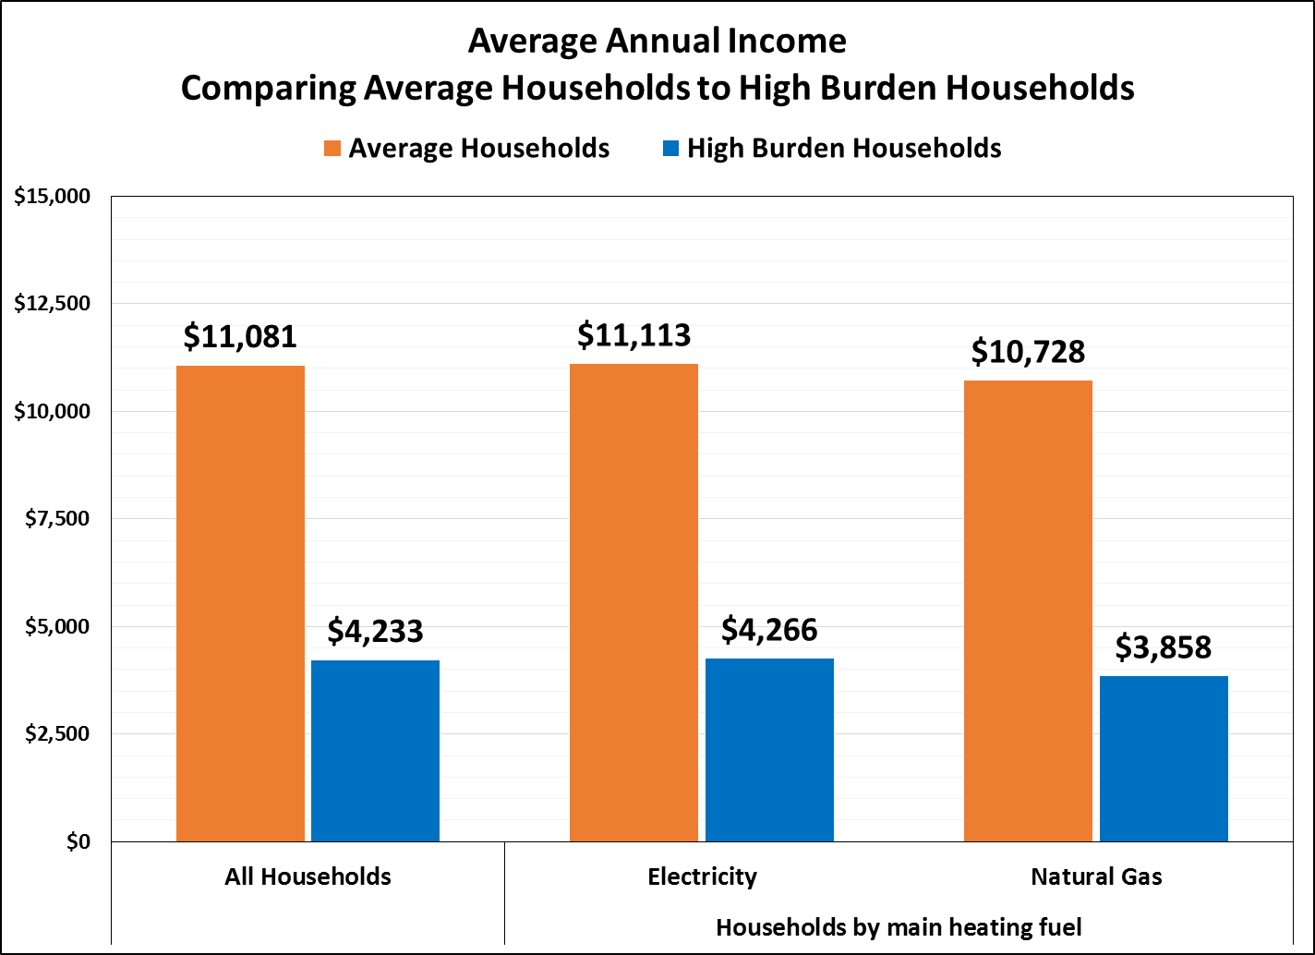
Putting LIHEAP Performance Measures into Practice: Alabama’s Perspective
*Recipients using propane main heat excl. from figure because data received for a limited number of recipients

Slide 46
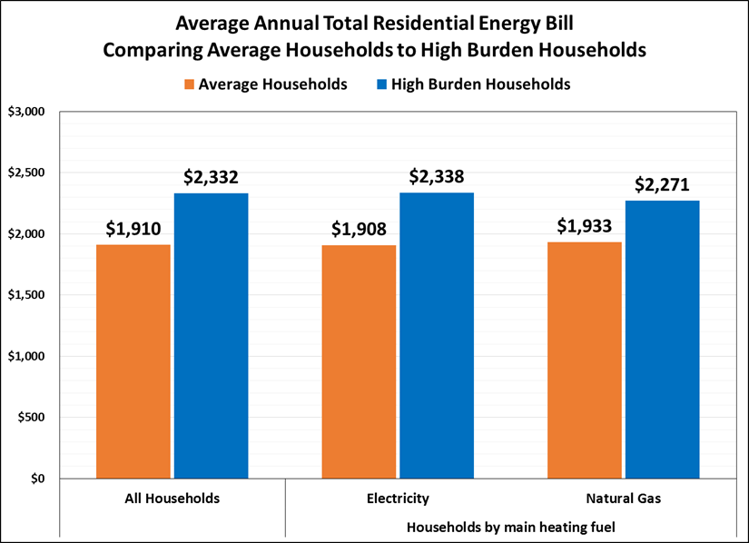
Putting LIHEAP Performance Measures into Practice: Alabama’s Perspective
*Recipients using propane main heat excl. from figure because data received for a limited number of recipients

Slide 47
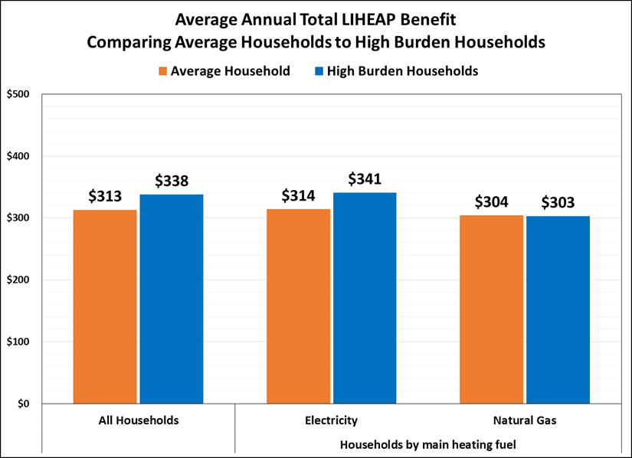
Putting LIHEAP Performance Measures into Practice: Alabama’s Perspective
*Recipients using propane main heat excl. from figure because data received for a limited number of recipients

Slide 48
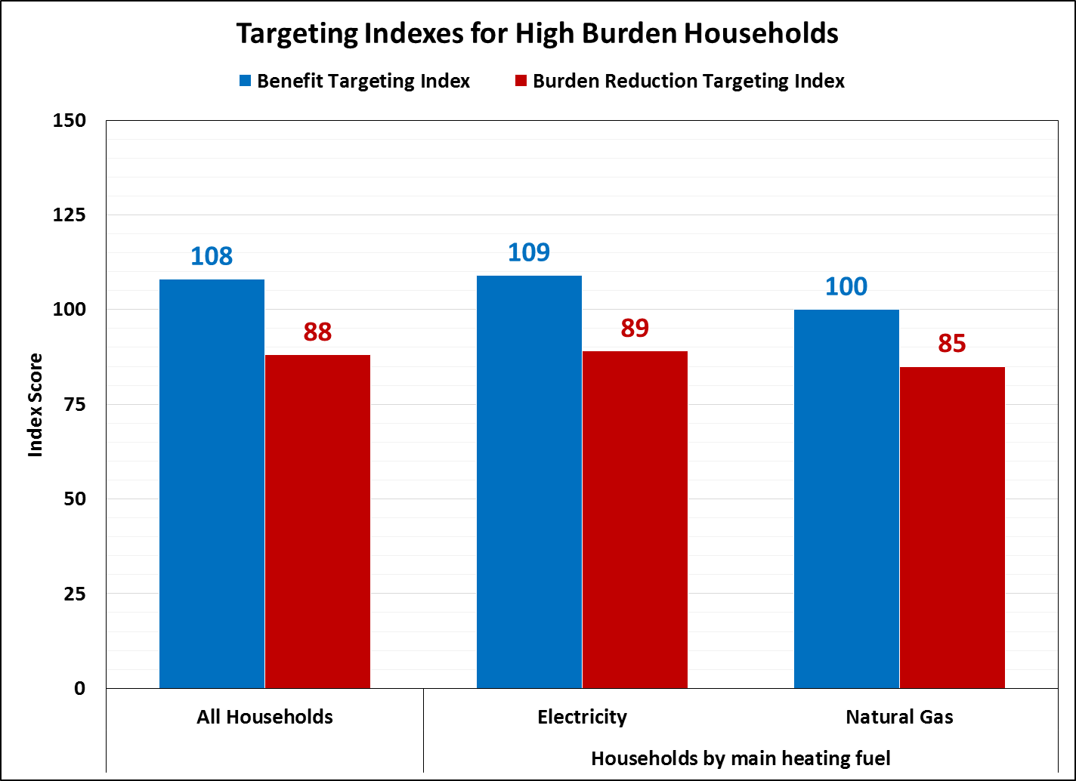
Putting LIHEAP Performance Measures into Practice: Alabama’s Perspective
*Recipients using propane main heat excl. from figure because data received for a limited number of recipients

Slide 49
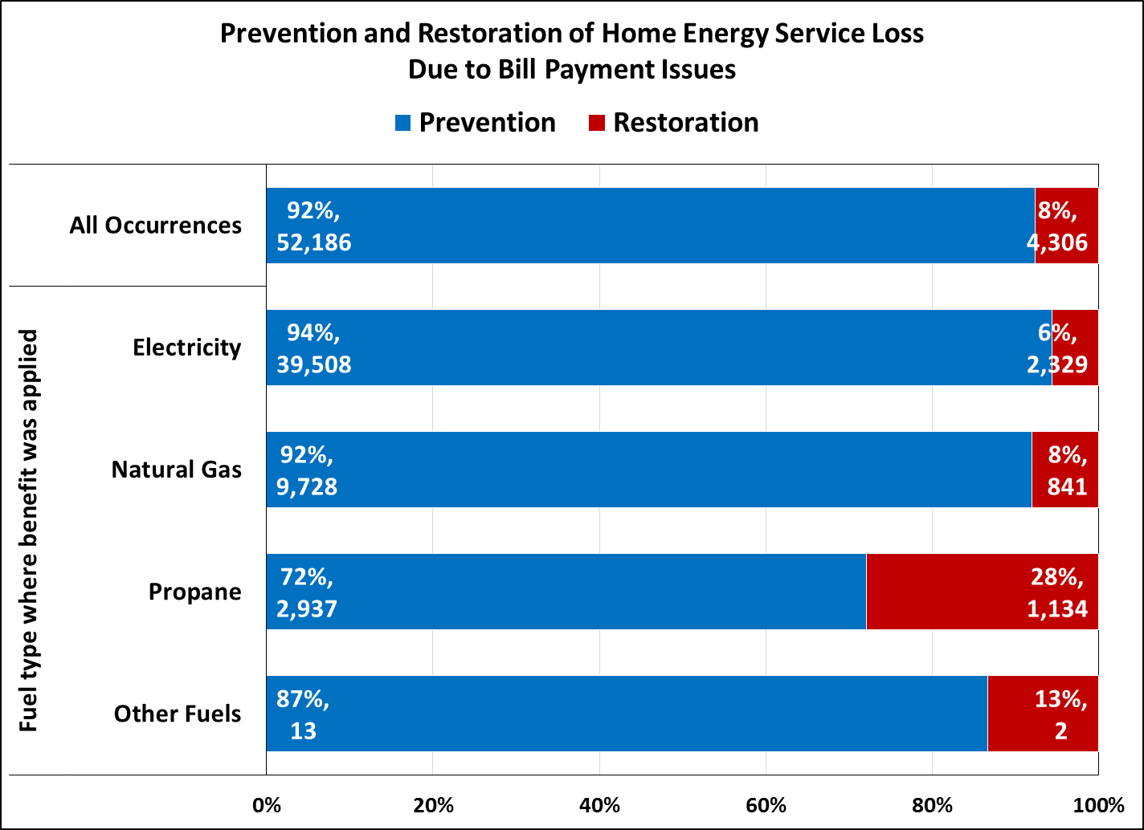
Putting LIHEAP Performance Measures into Practice: Alabama’s Perspective
*Fuel oil excluded from figure because no recipients in FY 2016 used fuel oil as their main heating fuel

Slide 50
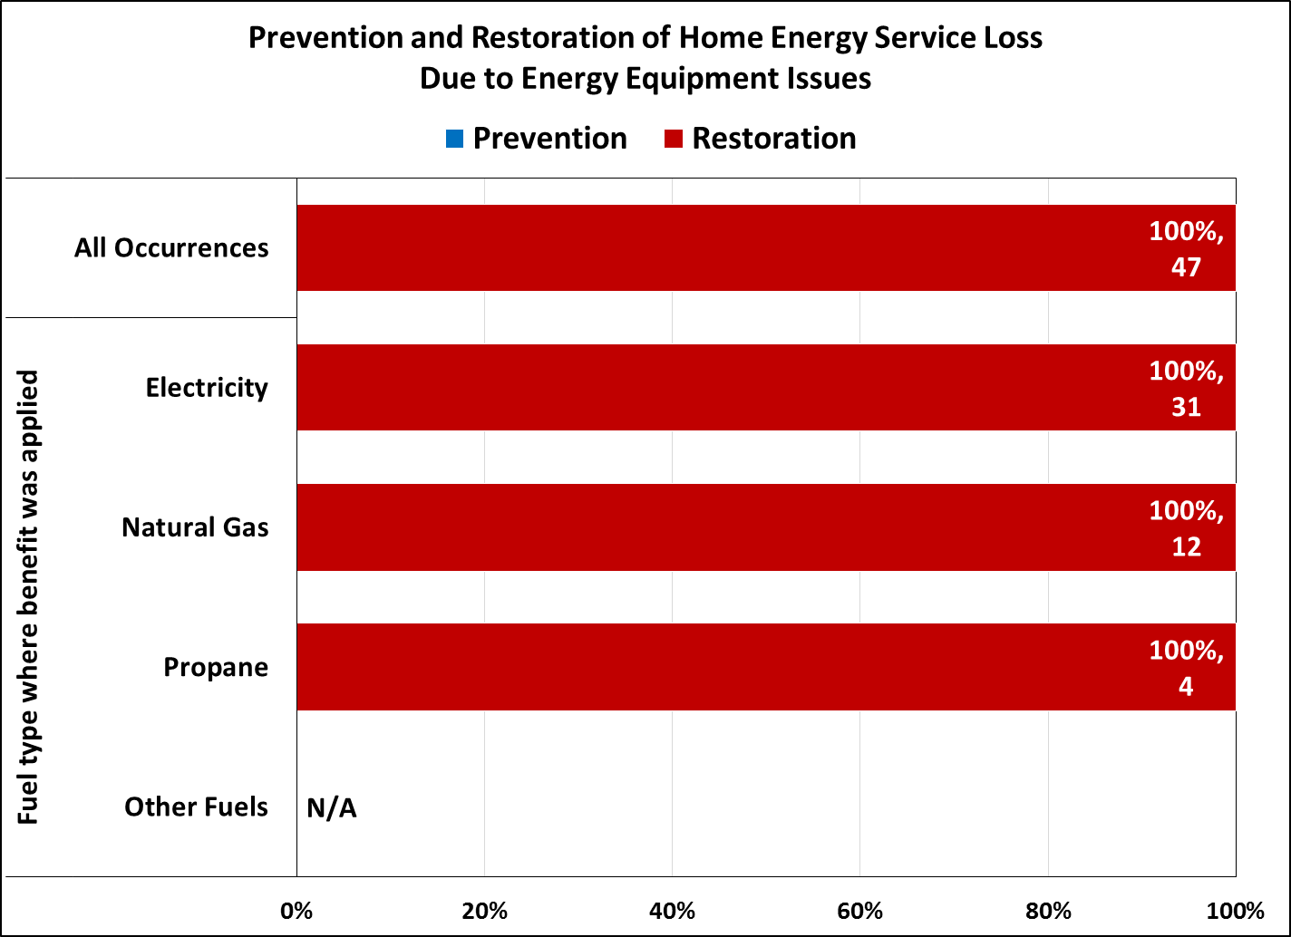
Putting LIHEAP Performance Measures into Practice: Alabama’s Perspective
*Fuel oil excluded from figure because no recipients in FY 2016 used fuel oil as their main heating fuel

Slide 51
Putting LIHEAP Performance Measures into Practice: Alabama’s Perspective
What did we learn and what questions were raised?
Propane households
  In FY 2016, approximately 7,197 households (10% of all unduplicated households) used propane as their main heat source.
  We want to reach out to our largest propane vendors to see if they have system capabilities to participate in future data exchanges.
  We feel it’s important to get a more complete picture of our program’s impact on households that heat with that fuel type.

Slide 52
Putting LIHEAP Performance Measures into Practice: Alabama’s Perspective
Invalid account numbers
  For one of our vendors, approximately 25% of the account numbers we provided to them through our data exchange were invalid.
    Intake data error?
    Did the LIHEAP clients move and were assigned new account numbers and vendor system could not track?

Slide 53
Putting LIHEAP Performance Measures into Practice: Alabama’s Perspective
Crisis benefits
  Do they impact our targeting indexes?
  Crisis benefits are awarded for the amount that will maintain or restore service for the next 30 days.
  The amount varies – some vendors require the entire bill amount, others require only a portion of the bill or the past due amount.

Slide 54
Putting LIHEAP Performance Measures into Practice: Alabama’s Perspective
Utility allowances
  Do they impact our targeting indexes?
  We deduct the utility allowance (for public housing and Section 8 households) from the LIHEAP benefit amount.
  Example: Household is eligible for $320 LIHEAP benefit and their utility allowance is $200, they would receive only $120.

Slide 55
Putting LIHEAP Performance Measures into Practice: Alabama’s Perspective
Where are we headed?
We do not intend on making significant changes to our program for FY 2018.
We have received the Performance Management Integration Guide from APPRISE with the What-If tool. This provides options of adjusting our benefit matrix to target high burden households more effectively.
We intend to analyze What-If scenarios and discuss our options within our network.

Slide 56
Putting LIHEAP Performance Measures into Practice: Alabama’s Perspective
Final Thoughts……
Don’t panic! FY2016 was the first year of reporting and we are ALL trying to understand our data.
  Review the State Snapshot from APPRISE, it may help you draw conclusions that may not have been as clear on the PM form.
Analysis paralysis? The PM Implementation Workgroup is developing materials to walk you through steps to consider before making programmatic design decisions.

Slide 57
Putting LIHEAP Performance Measures into Practice
Moving Forward

Slide 58
Putting LIHEAP Performance Measures into Practice
Building Upon What We’ve Learned
LIHEAP Grantees, the Performance Management Implementation Work Group (PMIWG), OCS, and APPRISE have maintained a consistent feedback loop via conference calls, site visits, webinars, and training sessions.
APPRISE is continuing to work with grantees to improve the quantity and quality of their Performance Measure data.
The PMIWG and APPRISE are working with grantees to better understand and analyze data in context of program design differences.

Slide 59
Putting LIHEAP Performance Measures into Practice
Emphasis on Performance Management
This Spring, APPRISE offered two webinars, as well as a three part national training workshop, focused on using LIHEAP data for Performance Management.
The PMIWG is actively working on tools (like the Performance Management Integration Guide) to help grantees better understand their data, and use it to consider potential changes to their programs.
Grantees are actively engaging partners (subgrantees and vendors) to review data and incorporate LIHEAP findings into program and policy discussions.

Slide 60
Putting LIHEAP Performance Measures into Practice
Tools and Resources
Tools and Resources
LIHEAP Performance Management Website
https://liheappm.acf.hhs.gov/
Includes grantee resources, data warehouse, and reporting tools. Also includes newsletters and updates from the Performance Management Implementation Work Group.
  LIHEAP Virtual Library
  https://liheappm.acf.hhs.gov/assessment/#nbb
  Provides an easy to use interface that guides grantees to resources associated with different areas of program administration.

Slide 61
Putting LIHEAP Performance Measures into Practice
Tools and Resources
  LIHEAP Clearinghouse
  https://liheapch.acf.hhs.gov/stateplans.htm
  Contains state model plans, state program manuals, and descriptions of various state program components.
  ACF Training Resources Website
  https://www.acf.hhs.gov/ocs/resource/liheap-trainings
  Archived webinars, regional training, and national training sessions.
Individual Training and Technical Assistance
melissa@verveassociates.net, Kevin-McGrath@appriseinc.org
APPRISE will work with grantees to assist with data collection, reporting, vendor data exchanges, IT systems, and more.

Slide 62
Putting LIHEAP Performance Measures into Practice
Contact Information
Melissa Torgerson
melissa@verveassociates.net
503-706-2647
Kevin McGrath
Kevin-McGrath@appriseinc.org
609-252-2081
Jennifer Lee
Jennifer.Lee@adeca.alabama.gov
334-353-3005

