Slide 2
LIHEAP 102 June 13th, 2023
Moderator: Tracy Smetana, Minnesota Department of Commerce
Melissa Torgerson, VERVE Associates
Iris Pennington, Arkansas Energy Office
Brian Sarensen, Washington State Department of Commerce
Jane Blank, Wisconsin Department of Administration

Slide 3
Introduction, Session Objectives
3
After this session, participants will better understand:
How LIHEAP assurances govern grantee decisions with respect to categorical eligibility, benefit determination, and coordination of services.
Key options and questions to consider when adopting categorical eligibility, joint applications, and/or information sharing within the LIHEAP program.
How states represented by our three panelists use these approaches in their programs, and whether they perceive them to be effective.
Presenter:
Tracy Smetana

Slide 4
Topics
4
LIHEAP Assurances – Program Design Options and Requirements
Melissa Torgerson, VERVE
Categorical Eligibility – What are the options? What do our panelists do and why?
Melissa and Panelists
Coordination of Services- What are the options? What do our panelists do and why?
Melissa and Panelists
Presenter:
Tracy Smetana

Slide 5
5
LIHEAP Assurances & Definitions
Presenter:
Melissa Torgerson

Slide 6
Refresher on Federal Statute (Assurances)
6
Every September, states/tribes/territories who wish to receive LIHEAP funding must submit a model plan. The model plan (LIHEAP application) lays out how each grantee will use LIHEAP funds in accordance with the law.
“Each State desiring to receive an allotment for any fiscal year under this title shall submit an application to the Secretary. Each such application shall contain assurances by the chief executive officer of the State that the State will meet the conditions enumerated in section (b).”
Section 2605(a)(1) of the LIHEAP Act, 42 U.S.C. § 8624(a)(1)
The LIHEAP law includes several parts, including sixteen “assurances” that must be officially certified each September by a governor or tribal chairperson (or his or her designee) via the model plan process.
Presenter:
Melissa Torgerson

Slide 7
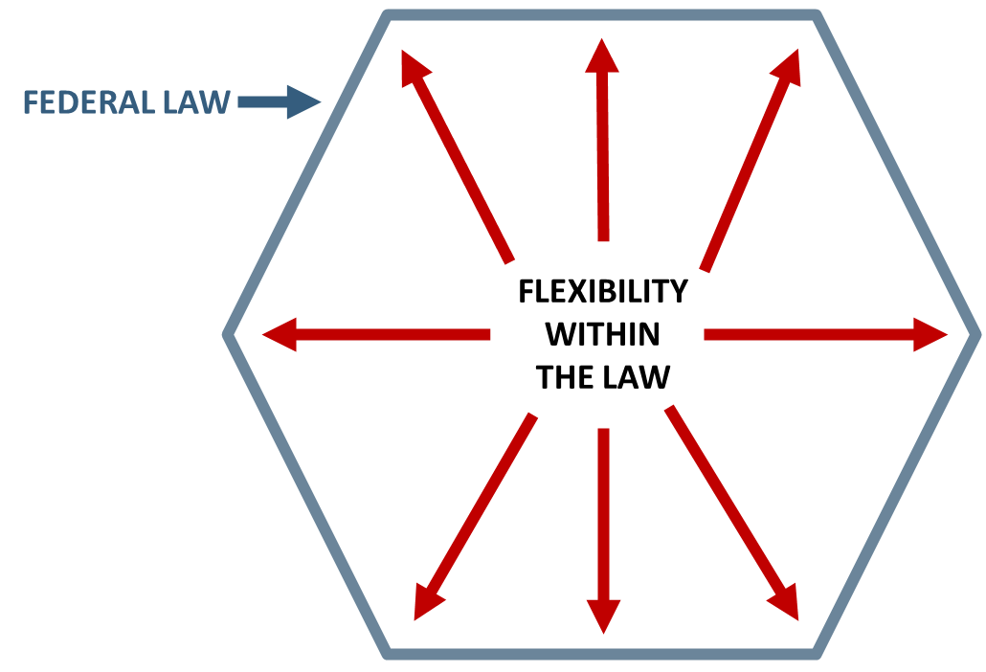
Nature of Federal Statute
7
Federal regulations at 45 CFR 96.50(e) indicate that grantees have the "primary responsibility" for interpreting the federal law as it relates to their administration of LIHEAP and that HHS will defer to their interpretations unless it is deemed "clearly erroneous."
The Federal LIHEAP statute provides grantees with “fenceposts” when designing their LIHEAP programs—leaving a lot of room for flexibility.
Presenter:
Melissa Torgerson

Slide 8
State Laws, Rules
8
While the federal statute provides “outer bounds” for grantees, state/tribal law can also influence or restrict the design and delivery of LIHEAP programs.
For example, although the federal statute allows income eligibility up to 60% of state median income, some states have enacted laws that make their LIHEAP income eligibility thresholds much lower.
STATE LAW
FLEXIBILITY WITHIN THE LAW
Federal Law
Presenter:
Melissa Torgerson

Slide 9
Section Overview
9
In this section, we’ll talk about the LIHEAP Assurances and other factors that are particularly important when thinking about Categorical Eligibility, Benefit Determination, and Coordination of Services.
Assurance #2 – Eligible Households
Assurance #5 – Benefit Determination
Assurance #4 – Program Coordination
Presenter:
Melissa Torgerson

Slide 10
Assurance 2: ELIGIBILITY Section 2605(b)(2) of LIHEAP Act, 42 U.S.C. § 8624(b)(2)
Grantees will only make LIHEAP payments to:
1. Households with a member receiving one or more of the following:
assistance under the State program funded under part A of title IV of the Social Security Act
supplemental security income payments under title XVI of the Social Security Act
food stamps under the Food Stamp Act of 1977
payments under section 415, 521, 541, or 542 of title 38, United States Code, or under section 306 of the Veterans' and Survivors' Pension Improvement Act of 1978
2. Households with an income at or below the greater of 150 percent of the Federal Poverty Guidelines (FPG) or 60 percent of the state’s median income (SMI).
The eligibility limit cannot be set lower than 110% FPG. Grantees can set additional eligibility criteria such as an assets test.
Notes:
Generally speaking, grantees’ policies may be more restrictive than the federal law, but not less so--such as in the case of a grantee including an assets test which the federal law doesn’t require.

Slide 11
Assurance 2: ELIGIBILITY Section 2605(b)(2) of LIHEAP Act, 42 U.S.C. § 8624(b)(2)
11
LIHEAP Grant recipients:
Can opt whether or not to use categorical eligibility—however, must always offer the income eligibility option to households applying for LIHEAP
Have the flexibility to determine which of the outlined programs will be used as basis for categorical eligibility
Have the flexibility to determine who to base categorical eligibility on (an individual in household versus all household members)
Presenter:
Melissa Torgerson

Slide 12
Assurance 2: ELIGIBILITY Section 2605(b)(2) of LIHEAP Act, 42 U.S.C. § 8624(b)(2)
12
Categorical eligibility gets households through the first “gateway” of LIHEAP (eligibility determination). In other words, categorical eligibility makes a household eligible for LIHEAP, regardless of their income.
Income information is still required to determine benefits for categorically eligible households.
Presenter:
Melissa Torgerson

Slide 13
Assurance 5: BENEFITS Section 2605(b)(5) of LIHEAP Act, 42 U.S.C. § 8624(b)(5)
13
Grantees will assure that the highest level of assistance will be furnished to those households which have the lowest incomes and the highest energy costs or needs in relation to income, taking into account family size.
Income must be a factor in determining the benefit.
Grantees may not determine benefits differently for households who are categorically eligible and households that are income eligible.
Categorical eligibility means that the household is eligible and that you can move on to benefit determination. Income must be used to determine benefit for all households.
Presenter:
Melissa Torgerson

Slide 14
Assurance 5: BENEFITS Section 2605(b)(5) of LIHEAP Act, 42 U.S.C. § 8624(b)(5)
14
While income must be collected for all households to determine the LIHEAP benefit, grant recipients may use different avenues to collect income information.
Presenter:
Melissa Torgerson

Slide 15
Assurance 4: COORDINATION OF SERVICES Section 2605(b)(4) of LIHEAP Act, 42 U.S.C. § 8624(b)(4)
15
Grantees must coordinate their LIHEAP program with similar and related programs administered by the Federal Government and State, in particular:
U.S. Dept. of Energy's Weatherization Assistance Program (WAP)
Community Services Block Grant (CSBG) Program
Supplemental Security Insurance (SSI) Program
Social Services Block Grant (SSBG) Program
Temporary Assistance for Needy Families (TANF) Program
Presenter:
Melissa Torgerson

Slide 16
Assurance 4: COORDINATION OF SERVICES Section 2605(b)(4) of LIHEAP Act, 42 U.S.C. § 8624(b)(4)
16
Examples of program coordination:
Obtaining lists of SNAP/TANF households to conduct LIHEAP outreach
Utilizing LIHEAP applications to facilitate automatic referrals or enrollment to other energy related programs
Using joint applications for LIHEAP and other programs
Sharing program data to assist in verifying LIHEAP eligibility and/or LIHEAP benefit determination
Presenter:
Melissa Torgerson

Slide 17
Assurance 4: COORDINATION OF SERVICES Section 2605(b)(4) of LIHEAP Act, 42 U.S.C. § 8624(b)(4)
17
Developing shared program criteria and definitions require extra coordination and/or consideration. For example, the definition of “household” can make coordination tricky between SNAP and LIHEAP.
LIHEAP: The term "household" means any individual or group of individuals who are living together as one economic unit for whom residential energy is customarily purchased in common or who make undesignated payments for energy in the form of rent.
SNAP: Everyone who lives together and purchases and prepares meals together is grouped together as one SNAP household.
Presenter:
Melissa Torgerson

Slide 18
Putting it all together
18
When designing their program, LIHEAP grant recipients must decide:
Who should be eligible for benefits
How they will determine benefit levels (targeting based on income and energy costs)
How they will coordinate with other public assistance programs
LIHEAP Grant Recipients Must Consider:
Federal and State Requirements
Limited total funding for LIHEAP benefits
Limited administrative funding to collect information on household need
Household Burden
Now let’s turn to our panelists for some examples.
Presenter:
Melissa Torgerson

Slide 19
19
Topic #1 - Categorical Eligibility
Iris Pennington, Arkansas Energy Office
Brian Sarensen, Washington State Department of Commerce
Jane Blank, Wisconsin Department of Administration
Presenter:
Melissa Torgerson

Slide 20
Section Overview
20
In this section, we’ll cover:
Options – What are some options for using categorical eligibility in LIHEAP program intake? What are they key questions grant recipients should be considering?
State Program Choices – How does each state on the panel use or not use categorical eligibility?
Panelist Opinions – What does each panelist thinks works or does not work about their program with respect to their program design?
Presenter:
Melissa Torgerson

Slide 21
Categorical Eligibility Options, Examples
21
Categorical Eligibility or No Categorical Eligibility
Relevant Programs – TANF, SSI, SNAP, Mean-Tested Veterans Programs. Grant Recipients have the option to pick one program and/or multiple programs from this list the as the basis for categorical eligibility.
Individuals versus Households – Grant Recipients have the option to decide who to base categorical eligibility on. For example:
Individuals: If any individual in the household receives benefits from one of the targeted programs, the household is eligible for LIHEAP
Households: If all individuals in the household receive benefits from one of the targeted programs, the household is eligible for LIHEAP
Presenter:
Melissa Torgerson

Slide 22
Categorical Eligibility Key Questions
22
Categorical eligibility makes some households eligible who may otherwise be over-income.
Is serving these households a priority for our state/tribe/territory?
Does our budget account for serving these households in addition to those we serve via traditional income eligibility?)
Presenter:
Melissa Torgerson

Slide 23
Wisconsin Approach
23
State Plan Section 1.4 Do you consider households categorically eligible if one household member receives one of the following categories of benefits in the left column below? No
Other (Specify): Households entirely composed of persons receiving Supplemental Security Income (SSI), TANF, or Food Stamps (SNAP) in the previous month from the date of application will be deemed a categorically eligible household.
State Plan Section 1.7a Do you allocate LIHEAP funds toward a nominal payment for SNAP households? No
Presenter:
Jane Blank

Slide 24
Wisconsin Discussion
24
Question #1 – Do you know why this policy was implemented?
Question #2 – What is good about this policy from your perspective?
Question #3 – Are there any issues with this policy from your perspective?
Question #4 – Would you recommend that others adopt the Wisconsin approach?
Presenter:
Jane Blank

Slide 25
Washington Approach
25
State Plan Section 1.4 Do you consider households categorically eligible if one household member receives one of the following categories of benefits in the left column below? Yes (TANF Only)
State Plan Section 1.7a Do you allocate LIHEAP funds toward a nominal payment for SNAP households? Yes
State Plan Section 1.7b Amount of Nominal Assistance: $20.01
State Plan Section 1.7c Frequency of Assistance: Once Per Year
Presenter:
Brian Sarensen

Slide 26
Washington Discussion
26
Question #1 – Do you know why this policy was implemented?
Question #2 – What is good about this policy from your perspective?
Question #3 – Are there any issues with this policy from your perspective?
Question #4 – Would you recommend that others adopt the Washington approach?
Presenter:
Brian Sarensen

Slide 27
Arkansas Approach
27
State Plan Section 1.4 Do you consider households categorically eligible if one household member receives one of the following categories of benefits in the left column below? Yes (TANF / SSI / SNAP)
State Plan Section 1.7a Do you allocate LIHEAP funds toward a nominal payment for SNAP households? No
Presenter:
Iris Pennington

Slide 28
Arkansas Discussion
28
Question #1 – Do you know why this policy was implemented?
Question #2 – What is good about this policy from your perspective?
Question #3 – Are there any issues with this policy from your perspective?
Question #4 – Would you recommend that others adopt the Arkansas approach?
Presenter:
Iris Pennington

Slide 29
29
Topic #2 – Coordination of Services:
Joint Applications and Information Sharing Options
Presenter:
Melissa Torgerson

Slide 30
Overview
30
In this section, we’ll cover:
Options – How can household information from other programs be used to assist with LIHEAP delivery (e.g., outreach, eligibility assessment, and benefit determination?) What are the key questions grant recipients should be considering?
State Program Choices – How does each state on the panel coordinate LIHEAP with other programs?
Panelist Opinions – What does each panelist thinks works or does not work about program coordination with respect to their LIHEAP design?
Presenter:
Melissa Torgerson

Slide 31
Program Coordination Options, Examples
31
LIHEAP Specific: Only information from a LIHEAP specific application is used to determine LIHEAP eligibility and benefits.
Joint Applications: Collect information for multiple programs (i.e., LIHEAP + SNAP /TANF/SSI/Veterans) to assess eligibility for multiple programs.
Data Extract: Extract data from other social service programs and use to simplify LIHEAP applications, assess eligibility, and/or determine benefits to the extent possible.
Presenter:
Melissa Torgerson

Slide 32
Program Coordination Key Questions
32
Sharing program applications and/or using other program data could potentially minimize household burden associated with applying for LIHEAP.
Joint applications: Which is better for households? A longer “universal” application or providing duplicate information on multiple shorter applications? Is it easy to quickly change the LIHEAP portion of a universal/combined application when needed?
Information sharing: Does the information collected by other programs jibe with the information we need for LIHEAP (e.g., household and income definitions)? Do we have a mechanism for collecting additional information from household members that might be missing or outdated in other programs?
Presenter:
Melissa Torgerson

Slide 33
Wisconsin Approach
33
State Plan Section 7.1 Describe how you will ensure that the LIHEAP program is coordinated with other programs available to low-income households (TANF, SS I, WAP, etc.).
Joint application for multiple programs: Yes
Intake referrals to/from other programs: Yes
One-stop intake centers: Yes
Other - Describe:
LIHEAP is coordinated at the state level with income maintenance programs through agreements and data collection / sharing with the Department of Children and Families (DCF) and Department of Health Services (DHS). DCF operates the Temporary Assistance to Needy Families (TANF), W-2, including the jobs and welfare to work program as well as other assistance programs. DHS operates Medicaid, FoodShare (SNAP), and Aging and Disability Resource Centers
Presenter:
Jane Blank

Slide 34
Wisconsin Approach
34
Other - Describe:
Beginning in FY2001, State of Wisconsin Public Benefits funds were used to make non-heating payments to eligible recipients. Public Benefit funds are fully integrated into the Wisconsin Home Energy Assistance Program, WHEAP. LIHEAP funding may be used to sustain non-heating payments to eligible recipients.
Coordination between the state and local level is achieved by including representation from a variety of private and government agencies interested in energy services and/or services for low-income persons on the Low Income Energy Advisory Committee (LIEAC). Wisconsin also utilizes a workgroup from the Wisconsin Home Energy Assistance Program (WHEAP) agencies to provide input on new policy and system related changes.
Presenter:
Jane Blank

Slide 35
Wisconsin Discussion
35
Question #1 – Do you know why this policy was implemented?
Question #2 – What is good about this policy from your perspective?
Question #3 – Are there any issues with this policy from your perspective?
Question #4 – Would you recommend that others adopt the Wisconsin approach?
Presenter:
Jane Blank

Slide 36
Washington Approach
36
State Plan Section 1.7a Do you allocate LIHEAP funds toward a nominal payment for SNAP households? Yes
State Plan Section 1.7d How do you confirm that the household receiving a nominal payment has an energy cost or need?
Clients are required to bring a copy of their utility bill to their intake appointment. In the case of nominal payments, we serve those who have heat included with rent. The client must bring the rental agreement to their intake appointment. The agreement must include a clause that heat is included in rent.
State Plan Section 7.1 Describe how you will ensure that the LIHEAP program is coordinated with other programs available to low-income households (TANF, SSI, WAP, etc.).
Joint application for multiple programs. Yes
Intake referrals to/from other programs. Yes
One - stop intake centers. No
Other - Describe: No
Presenter:
Brian Sarensen

Slide 37
Washington Discussion
37
Question #1 – Do you know why this policy was implemented?
Question #2 – What is good about this policy from your perspective?
Question #3 – Are there any issues with this policy from your perspective?
Question #4 – Would you recommend that others adopt the Washington approach?
Presenter:
Brian Sarensen

Slide 38
Arkansas Approach
38
State Plan Section 7.1 Describe how you will ensure that the LIHEAP program is coordinated with other programs available to low-income households (TANF, SS I, WAP, etc.).
Joint application for multiple programs. No
Intake referrals to/from other programs. Yes
One - stop intake centers. Yes
Other - Describe:
1) We will be coordinating our application to work for LIHWAP assistance as well as LIHEAP. Referrals are made to Weatherization through LIHEAP applications.
2) In some counties the CAAs share an office with DWS and other service providers.
3) CAAs operating other programs for low-income households, such as CSBG will make those program services available to eligible LIHEAP applicants.
Presenter:
Iris Pennington

Slide 39
Arkansas Discussion
39
Question #1 – Do you know why this policy was implemented?
Question #2 – What is good about this policy from your perspective?
Question #3 – Are there any issues with this policy from your perspective?
Question #4 – Would you recommend that others adopt the Arkansas approach?
Presenter:
Iris Pennington

Slide 40
40
Questions/Comments

Slide 41
Continuing the learning
In our next session, LIHEAP 102—we’ll take some time to look at how states have taken more innovative approaches to improve their LIHEAP programs.
Contact Information
Tracy Smetana, tracy.m.b.smetana@state.mn.us
Melissa Torgerson, melissa@verveassociates.net
Jane Blank, Jane.Blank@wisconsin.gov
Brian Sarensen, brian.sarensen@commerce.wa.gov
Iris Pennington, Iris.Pennington@adeq.state.ar.us
Presenter:
Tracy Smetana

