Slide 1

LIHEAP 101
June 28th, 2022
Moderator: David Carroll, APPRISE
Melissa Torgerson, Verve Associates
Lisa Goben, Oregon Housing & Community Services
Theresa Kullen, Colorado Department of Human Services
Jane Blank, Wisconsin Division of Energy, Housing, and Community Resources
Brian Sarensen, Washington State Department of Commerce
Keelie Gustin, Miami Valley Community Action Partnership

Slide 2
Introduction, Session Objectives
2
After this session, participants will better understand:
Some of the basic rules, guidelines, and considerations every grantee must account for when designing and delivering LIHEAP
Different ways that various states, tribes, and territories interpret federal statute and state laws when implementing LIHEAP
How to access the LIHEAP Virtual Library to learn more about LIHEAP Basics and Program Administration
Presenter:
David Carroll

Slide 3
Topics, Presenters
3
Program Basics—Federal Statute, State Law, and Other Considerations
Melissa Torgerson, VERVE
Program Administration—Accounting for Statute in LIHEAP Design, Delivery
Lisa Goben, Oregon Housing and Community Services
Program Partnerships—Maintaining Program Integrity Alongside Vendors
Theresa Kullen, Colorado Department of Human Services
Jane Blank, Wisconsin Division of Energy, Housing, and Community Resources
Keelie Gustin, Miami Valley Community Action Partnership
Presenter:
David Carroll

Slide 4
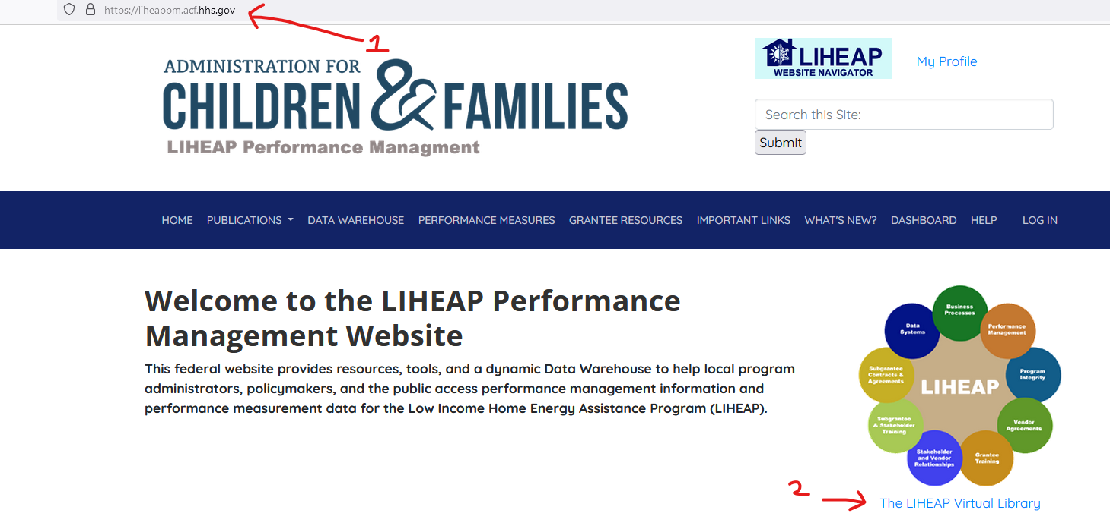
LIHEAP Virtual Library
4
Throughout the presentation, we’ll be referencing the “LIHEAP Virtual Library.”
The LIHEAP Virtual Library can be found on the homepage of the LIHEAP Performance Management website:
https://liheappm.acf.hhs.gov/
Presenter:
David Carroll

Slide 5
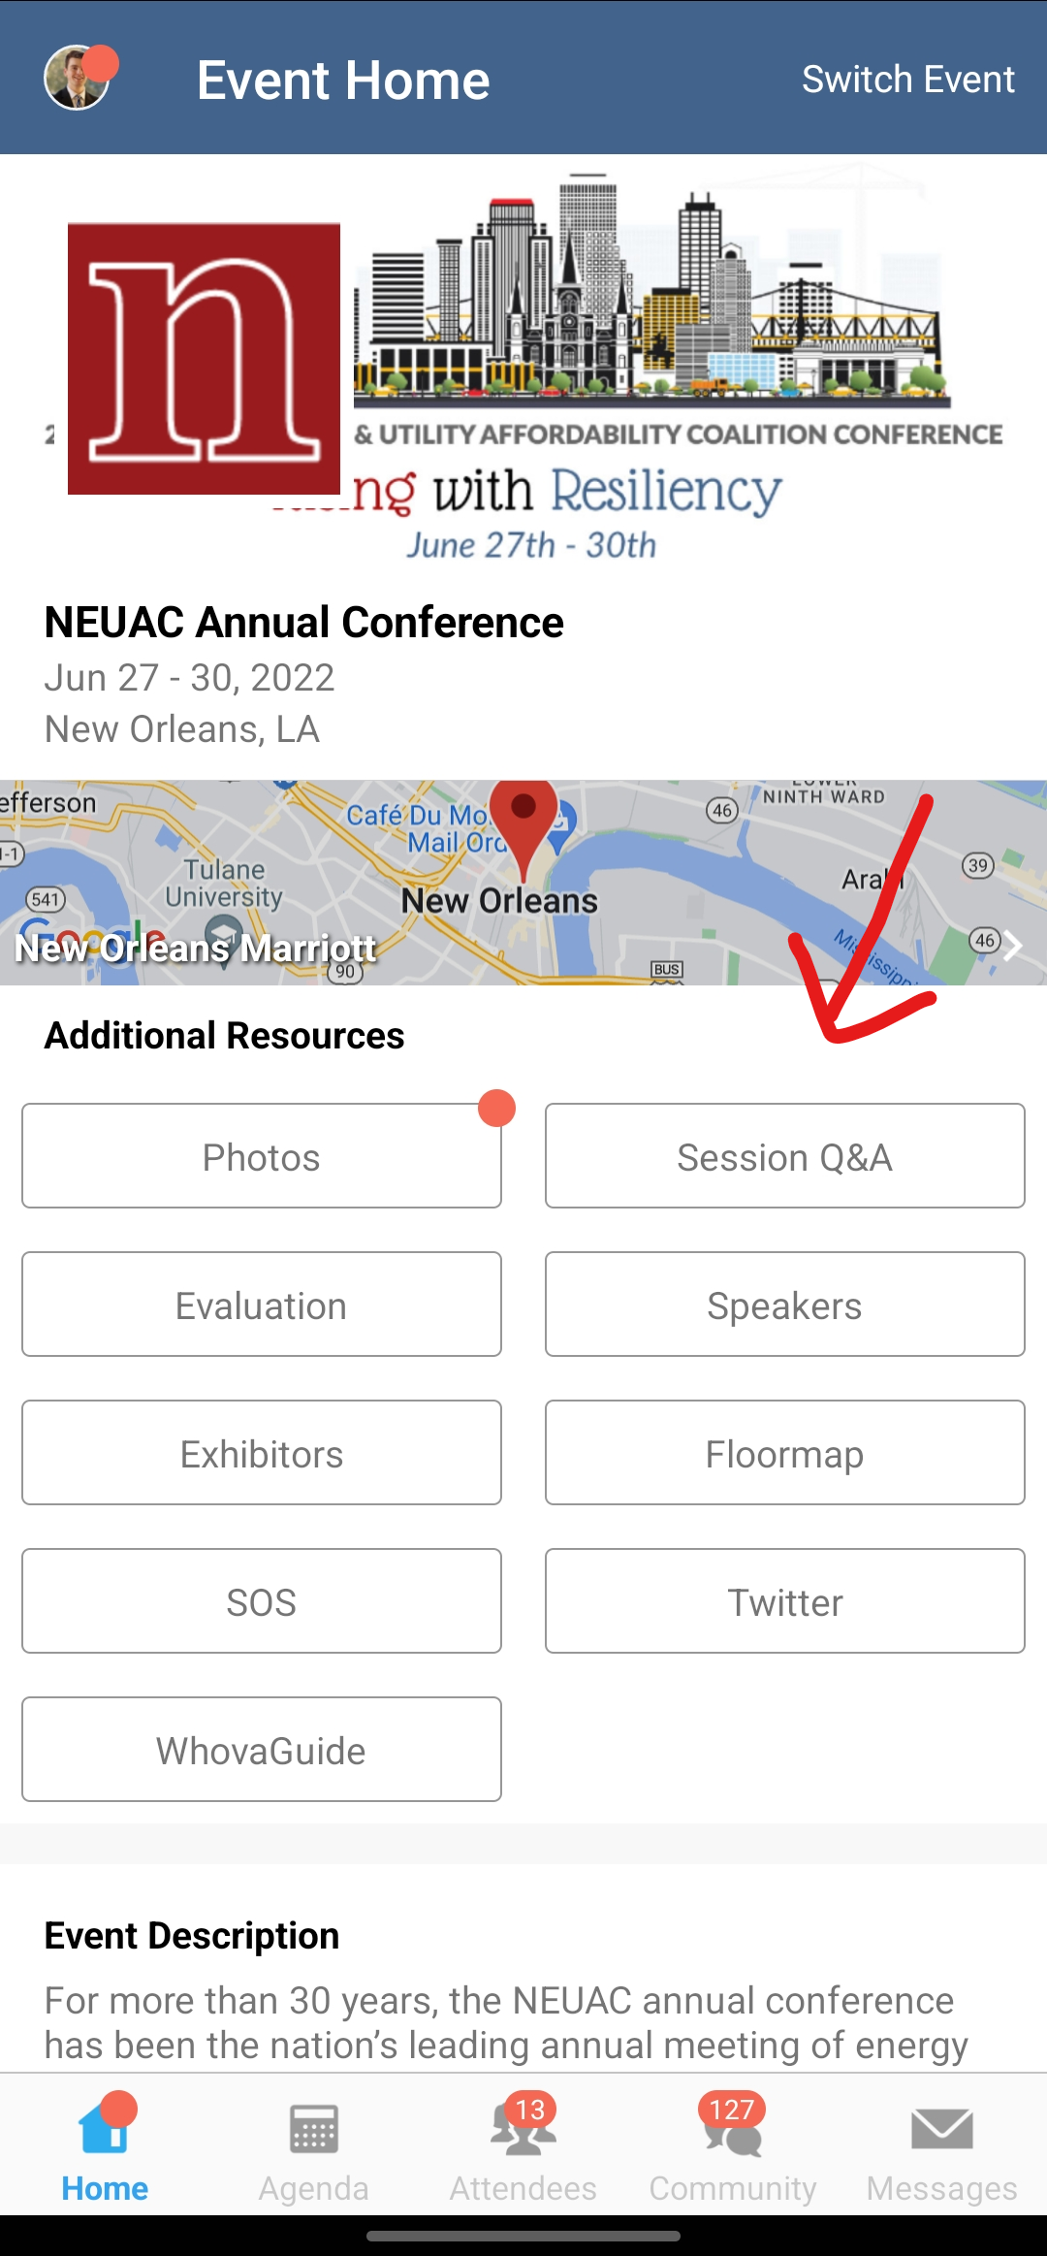
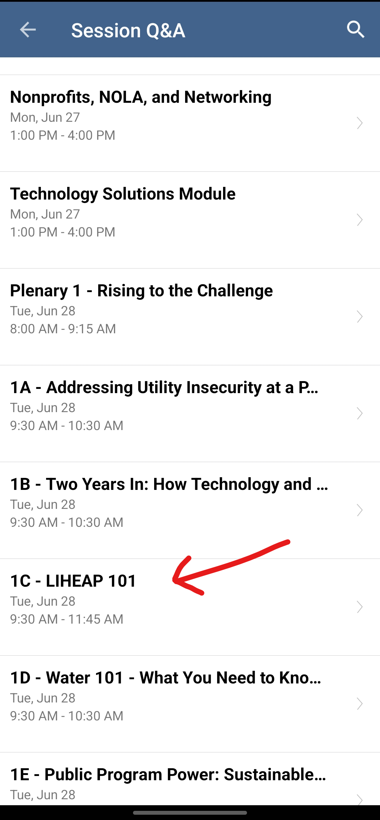
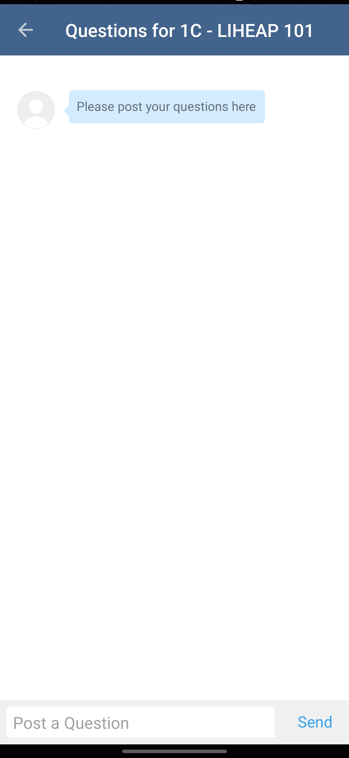
Questions
5
There will be some time for questions at the end of the workshop.
Participants are encouraged to use the Whova app throughout this session to enter and/or “vote up” questions they’d like answered.
Presenter:
David Carroll

Slide 6
6
LIHEAP Program Basics
Melissa Torgerson
VERVE Associates
Presenter:
Melissa Torgerson

Slide 7
Overview
7
In this section, we’ll talk about some of the basic factors all LIHEAP grantees must consider when designing and implementing LIHEAP. These include:
LIHEAP Assurances
Other Federal Statutory Rules/Guidelines
State Statute and Rules
Factors Unique to State/Territory/Tribal Community
Presenter:
Melissa Torgerson

Slide 8
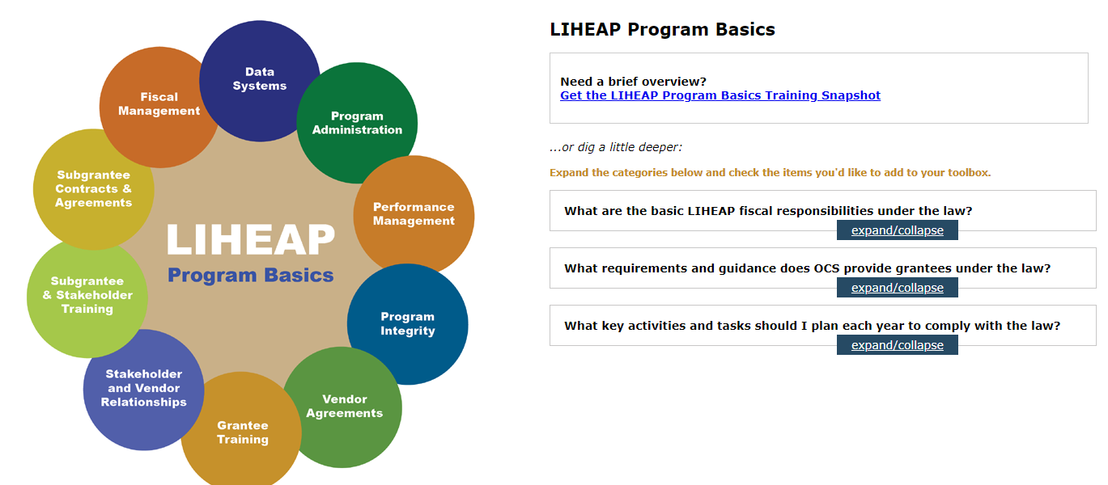
Overview
8
Both during and after the session, participants can learn more by visiting the “Program Basics” area of the LIHEAP Virtual Library.
Presenter:
Melissa Torgerson

Slide 9
Federal Statute--Assurances
9
Every September, states/tribes/territories who wish to receive LIHEAP funding must submit a model plan. The model plan (LIHEAP application) lays out how each grantee will use LIHEAP funds in accordance with the law.
“Each State desiring to receive an allotment for any fiscal year under this title shall submit an application to the Secretary. Each such application shall contain assurances by the chief executive officer of the State that the State will meet the conditions enumerated in section (b).”
Section 2605(a)(1) of the LIHEAP Act, 42 U.S.C. § 8624(a)(1)
The LIHEAP law includes several parts, including sixteen “assurances” that must be officially certified each September by a governor or tribal chairperson (or his or her designee) via the model plan process.
Presenter:
Melissa Torgerson

Slide 10
Federal Statute--Assurances
10
Assurance #2 – Establishes income limits for program eligibility.
Assurance #3 – Requires grantees to target vulnerable and high burden households
Assurance #6 – Requires grantees to give “special consideration” to Community Action Agencies for local program intake
Assurance #7 – Authorizes grantees to pay energy vendors directly, but also establishes requirements associated with those payments
Assurance #8 – Requires grantees to treat owners and renters “equitably”
Presenter:
Melissa Torgerson

Slide 11
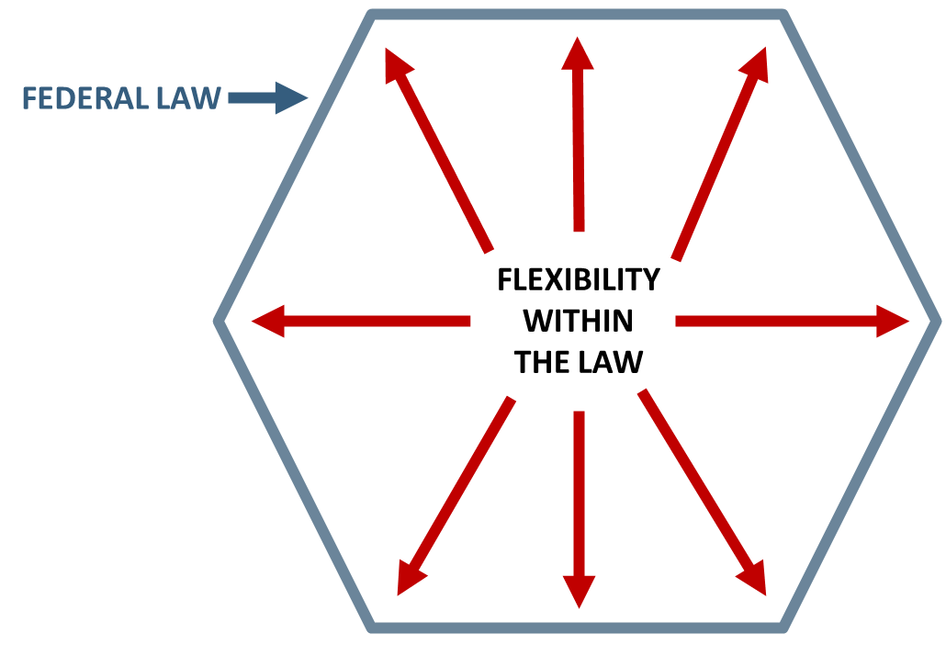
Federal Statute
11
The Federal LIHEAP statute provides grantees with “fenceposts” when designing their LIHEAP programs—leaving a lot of room for flexibility.
Federal regulations at 45 CFR 96.50(e) indicate that grantees have the "primary responsibility" for interpreting the federal law as it relates to their administration of LIHEAP and that HHS will defer to their interpretations unless it is deemed "clearly erroneous."
Presenter:
Melissa Torgerson

Slide 12
State Laws, Rules
12
While the federal statute provides “outer bounds” for grantees, state/tribal law can also influence or restrict the design and delivery of LIHEAP programs.
For example, although the federal statute allows income eligibility up to 60% of state median income, some states have enacted laws that make their LIHEAP income eligibility thresholds much lower.
STATE LAW
FLEXIBILITY WITHIN THE LAW
Federal Law
Presenter:
Melissa Torgerson

Slide 13
Other Factors
13
Other factors, aside from federal and state law, must be taken into consideration when designing and delivering LIHEAP programs. Some of these may include:
Client Need
Other available Energy Assistance or Weatherization Resources
Climate
Fuel type/Costs
Geography
Let’s look at an example of how all these factors fit together.
Presenter:
Melissa Torgerson

Slide 14
Example: Assurance 1 (Uses of Funds)
14
  Assurance 1: Uses of Funds
  Section 2605(b)(1) of LIHEAP Act, 42 U.S.C. § 8624(b)(1)
  This assurance states that the funds grantees receive for LIHEAP must be used only for purposes explicitly authorized in the law. These include:
  Heating and/or Cooling Assistance
  Crisis Assistance
  Weatherization and energy-related Home Repair
  Outreach to households with lowest income and highest home energy needs
  Planning, Development, and Administration (including Leveraging)
Presenter:
Melissa Torgerson

Slide 15
Example: Assurance 1 (Uses of Funds)
15
  Grantees must tell HHS each September:
  Which program components will be administered
  How much funding will be allocated to each component
  When each component will be offered (e.g., winter versus year-round crisis)
  What each program component will include (e.g., equipment repair or bill payment only)
 | # of State/Territory Grantees* | Lowest % of Funds Allocated | Highest % of Funds Allocated
Heating | 51 of 54 | 5% | 78%
Cooling | 32 of 54 | 1% | 84%
Crisis | 54 of 54 | 0.25% | 42%
Weatherization | 53 of 54 | 2% | 25%
* Including America Samoa, Puerto Rico, and Washington DC
Presenter:
Melissa Torgerson
Notes:
Data from 2018 plans

Slide 16
Example: Assurance 1 (Uses of Funds)
16
  STATE LAW: When determining how funds will be used, some grantees must consider state laws regarding implementation of certain LIHEAP components. For example, some states have laws in place that require a certain portion of LIHEAP funds be used for LIHEAP weatherization.
  OTHER FACTORS: In addition to federal and state laws, grantees must consider “other factors” when determining how to best use their LIHEAP funds, for example:
Need | Are we turning away households from one component (e.g., heating) in order to keep another (e.g., cooling)? Are we seeing an increase in households with high energy usage or inoperable equipment that may warrant more crisis or weatherization services?
Climate | Are more households requesting LIHEAP during months when the program hasn’t typically been offered (e.g., summer)?
Resources | Do we have money left over at the end of each heating season that could fund cooling, summer crisis, or year-round crisis programs?
Presenter:
Melissa Torgerson
Notes:
Data from 2018 plans

Slide 17
17
Questions/Comments

Slide 18
18
LIHEAP Program Administration
Lisa Goben
Oregon Housing and Community Services
Presenter:
Lisa Goben

Slide 19
Overview
19
In this section, we’ll cover:
How in Oregon… we incorporate federal statute, state law, and other local factors into the design and delivery of our LIHEAP program.
Presenter:
Lisa Goben

Slide 20
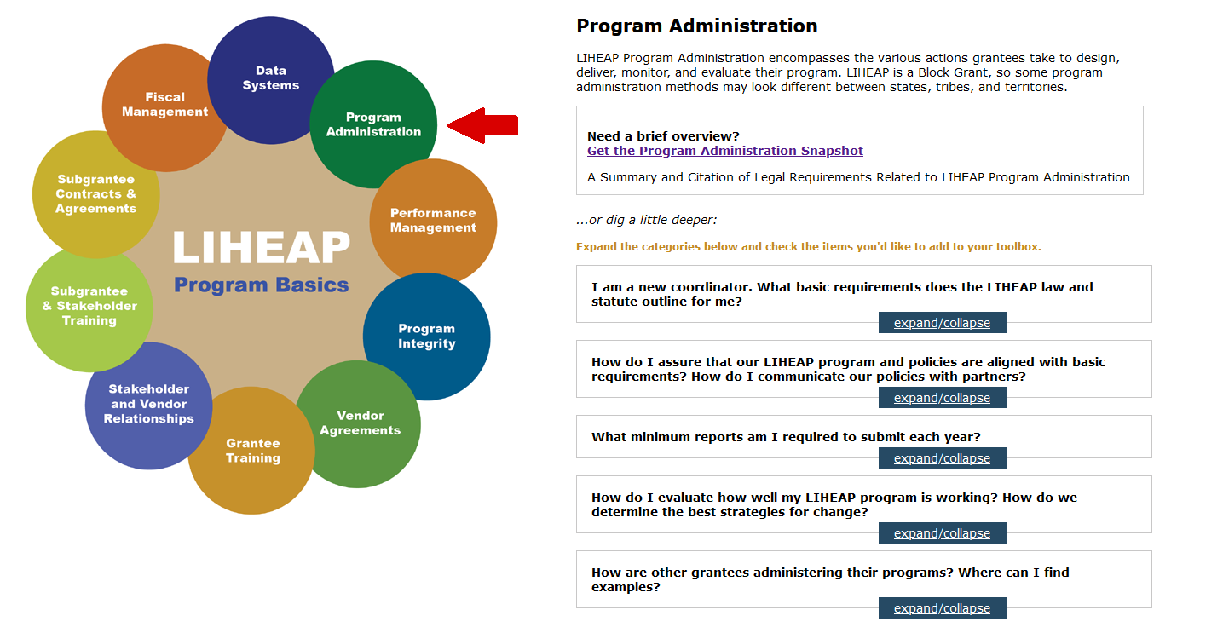
The LIHEAP Virtual Library
20
Both during and after this session, participants can learn more by visiting the “Program Administration” area of the LIHEAP Virtual Library.
Screenshot here
Presenter:
Lisa Goben

Slide 21
Common Grantee Tasks/Activities
21
In order to comply with statute, there are certain common tasks and activities LIHEAP grantees must undertake each year. These include:
Completing the LIHEAP Model Plan (LIHEAP Funding Application)
Executing Subgrantee Agreements
Compiling and Submitting Required Reports
While these tasks may be common among grantees, the methods used by each state, tribe, or territory to complete these tasks often look very different.
Presenter:
Lisa Goben

Slide 22
Example 1: The LIHEAP Model Plan
22
As mentioned earlier in this presentation, the LIHEAP Statute requires that grantees submit a model plan (LIHEAP application) each September. The model plan spells out how we as a state will implement LIHEAP and assure that the conditions outlined in the federal statute will be met.
However, the process of completing our Model Plan is as important as the plan itself. Assurance 12 of the LIHEAP Statute (Section 2605(b)(12) of LIHEAP Act, 42 U.S.C. § 8624(b)(12)) states that:
“Grantees must provide for timely and meaningful public participation in the development of the LIHEAP model plan.”
Presenter:
Lisa Goben

Slide 23
Example 1: The LIHEAP Model Plan
23
  Many grantees, including us in Oregon, begin working on the model plan in the late winter or early spring. This allows the Model Plan to be made available to the public with plenty of time for review and comment.
  Some grantees engage local agencies and/or major stakeholders to consider new policy and develop revisions to the previous year’s Model Plan.
  For example, in Oregon, we typically hold a meeting each Spring with our subgrantees to review “what worked and what didn’t.” We also review with our utilities as well. The feedback gleaned from these meetings is used in the development of our model plan for the next year, and in the review of our statewide LIHEAP Policy and Procedures manual.
Presenter:
Lisa Goben

Slide 24
Example 1: The LIHEAP Model Plan
24
  Other examples of how grantees assure “timely and meaningful” public participation might include:
  Presenting the plan to existing stakeholder groups (e.g., advisory committees)
  Holding “listening sessions” or hearings in geographically accessible locations
  Allowing alternative forms of feedback (e.g., email, public webinars, online forums)
  Facilitating community meetings in underserved locations
  Asking advocates or “gatekeepers” to sponsor meetings in hard-to-reach areas
Presenter:
Lisa Goben

Slide 25
Example 2: Subgrantee Agreements
25
Like many states, Oregon opts to use local agencies to deliver LIHEAP services. In Oregon, state law requires that we use Community Action agencies for delivery of LIHEAP.
Subgrantees are required to comply with the federal LIHEAP statute and state LIHEAP laws. Therefore, in Oregon, we ask our subgrantees to submit an annual workplan that is somewhat similar to the LIHEAP model plan we complete each year as a state.
Among other responsibilities, each local agency is asked to outline how they will comply with assurances related to Outreach (Assurance 3), Coordination of Services with Other Service Providers (Assurance 4), and how they assure Timely Benefits (Assurance 5).
Presenter:
Lisa Goben

Slide 26
Example 2: Subgrantee Agreements
26
We believe that allowing each local subgrantee to submit their own work plan is advantageous because:
It gives each agency the flexibility to meet the unique needs of their individual communities. We know that what works well in an urban area such as Portland may not work as well in a more rural area.
It gives us the information needed to conduct thorough monitoring. While some state policies and procedures are hard and fast—the work plan gives us the details needed to monitor those areas where more flexibility is allowed. Subgrantees are expected to run their program as they’ve spelled out in their work plans and submit amendments if things change.
Presenter:
Lisa Goben

Slide 27
Example 2: Subgrantee Agreements
27
  While not all grantees ask their subgrantees to submit work plans, many (including Oregon) execute subgrantee contracts that at minimum outline:
  Budget and allowable expenditures
  Methods for determining and disbursing benefits
  Required fiscal procedures/accounting practices
  Mandatory data collection and reporting
  Monitoring and auditing procedures
Presenter:
Lisa Goben

Slide 28
Example 3: Data Collection and Reporting
28
Assurance 14 (Section 2605(b)(14) of LIHEAP Act, 42 U.S.C. § 8624(b)(14)) says that the grantee must cooperate with the Secretary with respect to data collecting and reporting under section 2610 of the LIHEAP Act. This includes:
Information concerning home energy consumption
The amount, cost and type of fuels used for households eligible for LIHEAP assistance
The type of fuel used by various income groups
The number and income levels of households assisted with LIHEAP
The number of households which received LIHEAP and include one or more individuals who are 60 years or older or disabled or include young children
The impact of each State's program on recipient and eligible households
Presenter:
Lisa Goben

Slide 29
Example 3: Data Collection and Reporting
29
In Oregon, we have a statewide central database that all subgrantee agencies are required to use. This requirement is outlined in the subgrantee agreement.
The system has a number of canned reports, as well as some ad hoc reports that are available upon request—both of which are accessible to all local agencies and state staff.
We have one tribe that opts to use our state database to assure non-duplication of benefits.
Federally required reports are all run at the state level. The state agency requests LIHEAP Performance Measure data (annual cost and consumption) from energy vendors at the end of each fiscal year.
Presenter:
Lisa Goben

Slide 30
Example 3: Data Collection and Reporting
30
Assurance 10 (Section 2605(b)(10) of LIHEAP Act, 42 U.S.C. § 8624(b)(10)) says that the grantee must establish procedures necessary to assure to the proper disbursal of and accounting for Federal LIHEAP funds.
Oregon’s central database automatically calculates benefits based on income, fuel type, geography, and other household data entered into the system. One exception is in the case of crisis benefits—where the amount is somewhat discretionary (however, the system still places a cap on the crisis benefit amount based on entered data).
The state ratepayer assistance program (OEAP) is also run through the central state database—which allows subgrantees to easily see what other assistance a household might have gotten, besides LIHEAP. Many subgrantees also have “local funded” programs that they also run through the central database for ease.
Presenter:
Lisa Goben

Slide 31
31
Questions/Comments

Slide 32
32
Program Partnerships
Theresa Kullen, Colorado Department of Human Services
Jane Blank, Wisconsin Division of Energy, Housing, and Community Resources
Keelie Gustin, Miami Valley Community Action Partnership
Presenter:
Theresa Kullen

Slide 33
Overview
33
In this section, we’ll cover:
How three states work with energy vendors to assure program integrity and fiscal accountability within LIHEAP.
Presenter:
Theresa Kullen

Slide 34
Example 4: Vendor Relationships and Agreements
34
There are several assurances within the LIHEAP statute that require collaboration with home energy suppliers. Most notable, however, is Assurance 7 (Section 2605(b)(7) of LIHEAP Act, 42 U.S.C. § 8624(b)(7)) which states that:
Grantees who choose to pay home energy suppliers directly must establish procedures to –
Make sure the household knows how much assistance the vendor received as payment for the household's fuel (each household must receive Notice of Action).
Make sure that the vendor reduces the household’s bill by the amount of its LIHEAP benefit and does not overcharge the household.
Make sure that the vendor does not treat LIHEAP households adversely or discriminate against LIHEAP households.
Presenter:
Theresa Kullen

Slide 35
Example 4: Vendor Relationships and Agreements
35
In Colorado, the state government signs the vendor agreements, which are renewed every 5 years. We conduct trainings with new vendors.
We hold annual vendor meetings before the next application period, to inform vendors of any programmatic changes. We also hold informational and fact gathering meetings in the event of more significant changes (e.g. the option to pay off arrears with ARPA funds).
Our program is a lump sum benefit payment, paid out each half of the heating season. Vendors are sent monthly payments and are asked to complete a monthly reconciliation report to verify payment. We have four large vendors in the state with whom we connect our system with. We hope vendors remember to submit reconciliation reports on time.
We meet with vendors quarterly through our state statutory mandated
commissions and our reduced ratepayer (metered accounts only) program.
Presenter:
Theresa Kullen

Slide 36
Example 4: Vendor Relationships and Agreements
36
In Wisconsin, the state manages the vendor contracts (agreements). The contract information is stored in our centralized system, which can be accessed by local agencies.
  Centralized system Web Service obtains live account information from vendors at the time of customer intake.
  Centralized system issues payments, receipts and refunds (manual and automated) and offer the option to receive electronic payments.
  Conduct vendor monitoring activities, such as verifying the records and returns of customer benefits.
  Regularly meet with our Investor-Owned Utilities (IOUs) and deliverable fuel vendors for the planning of annual training events and for program design and processes. We’ve worked with IOUs to automate the application process. Our Public Benefit statute (rate payer program) supports our strong working relationships.
Presenter:
Jane Blank

Slide 37
Example 4: Vendor Relationships and Agreements
37
In Ohio, vendor agreements are handled by individual agencies. Agencies use state-provided forms to grant vendors access to the state system, and agencies are required to work with the vendor to submit the vendor agreement to the State.
Vendor payments will soon be made by all Ohio delegate agencies. The agencies maintain close communication with vendors to ensure clients were paid. Any notes are left in the state system, to apprise the State of the actions taken.
In our agency, we maintain a close relationship with our main electric provider. We can communicate with a team that maintains an exclusive phone line and email account for energy assistance issues. We can receive account updates and access an online portal.
We’d like the State to provide additional support to vendors and agencies and allow agencies to develop closer relationships with vendors. In some cases, agencies
have been apprised of vendor issues, escalated to the State, only months later.
Presenter:
Keelie Gustin

Slide 38
38
Questions/Comments

Slide 39
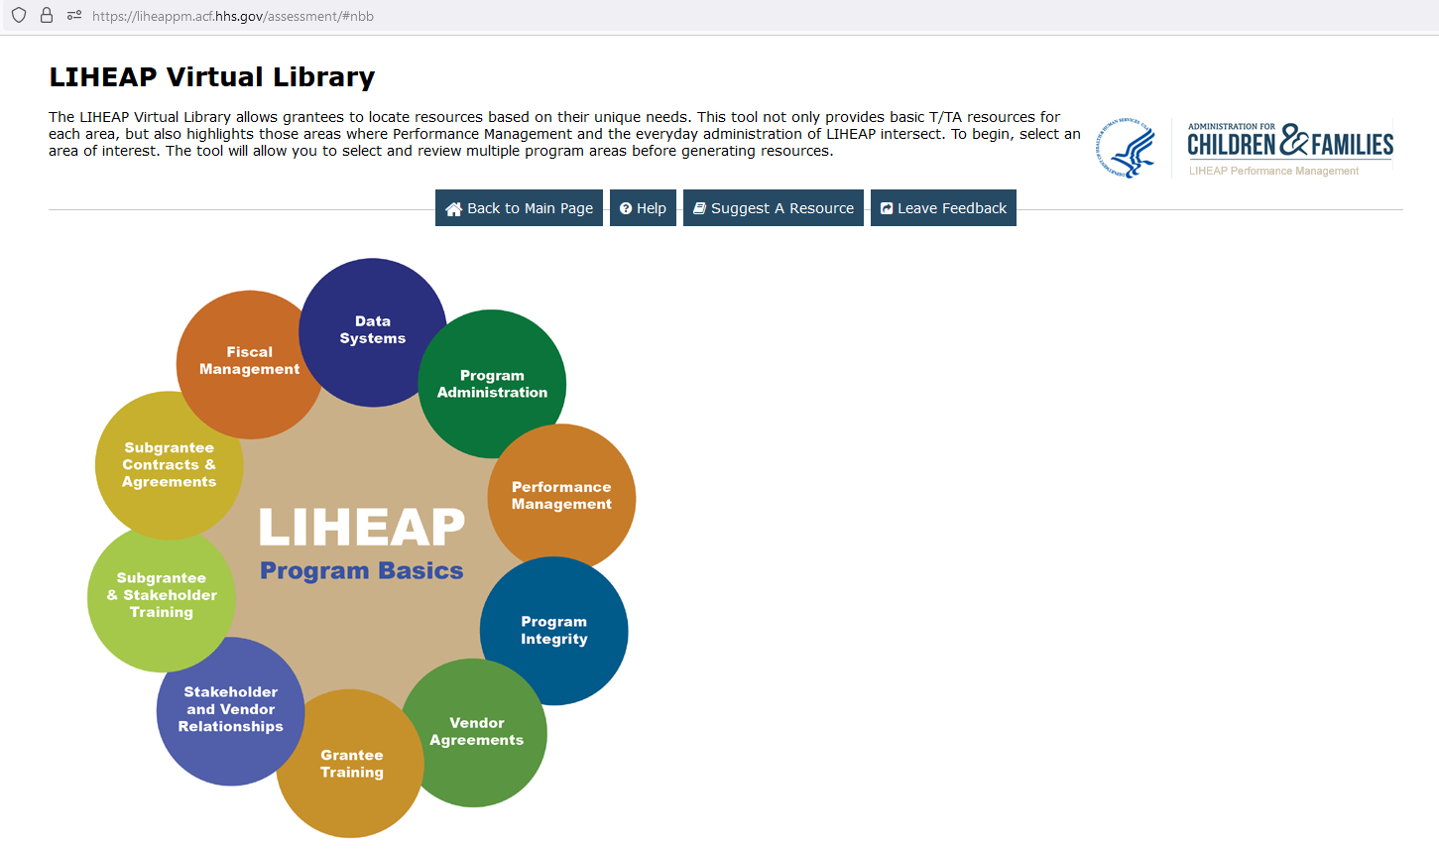
Conclusion
39
The LIHEAP Virtual Library contains resources that provide more comprehensive overview of federal statute, as well as more examples of how grantees incorporate federal statute, state law, and other factors into their programs.
Screenshot here.
Presenter:
David Carroll

Slide 40
LIHEAP Grantee Panel – Responding to Attendee Questions and Concerns
40
During this part of the session, we will ask our panelists to respond to your most pressing questions on designing and implementing LIHEAP programs for your state or tribe. We’ve allocated 5 minutes to each of three topics that have been proposed by attendees.
Presenter:
David Carroll

Slide 41
Conclusion
41
In our next session, LIHEAP 102—we’ll take some time to look at how states have taken more innovative approaches to improve their LIHEAP programs.
Contact Information
David Carroll, David-Carroll@appriseinc.org
Melissa Torgerson, melissa@verveassociates.net
Lisa Goben, Lisa.GOBEN@hcs.oregon.gov
Theresa Kullen, theresa.kullen@state.co.us
Jane Blank, Jane.Blank@wisconsin.gov
Keelie Gustin, Keelie.Gustin@mvcap.com
Brian Sarensen, brian.sarensen@commerce.wa.gov
Presenter:
David Carroll

