Slide 2
LIHEAP 101 June 13th, 2023
Moderator: Häly Laasme, Delaware Department of Health and Social Services
Melissa Torgerson, VERVE Associates
Cynthia Bryant, Georgia Department of Human Services
Theresa Kullen, Colorado Department of Human Services
Deirdre Weedon, Rhode Island Department of Human Services
Brian Whorl, Pennsylvania Department of Human Services

Slide 3
Introduction, Session Objectives
3
After this session, participants will better understand:
Some of the basic rules, guidelines, and considerations every grantee must account for when designing and delivering LIHEAP
Different ways that various states, tribes, and territories interpret federal statute and state laws when implementing LIHEAP
How to access the LIHEAP Virtual Library to learn more about LIHEAP Basics and Program Administration
Presenter:
Häly Laasme

Slide 4
Topics, Presenters
4
Program Basics—Federal Statute, State Law, and Other Considerations
Melissa Torgerson, VERVE
Program Administration—Accounting for Statute in LIHEAP Design, Delivery
Cynthia Bryant, Georgia Department of Human Services
Program Partnerships—Maintaining Program Integrity Alongside Vendors
Theresa Kullen, Colorado Department of Human Services
Deirdre Weedon, Rhode Island Department of Human Services
Brian Whorl, Pennsylvania Department of Human Services
Presenter:
Häly Laasme

Slide 5
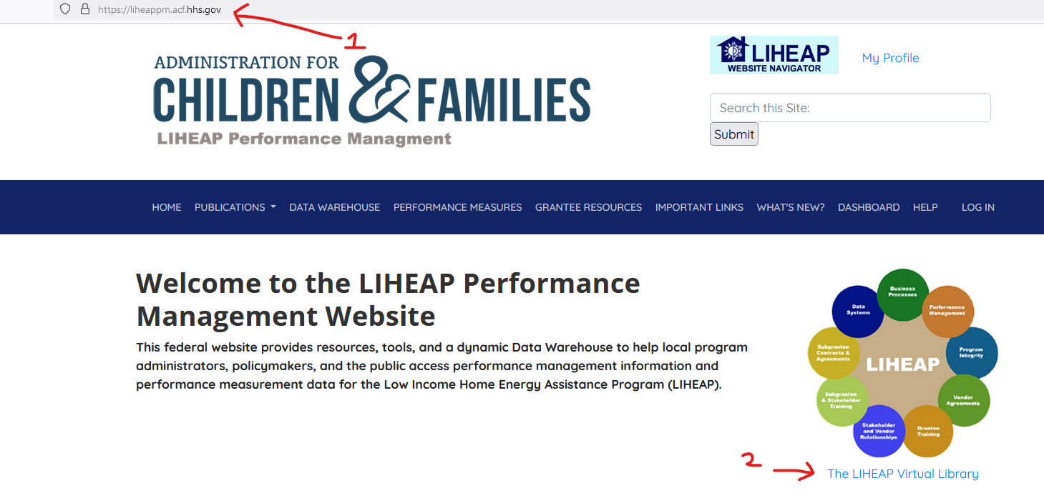
LIHEAP Virtual Library
5
Throughout the presentation, we’ll be referencing the “LIHEAP Virtual Library.”
The LIHEAP Virtual Library can be found on the homepage of the LIHEAP Performance Management website:
https://liheappm.acf.hhs.gov/
Presenter:
Häly Laasme

Slide 6
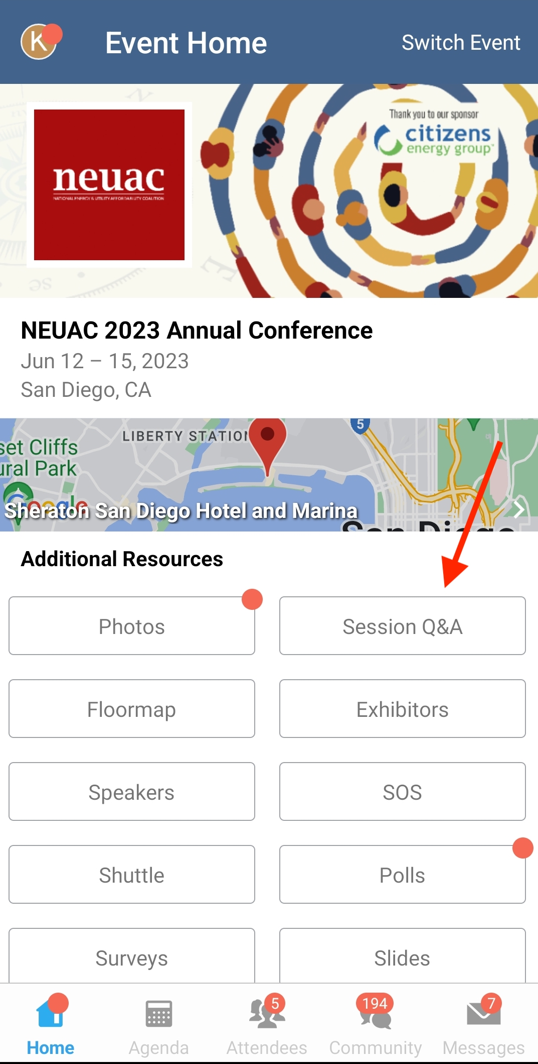
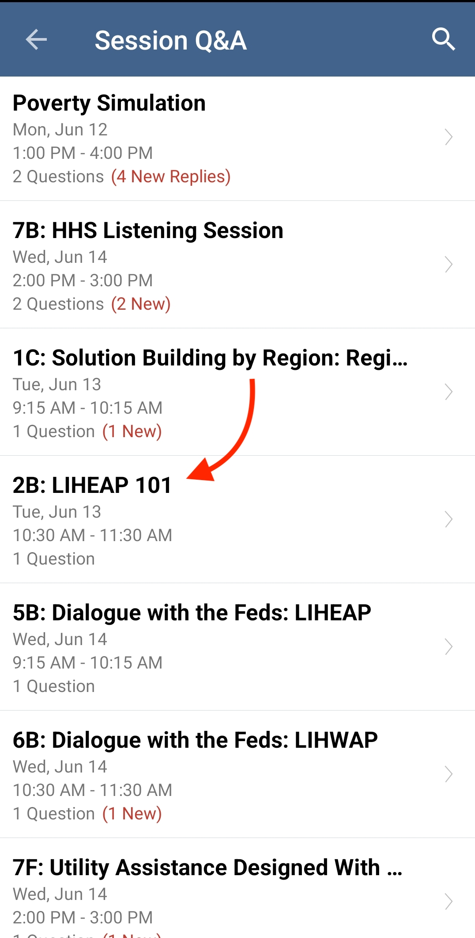
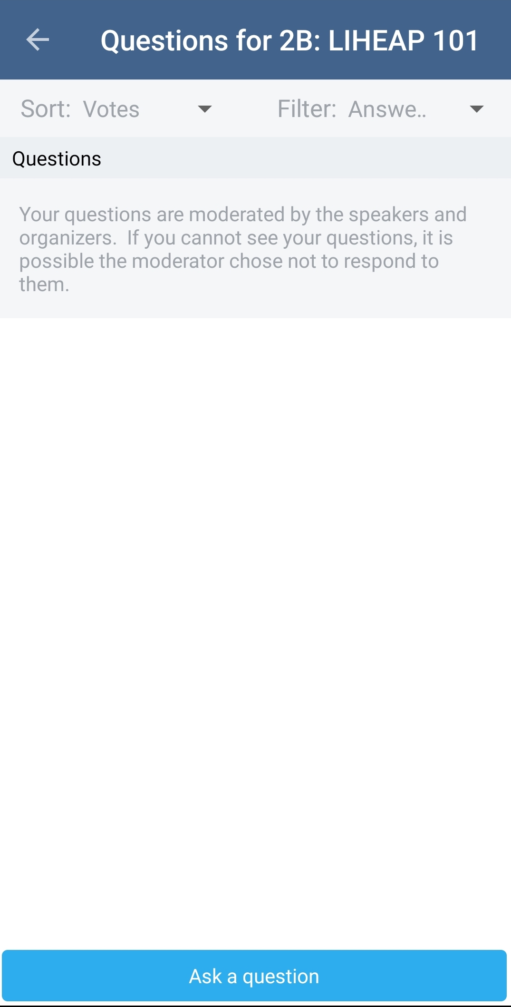
Questions
6
We have set aside 15 minutes are the end of the presentation for discussion of topics you would like covered.
Participants are encouraged to use the Whova app throughout this session to enter and/or “vote up” topics they’d like addressed.
Presenter:
Häly Laasme

Slide 7
7
LIHEAP Program Basics
Melissa Torgerson
VERVE Associates
Presenter:
Melissa Torgerson

Slide 8
Overview
8
In this section, we’ll talk about some of the basic factors all LIHEAP grantees must consider when designing and implementing LIHEAP. These include:
LIHEAP Assurances
Other Federal Statutory Rules/Guidelines
State Statute and Rules
Factors Unique to State/Territory/Tribal Community
Presenter:
Melissa Torgerson

Slide 9
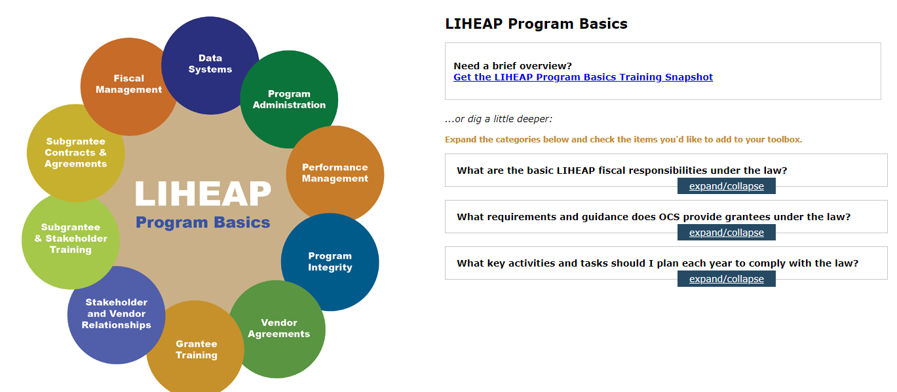
Overview
9
Both during and after the session, participants can learn more by visiting the “Program Basics” area of the LIHEAP Virtual Library.
Presenter:
Melissa Torgerson

Slide 10
Federal Statute — Assurances
10
Every September, states/tribes/territories who wish to receive LIHEAP funding must submit a model plan. The model plan (LIHEAP application) lays out how each grantee will use LIHEAP funds in accordance with the law.
“Each State desiring to receive an allotment for any fiscal year under this title shall submit an application to the Secretary. Each such application shall contain assurances by the chief executive officer of the State that the State will meet the conditions enumerated in section (b).”
Section 2605(a)(1) of the LIHEAP Act, 42 U.S.C. § 8624(a)(1)
The LIHEAP law includes several parts, including sixteen “assurances” that must be officially certified each September by a governor or tribal chairperson (or his or her designee) via the model plan process.
Presenter:
Melissa Torgerson

Slide 11
Federal Statute — Example Assurances
11
Assurance #2 – Establishes income limits for program eligibility.
Assurance #3 – Requires grant recipients to conduct outreach that assures eligible households are aware of LIHEAP.
Assurance #5 – Requires grantees to target vulnerable and high burden households
Assurance #7 – Authorizes grantees to pay energy vendors directly, but also establishes requirements associated with those payments
Assurance #8 – Requires grantees to treat owners and renters “equitably”
Presenter:
Melissa Torgerson

Slide 12
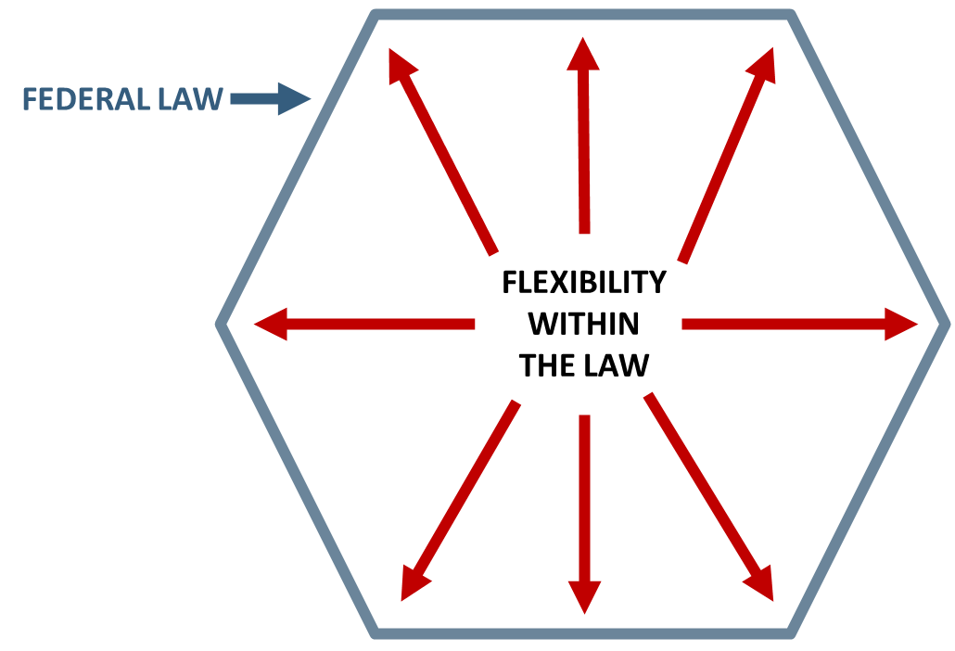
Nature of Federal Statute
12
Federal regulations at 45 CFR 96.50(e) indicate that grantees have the "primary responsibility" for interpreting the federal law as it relates to their administration of LIHEAP and that HHS will defer to their interpretations unless it is deemed "clearly erroneous."
The Federal LIHEAP statute provides grantees with “fenceposts” when designing their LIHEAP programs—leaving a lot of room for flexibility.
Presenter:
Melissa Torgerson

Slide 13
State Laws, Rules
13
While the federal statute provides “outer bounds” for grantees, state/tribal law can also influence or restrict the design and delivery of LIHEAP programs.
For example, although the federal statute allows income eligibility up to 60% of state median income, some states have enacted laws that make their LIHEAP income eligibility thresholds much lower.
STATE LAW
FLEXIBILITY WITHIN THE LAW
Federal Law
Presenter:
Melissa Torgerson

Slide 14
Other Factors
14
Other factors, aside from federal and state law, must be taken into consideration when designing and delivering LIHEAP programs. Some of these may include:
Client Need
Other available Energy Assistance or Weatherization Resources
Climate
Fuel type/Costs
Geography
Let’s look at an example of how all these factors fit together.
Presenter:
Melissa Torgerson

Slide 15
Example: Assurance 1 (Uses of Funds)
15
Assurance 1: Uses of Funds
Section 2605(b)(1) of LIHEAP Act, 42 U.S.C. § 8624(b)(1)
This assurance states that the funds grantees receive for LIHEAP must be used only for purposes explicitly authorized in the law. These include:
Heating and/or Cooling Assistance
Crisis Assistance
Weatherization and energy-related Home Repair
Outreach to households with lowest income and highest home energy needs
Planning, Development, and Administration (including Leveraging)
Presenter:
Melissa Torgerson

Slide 16
Example: Assurance 1 (Uses of Funds)
16
Grantees must tell HHS each September:
Which program components will be administered
How much funding will be allocated to each component
When each component will be offered (e.g., winter versus year-round crisis)
What each program component will include (e.g., equipment repair or bill payment only)
 | # of State/Territory Grantees* | Lowest % of Funds Allocated | Highest % of Funds Allocated
Heating | 51 of 54 | 5% | 80%
Cooling | 30 of 54 | 1% | 80%
Crisis | 54 of 54 | 1% | 42%
Weatherization | 52 of 54 | 2% | 15%
* Including America Samoa, Marianas Islands, Puerto Rico, and Washington, DC
Presenter:
Melissa Torgerson
Notes:
Data from 2018 plans

Slide 17
Example: Assurance 1 (Uses of Funds)
17
STATE LAW: When determining how funds will be used, some grantees must consider state laws regarding implementation of certain LIHEAP components. For example, some states have laws in place that require a certain portion of LIHEAP funds be used for LIHEAP weatherization.
OTHER FACTORS: In addition to federal and state laws, grantees must consider “other factors” when determining how to best use their LIHEAP funds, for example:
Need | Are we turning away households from one component (e.g., heating) in order to keep another (e.g., cooling)? Are we seeing an increase in households with high energy usage or inoperable equipment that may warrant more crisis or weatherization services?
Climate | Are more households requesting LIHEAP during months when the program hasn’t typically been offered (e.g., summer)?
Resources | Do we have money left over at the end of each heating season that could fund cooling, summer crisis, or year-round crisis programs?
Presenter:
Melissa Torgerson
Notes:
Data from 2018 plans

Slide 18
18
Questions/Comments

Slide 19
19
LIHEAP Program Administration
Cynthia Bryant
Georgia Department of Human Services
Presenter:
Cynthia Bryant

Slide 20
Overview
20
In this section, we’ll cover:
How in Georgia… we incorporate federal statute, state law, and other local factors into the design and delivery of our LIHEAP program.
Presenter:
Cynthia Bryant

Slide 21
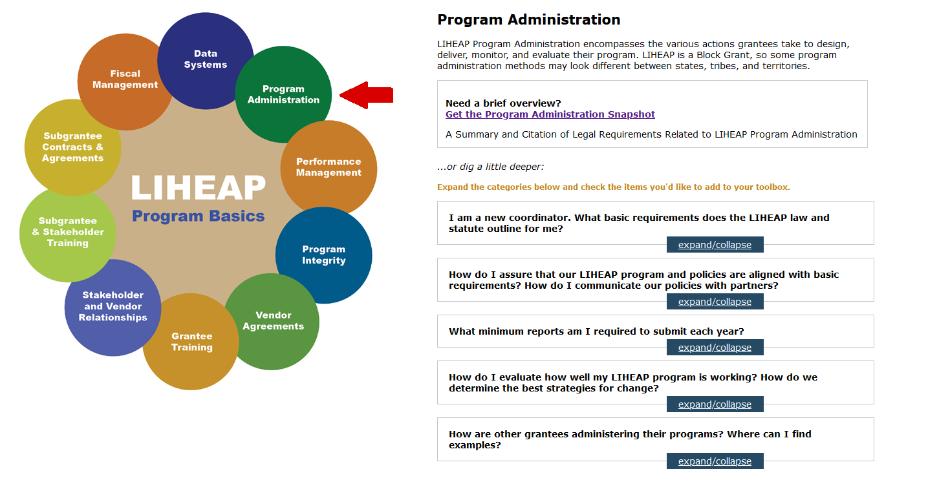
The LIHEAP Virtual Library
21
Both during and after this session, participants can learn more by visiting the “Program Administration” area of the LIHEAP Virtual Library.
Screenshot here
Presenter:
Cynthia Bryant

Slide 22
Common Grantee Tasks/Activities
22
In order to comply with statute, there are certain common tasks and activities LIHEAP grantees must undertake each year. These include:
Completing the LIHEAP Model Plan (LIHEAP Funding Application)
Executing Subgrantee Agreements
Compiling and Submitting Required Reports
While these tasks may be common among grantees, the methods used by each state, tribe, or territory to complete these tasks often look very different.
Presenter:
Cynthia Bryant

Slide 23
Example 1: The LIHEAP Model Plan
23
As mentioned earlier in this presentation, the LIHEAP Statute requires that grantees submit a model plan (LIHEAP application) each September. The model plan spells out how we as a state will implement LIHEAP and assure that the conditions outlined in the federal statute will be met.
However, the process of completing our Model Plan is as important as the plan itself. Assurance 12 of the LIHEAP Statute (Section 2605(b)(12) of LIHEAP Act, 42 U.S.C. § 8624(b)(12)) states that:
“Grantees must provide for timely and meaningful public participation in the development of the LIHEAP model plan.”
Presenter:
Cynthia Bryant

Slide 24
Example 1: The LIHEAP Model Plan
24
To ensure “timely and meaningful” public participation, many grantees, including us in Georgia, begin working on the model plan in the late winter or early spring. This allows the Model Plan to be made available to the public with plenty of time for review and comment.
Other examples of how grantees assure “timely and meaningful” public participation might include:
Presenting the plan to local agencies and/or existing stakeholder groups (e.g., advisory committees)
Holding “listening sessions” or hearings virtually or in geographically accessible locations
Advertising request for comments on the plan
Facilitating community meetings in underserved locations
Asking advocates or “gatekeepers” to sponsor meetings in hard-to-reach areas
Presenter:
Cynthia Bryant

Slide 25
Example 1: The LIHEAP Model Plan
25
Deviating From the Plan
In many cases, states can deviate from their plan as written without OCS approval in order to adapt to changing circumstances.
For example, states can shift their use of funds from what was originally outlined in their plans.
In FY 2021, Georgia planned to spend a substantial amount on Crisis and Weatherization benefits, but since utilities were not shutting people off and the WAP crews could not go into homes, they shifted funds to heating assistance.
Assistance Type/Spending Category | Georgia’s FY 2021 Plan | Actual Spending
Heating | 39.5% | 65.4%
Cooling | 20% | 17.1%
Crisis | 23% | 4.7%
Weatherization | 7% | 2.1%
Carryover to Next FY | 0% | 1.1%
Administrative | 10% | 9.4%
Assurance 16 Activities | 0.5% | 0.1%
Total | 100% | 100%
Presenter:
Cynthia Bryant

Slide 26
Example 2: Subgrantee Agreements
26
Like many states, Georgia opts to use local agencies to deliver LIHEAP services. In Georgia, we use Community Action Agencies (CAAs) for delivery of LIHEAP.
Subgrantees are required to comply with the federal LIHEAP statute and state LIHEAP laws. Therefore, in Georgia, we ask our subgrantees to submit an annual workplan that is somewhat similar to the LIHEAP model plan we complete each year as a state.
Among other responsibilities, each local agency is asked to outline how they will comply with assurances related to Outreach (Assurance 3), Coordination of Services with Other Service Providers (Assurance 4), and how they assure Timely Benefits (Assurance 5).
Presenter:
Cynthia Bryant

Slide 27
Example 2: Subgrantee Agreements
27
We believe that allowing each local subgrantee to submit their own work plan is advantageous because:
It gives each agency the flexibility to meet the unique needs of their individual communities. We know that what works well in an urban area such as Atlanta may not work as well in a more rural area.
It gives us the information needed to conduct thorough monitoring. While some state policies and procedures are hard and fast—the work plan gives us the details needed to monitor those areas where more flexibility is allowed. Subgrantees are expected to run their program as they’ve spelled out in their work plans and submit amendments if things change.
Presenter:
Cynthia Bryant

Slide 28
Example 2: Subgrantee Agreements
28
While not all grantees ask their subgrantees to submit work plans, many (including Georgia) execute subgrantee contracts that at minimum outline:
Budget and allowable expenditures
Methods for determining and disbursing benefits
Required fiscal procedures/accounting practices
Mandatory data collection and reporting
Monitoring and auditing procedures
Presenter:
Cynthia Bryant

Slide 29
Example 3: Data Collection and Reporting
29
Assurance 14 (Section 2605(b)(14) of LIHEAP Act, 42 U.S.C. § 8624(b)(14)) says that the grantee must cooperate with the Secretary with respect to data collecting and reporting under section 2610 of the LIHEAP Act. This includes:
Information concerning home energy consumption
The amount, cost, and type of fuels used for households eligible for LIHEAP assistance
The type of fuel used by various income groups
The number and income levels of households assisted with LIHEAP
The number of households which received LIHEAP and include one or more individuals who are 60 years or older or disabled or include young children
The impact of each State's program on recipient and eligible households
Presenter:
Cynthia Bryant

Slide 30
Example 3: Data Collection and Reporting
30
In Georgia, we have a statewide central database that all subgrantee agencies are required to use. This requirement is outlined in the subgrantee agreement.
The system has a number of canned reports, as well as some ad hoc reports that are available upon request—both of which are accessible to all local agencies and state staff.
Federally required reports are all run at the state level. The state agency requests LIHEAP Performance Measure data (annual cost and consumption) from energy vendors at the end of each fiscal year.
Presenter:
Cynthia Bryant

Slide 31
Example 3: Data Collection and Reporting
31
Assurance 10 (Section 2605(b)(10) of LIHEAP Act, 42 U.S.C. § 8624(b)(10)) says that the grantee must establish procedures necessary to assure to the proper disbursal of and accounting for Federal LIHEAP funds.
Georgia’s central database automatically calculates benefits based on income, fuel type, geography, and other household data. The database is also used to monitor local agencies and track agency and county use of benefit fund expenditures.
In Georgia, all local and state agencies receiving LIHEAP funds are required to maintain an accounting system and supporting fiscal records so they can be audited and verify that the assistance payments and administrative cost claims for reimbursement meet Federal requirements.
Presenter:
Cynthia Bryant

Slide 32
32
Questions/Comments

Slide 33
33
Reducing Burdens for Clients and Vendors
Theresa Kullen, Colorado Department of Human Services
Deirdre Weedon, Rhode Island Department of Human Services
Brian Whorl, Pennsylvania Department of Human Services
Presenter:
Brian Whorl

Slide 34
Overview
34
In this section, we’ll cover:
The importance of collecting sufficient information from clients and vendors.
How three states have worked to reduce the burden on clients and vendors while maintaining program integrity and fiscal accountability within LIHEAP.
Ideas and innovations for further reducing client and vendor burden.
Presenter:
Brian Whorl

Slide 35
Why Collect So Much Data From Clients and Vendors?
35
Collecting data demonstrates program integrity, program effectiveness, and fiscal accountability to ensure LIHEAP will be available for clients in the future.
There is a history of critique, criticism, and skepticism of LIHEAP.
2003: OMB report gave LIHEAP a "Results Not Demonstrated" assessment rating because it had not been able to develop acceptable performance goals or collect data to determine program performance. Since then, OCS has made an ongoing effort to develop and implement meaningful performance measures and management.
2010: GAO published a study called Low-Income Home Energy Assistance Program: Greater Fraud Prevention Controls Are Needed. The study identified some very real vulnerabilities of the LIHEAP program procedures, particularly with respect to energy vendor relationships.
2017: Trump Administration proposed eliminating LIHEAP, claiming that the program has fiscal integrity problems and does not have a significant impact.
Presenter:
Brian Whorl

Slide 36
Why Collect So Much Data From Clients and Vendors?
36
To ensure that LIHEAP maintains its “good name,” grantees need to ask both clients and energy vendors for documentation that may be challenging for them to collect and submit. For example:
Income verification from households.
Grantees are unwilling to accept self-attestation as the GAO sees it as an inadequate control for income verification. Even well-intentioned households may not adhere to LIHEAP's income reporting requirements. While grantees allow households to declare no income, there are procedures to inquire about their means of sustaining a household without income.
Verification from vendors that that they are delivering benefits to the correct households.
Verification from vendors that they are not charging LIHEAP households any differently than any other customer.
Presenter:
Brian Whorl

Slide 37
Example 4: Reducing Client and Vendor Burden
37
There are many innovative ways grantees are reducing the burden on clients and vendors to collect the required information by streamlining program applications, payments, and more. For example, grantees are:
Reviewing information requirements to ensure they are only collecting what they absolutely need
Looking at technical solutions that make it easier to submit necessary documentation
Developing technical assistance resources to help clients and vendors obtain the required information
Finding ways to allow for joint program applications or to use information already submitted by clients for other assistance programs
Our panelists are going to present solutions their states have implemented—and ideas and innovations to continue reducing client and vendor burden in the future.
Presenter:
Brian Whorl

Slide 38
Example 4: Reducing Client and Vendor Burden
38
What Pennsylvania is Currently Doing to Reduce Client and Vendor Burden
Sending preseason applications – Any household that received LIHEAP in our previous season is mailed a pre-populated application or a postcard with a COMPASS token number before the season officially opens to the public.
Real Time Eligibility – If a household applies through COMPASS, our system checks against the data exchanges we have in place as well as the information already known to our eligibility system and if all gateposts are passed, an eligibility determination is made as soon as the application is submitted.
Use of Income Already on File – Our application asks whether a household is already receiving PA DHS benefits (TANF, SNAP, MA) and if so, the household can choose to use income already on file with PA DHS. This reduces the amount of paperwork that a household may have to submit for the LIHEAP eligibility to be determined.
Utility File Transfer – Utilities sign a special UFT agreement and may submit for Crisis benefits any household that previously received LIHEAP within the current season, if they are in a Crisis situation (shut off or have a shut off notice). The utility must collect the household’s consent before submitting the Crisis request on the household’s behalf.
Presenter:
Brian Whorl

Slide 39
Example 4: Reducing Client and Vendor Burden
39
Pennsylvania: Innovations and Ideas for the Future
Review of content and usage of verification forms – one of the things we have heard from our LIHEAP Advocacy Committee in Pennsylvania is that there are situations where a form is being requested that it is not necessary or that the form being sent can be confusing or intimidating to households. PA DHS is planning to review the language on these forms and also perform specific training related to when these forms should and should not be used.
Data Sharing for Customer Assistance Program (CAP) enrollment – PA DHS is working toward the goal of sharing LIHEAP data with utilities operating CAPs to streamline the enrollment of LIHEAP recipients into these programs. A new question on our LIHEAP application will obtain households’ consent to share this data, and we will be able to generate systematic reports for utilities that sign a Data Sharing Agreement (separate from the standard LIHEAP Vendor Agreement). PA DHS intends to implement this data sharing starting with our 2024-2025 LIHEAP season.
Telephonic Signature – For a LIHEAP application, the applicant must sign and date the Rights and Responsibilities. PA DHS is looking to introduce a way for households who forget to sign the application to do so telephonically.
Presenter:
Brian Whorl

Slide 40
Example 4: Reducing Client and Vendor Burden
40
What Colorado is Currently Doing to Reduce Client and Vendor Burden
In depth review of state statutes and revise them accordingly that reduce client barriers, for example, allowing collateral contact verification in lieu of written verification.
Introduction of telephonic applications.
Introduction of an on-line an application portal, which is a single point of entry where folks can apply for numerous public assistance programs at one time.
Vendor portal access where eligibility technicians can verify vendor accounts and heat costs.
Presenter:
Theresa Kullen

Slide 41
Example 4: Reducing Client and Vendor Burden
41
Colorado: Innovations and Ideas for the Future
In the process of building an interface between the SNAP and LIHEAP systems.
Migrating to Salesforce Lightening, which will make the system scalable for additional funding and program opportunities (e.g., water, cooling, etc.).
Lightening Conversion will also open up more communication opportunities with the client. We will be able to do electronic communication vs. snail mail.
In addition, vendors will be able to reconcile payments in the system from any funding stream.
Presenter:
Theresa Kullen

Slide 42
Example 4: Reducing Client and Vendor Burden
42
What Rhode Island is Currently Doing to Reduce Client and Vendor Burden
Household application data is migrated from SNAP eligibility system to LIHEAP system:
Community Action Agencies (CAAs) outreach households
Applicant households submit abbreviated LIHEAP application
Online application for new LIHEAP applicants:
Households can apply for other services that CAAs offer
Currently, data does not go directly into the software used for LIHEAP
LIHEAP applicants are certified outside the heating season to be deemed eligible for utility arrearage forgiveness and other payment plans with utility company.
Utility vendor receives monthly files from CAAs listing LIHEAP clients eligible for discounted utility rates (25% off utilities for households).
Presenter:
Deirdre Weedon

Slide 43
Example 4: Reducing Client and Vendor Burden
43
Rhode Island: Innovations and Ideas for the Future
Explore using online application in which application data will go directly into the LIHEAP software (pilot in FFY 2024).
Evaluate starting a centralized intake team at DHS to handle overflow applications from CAAs.
Standardize the review of deliverable fuel price per gallon for LIHEAP grants and compare to state price per gallon averages within specified time periods.
Assess the efficiency of the state paying LIHEAP vendors directly rather than paying them through the CAAs.
Presenter:
Deirdre Weedon

Slide 44
44
Questions/Comments

Slide 45
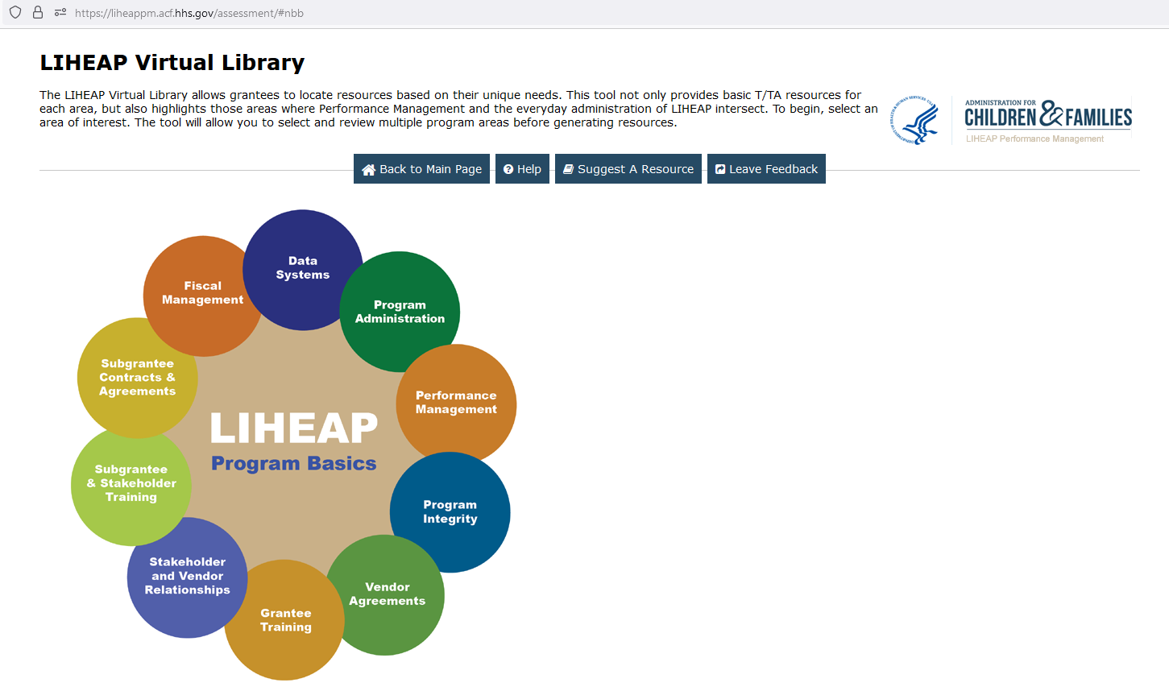
Conclusion
45
The LIHEAP Virtual Library contains resources that provide more comprehensive overview of federal statute, as well as more examples of how grantees incorporate federal statute, state law, and other factors into their programs.
Screenshot here.
Presenter:
Häly Laasme

Slide 46
LIHEAP Grantee Panel – Responding to Attendee Questions and Concerns
46
During this part of the session, we will ask our panelists to respond to your most pressing questions on designing and implementing LIHEAP programs for your state or tribe. We’ve allocated 5 minutes to each of three topics that have been proposed by attendees.
Presenter:
Häly Laasme

Slide 47
Continuing the learning
In our next session, LIHEAP 102—we’ll take some time to look at how states have taken more innovative approaches to improve their LIHEAP programs.
Contact Information
Häly Laasme, Haly.Laasme-McQuilkin@delaware.gov
Melissa Torgerson, melissa@verveassociates.net
Cynthia Bryant, cynthia.bryant@dhs.ga.gov
Theresa Kullen, theresa.kullen@state.co.us
Dierdre Weedon, Deirdre.Weedon@dhs.ri.gov
Brian Whorl, bwhorl@pa.gov
Presenter:
Häly Laasme

