Slide 1
LIHEAP Performance Management in New Hampshire
Tracy Desmarais
Fuel Assistance Program Administrator
Office of Strategic Initiatives
2019 NEUAC Annual Conference

Slide 2
Presentation Agenda
Performance Management in Assurance 16
Energy Burden Data
  Data Collection and Reporting
  Understanding Performance
  FY 2020 and Beyond - Building New Systems
Prevention and Restoration Data
  Understanding Performance
  FY 2020 and Beyond - Improving Data Collection
Notes:
I am a relatively new LIHEAP Director. In 2018 I took over this position from Celeste Lovett, the long-time New Hampshire LIHEAP Program Administrator. And while I had some big shoes to fill, I think that I came into this job at a great time. The national LIHEAP program has made a commitment to increase the use of data for LIHEAP Performance Management. And, at the same time, New Hampshire has made a commitment to upgrade our information systems in a way that will give me much better information for managing the program than Celeste ever had.
In this presentation, I want to talk about Performance Management in New Hampshire. I’ll start with a brief review of the Performance Management work that New Hampshire has done for many years with our Assurance 16 program to demonstrate that there is a culture of using data to measure performance for our program. But, since many people who have been at this conference have heard about our Assurance 16 initiative before, I’ll focus most of my talk today on how we are collecting and using data on energy expenditures and on restoration and prevention to make sure we are serving our clients in the best way possible.

Slide 3
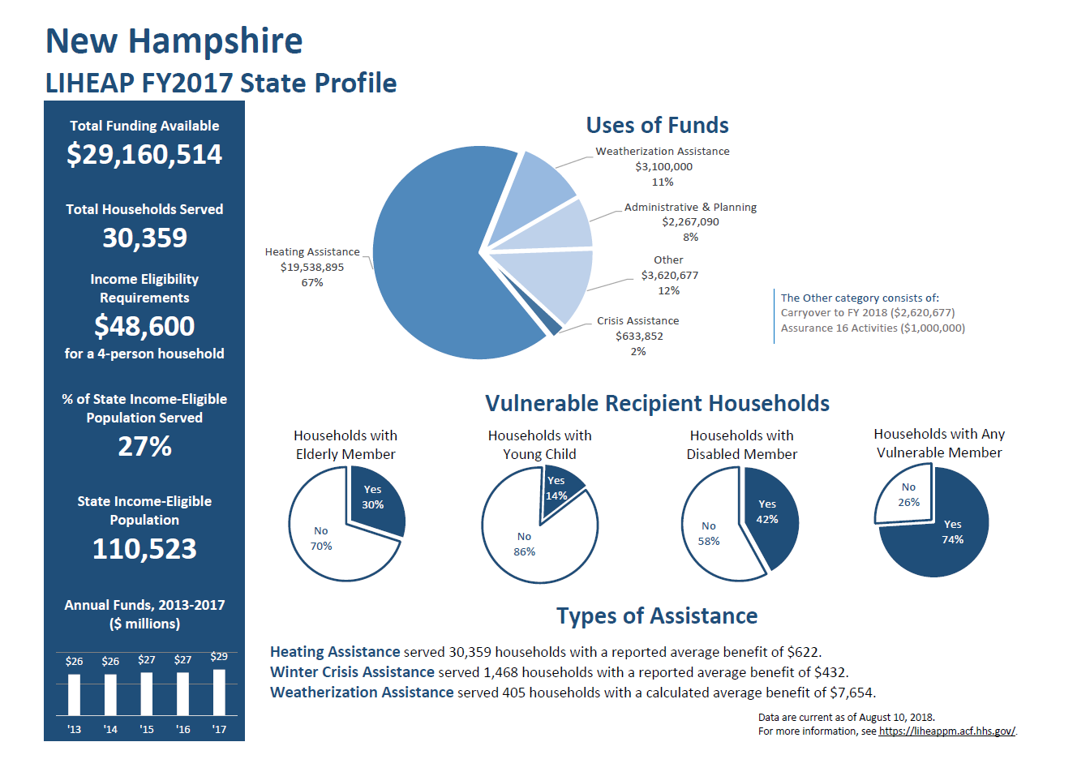
New Hampshire’s LIHEAP Program
Notes:
Here is the State Profile for New Hampshire that is located on the LIHEAP Performance Management Website. You can see that our state received about $29 million in funding for FY 2017 and with that amount we were able to serve about 27% of our income-eligible population.
Something that I would like to highlight for you is that in New Hampshire, we devote almost two-thirds of our funding to regular Heating Assistance and only 2% to Crisis Assistance.
If you have been attending the sessions in this track, you will have heard from Holly in the first session yesterday that grantees are required to have sufficient funds available for energy crisis intervention. And, you might wonder why we are only spending 2% of our funds on crisis benefits. Well, there are two things. First, instead of having a separate crisis program, we “fast track” clients who come into the intake offices with a crisis, and those funds are categorized under regular assistance. The dollar amount we report for crisis is the amount it takes to resolve the energy crisis. But, you also can see that we spent $1,000,000 in FY 2017 on our Assurance 16 program. And, our Assurance 16 program is targeted at identifying households that might potentially have an energy crisis and getting them to come in and apply for regular benefits before they get into a situation where they are at risk of losing their energy service.

Slide 4
Assurance 16
Performance Management in

Slide 5
New Hampshire’s Assurance 16 Program
Grants to Local Agencies
Information System to Identify “At Risk” Households
Proactive Outreach for Regular Benefits
Annual Tracking Procedure as Required by the Statute
https://neuac.org/wp-content/uploads/2017/07/2D-AndreaBrochu.pdf
Notes:
The New Hampshire Assurance 16 program demonstrates both an innovative approach to avoiding energy crises and the long-term commitment of New Hampshire to Performance Management.
Our Assurance 16 program furnishes grants to local agencies to fund an information system and case management. The information system identifies households who has an energy crisis in the prior year. The case manager reaches out to the household at the start of the LIHEAP season and encourages them to apply for regular benefits. And then, each year, we examine whether we were successful in getting those households to apply and avoid a crisis situation. And, we have been successful at that for many years.
For those of you who are NEUAC members, you can follow the link inserted into this presentation and get more details on our Assurance 16 program as it was presented at the NEUAC conference in 2017 in Denver.

Slide 6
Energy Burden Data
Performance Management -

Slide 7
Data Collection and Reporting
Heating fuel data collected by agencies
  Not every agency was collecting
  Manual processing leads to some data integrity issues
Electric baseload data was not being collected
  Special procedure to identify households with ratepayer electric benefits
Notes:
Meeting the requirements to collect and report energy burden data has been a work in progress. Even before the implementation of the new data collection requirements, some of our agencies were collecting and using heating fuel expenditure data. So, from that perspective, we were able to start reporting information right away in FY 2016.
However, we found that not all agencies were collecting the data. The way that the data were being collected was subject to computation errors. And, none of the agencies were collecting the required baseload electric data. For FY 2018, we were able to increase the number of agencies collecting the heating fuel expenditure data and the to get electric data for some households by matching the LIHEAP records to the records for the electric ratepayer assistance program.
While that still is not perfect, it was able to give us some valuable information about our program.

Slide 8
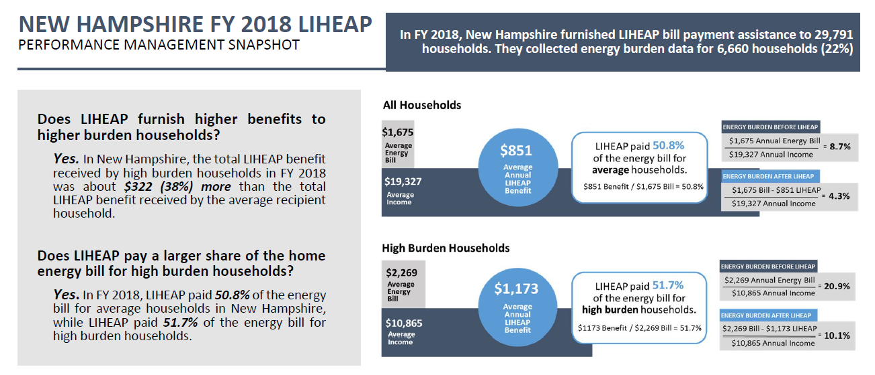
Understanding Performance –
Performance Measures Executive Summary
Notes:
Here is the Performance Management Executive Summary for FY 2018. When we looked at this report, we were very pleased to see that our program does, in fact, deliver higher benefits to the high burden households.
From this chart you can see that the average household receives a benefit of about $851, while our high burden households receive a benefit of $1,173, about 38% higher than the average. In addition, we pay 52% of the energy bill for the high burden households which is a little higher than the 51% of the bill we pay for the average household.
So, it seems like our program is meeting the basic requirements established by the LIHEAP statute.

Slide 9
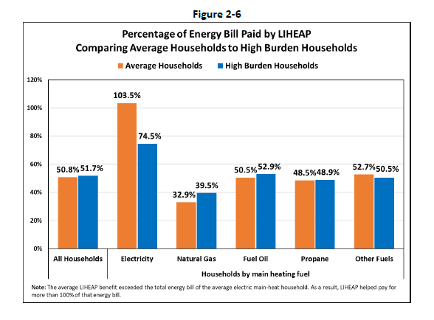
Understanding Performance –
Performance Measures Snapshot
Notes:
However, as we learned in our recent National LIHEAP Training Workshop, it is important to look a little deeper into your program even if your overall performance is good. In this chart, you can see that we are not necessarily treating all energy sources equally. For households with electric main heat, we are paying over 100% of the average bill for all households and about 75% of the bill for the high burden households. But, for the delivered fuels … Fuel Oil, Propane, and Other … we are only paying about 50% of the bill. And, finally, we are only paying about one-third of the bill for the natural gas households.
So, as you can see, we still have some work to do in terms of understanding and using our energy expenditure performance measures data.

Slide 10
FFY 2020 and Beyond –
Building a New LIHEAP System
Development of new LIHEAP Information System
  Increased functionality for individual agencies
  Standard and custom reports accessible to state office
Collection of data from energy vendors to reduce agency burden AND increase quality
Notes:
As I mentioned earlier, we have a very old information system that simply cannot meet all of the need for program management and for report. We are working to implement a new system for the FFY 2020 program year.
We are confident that the new system will both increase capacity and reduce costs. It will give our agencies better “real-time” management information. And, it will automate the development of reports that currently require a lot of manual intervention.
In addition, we will be moving away from having the individual agencies collecting expenditure data manually and will work to automate that data collection process with the energy vendors. If we are successful with that, it will result in much lower administrative cost AND much higher quality data.

Slide 11
Prevention & Restoration Data
Performance Management -

Slide 12
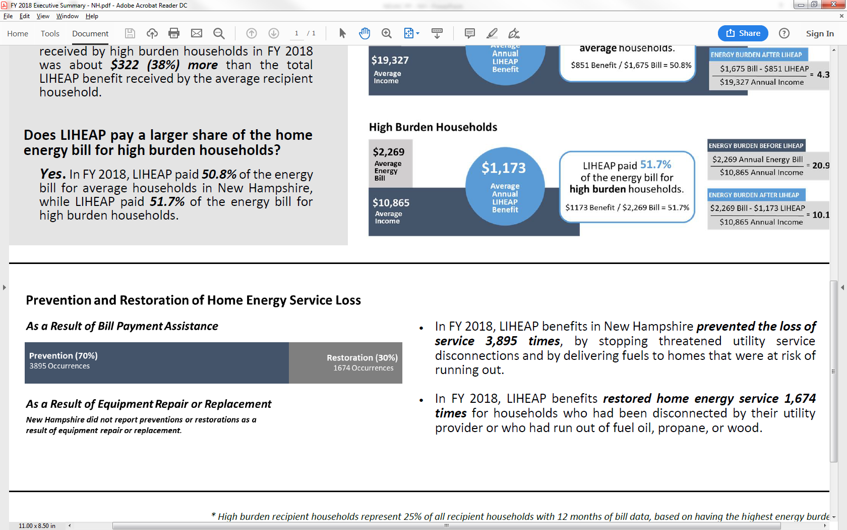
Understanding Performance –
Performance Measures Executive Summary
Notes:
Now I am going to turn my attention to the Prevention and Restoration data for our program. Here again is our Performance Management Executive Summary for FFY 2018.
You can see from the Executive Summary that our current data shows that we prevent loss of energy service about 70% of the time and have to restore service only 30% of the time. In general, because there are client health risks associated with any restoration and it also costs more to restore service than to prevent loss in the first place, we are happy to see that the prevention rate is higher than the restoration rate on average.

Slide 13
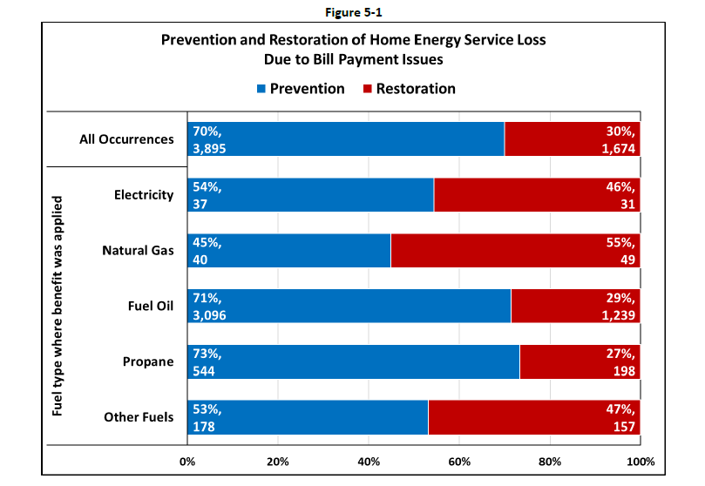
Understanding Performance –
Performance Measures Snapshot
Notes:
Again, as we learned in our recent National LIHEAP Training Workshop, it is important to look a little deeper into your program even if your overall performance is good.
So, here is a chart from the Performance Measures SNAPSHOT that furnishes more detail on the prevention and restoration by main heating fuel. What you can see here is that almost all of our prevention and restoration occurrences are associated with delivered fuels, with most of those related to our fuel oil households. And, these data show that we ARE successful at preventing the loss of services for about 70% of those households.
There are higher rates of restoration for the households who heat with electric, natural gas, and other fuels. But even though those are higher rates, they only represent a small number of households compared to the total population.

Slide 14
FFY 2020 and Beyond –
Improving Data Quality
Question on Data Quality
  Collection from client
  Accurate when applying during the LIHEAP season
  Note accurate for households that pre-register for the program
Question on Data Completeness
  Funds allocated to Weatherization can replace heating equipment
  Need to capture that information to improve overall reporting on prevention and restoration
Notes:
I think that the Prevention and Restoration data shows that we are doing a pretty good job of reaching out to clients and getting them to apply for benefits before they experience a crisis. However, I am not completely confident that we are seeing the whole picture with our current data collection system.
As recommended by the federal LIHEAP office, we do collect restoration and prevention data directly from the clients, since they usually are best able to inform us about their current status. However, we have a pre-registration system during the summer months that allows clients to complete their application prior to the time when the LIHEAP program is opened. That helps to smooth out the agency workflow and helps to ensure that clients get their benefits as soon as possible. However, while the client is able to report his or her status at the time of registration, it is not clear that their status is the same at the time that we actually furnish the LIHEAP grant. Going forward, we are going to try to collect information both from the client and from the energy vendor so that we have a complete picture of the household’s status.
In addition, by comparing our data to the data for some of my colleagues, I realized that we were not yet getting information from our weatherization office about the number of households for whom they repair or replace heating equipment with the funding that we transfer to deliver weatherization services. We will need to be sure we get those data for the coming year to fully meet the LIHEAP reporting requirements.

Slide 15
Questions

Slide 16
Contact Information
Tracy Desmarais
Fuel Assistance Program Administrator
TEL: (603) 271-2685
E-MAIL: Tracy.Desmarais@OSI.NH.Gov

