Slide 1
LIHEAP Virtual Library
NEUAC 2019
Fort Worth, TX
Presenters:
Lisa Goben, Oregon Housing & Community Services
Casey Letran, Oklahoma Department of Human Services

Slide 2
LIHEAP Virtual Library: Background
The LIHEAP Virtual Library (LVL) was designed by the Performance Management Implementation Work Group (PMIWG) in 2015 to help grantees:
Learn about key elements of an effective program
Better use information to plan, design, manage, evaluate and improve their programs (Performance Management)
Provide a framework that helps grantees find and use information to manage their programs
Provides states and tribes with the opportunity to share resources that may help other grantees
Presenter(s):
Lisa Goben

Slide 3
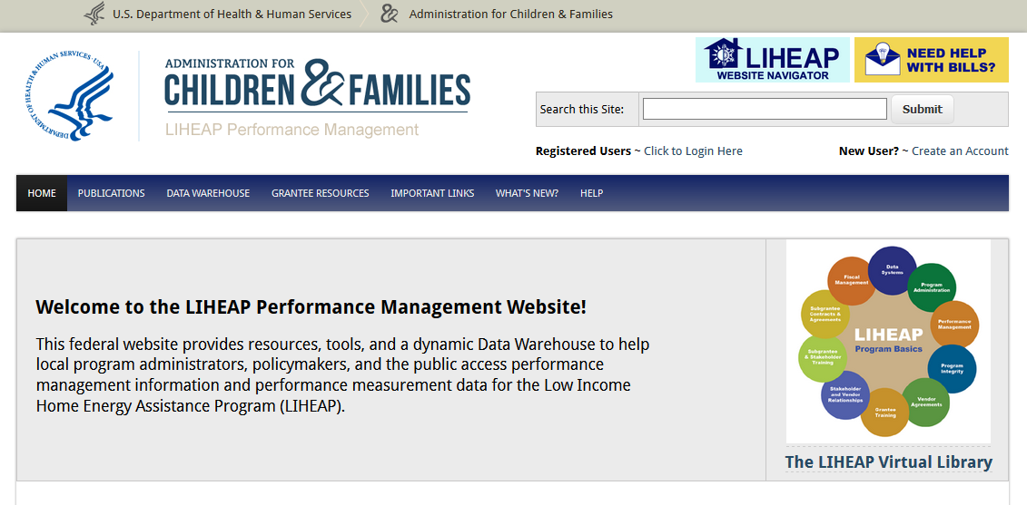
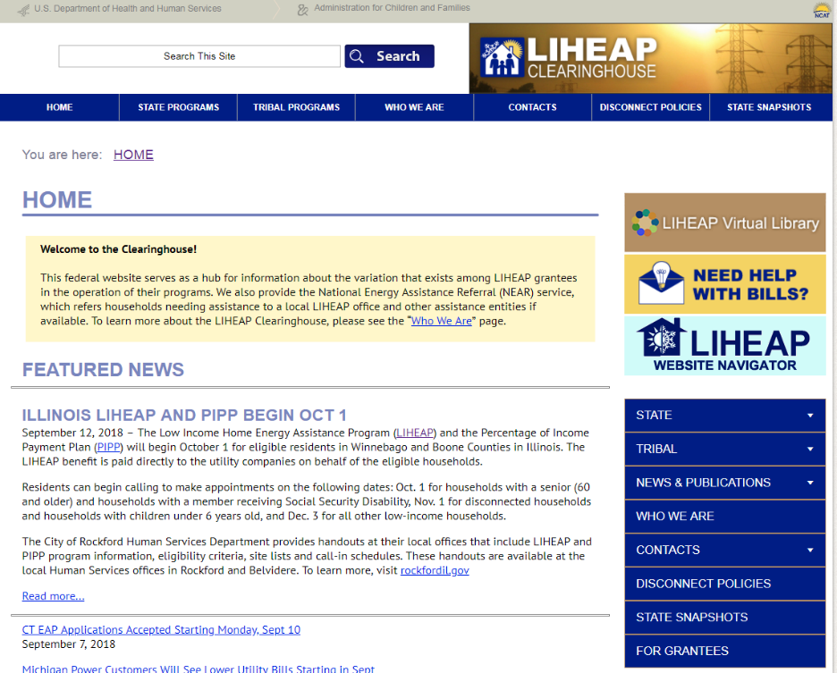
Accessing the LIHEAP Virtual Library
A direct link to the LIHEAP Virtual Library: https://liheappm.acf.hhs.gov/assessment/#nbb
An icon on the LIHEAP Clearinghouse Website and OCS LIHEAP Website
An icon on the LIHEAP Performance Management Website homepage
Presenter(s):
Lisa Goben

Slide 4
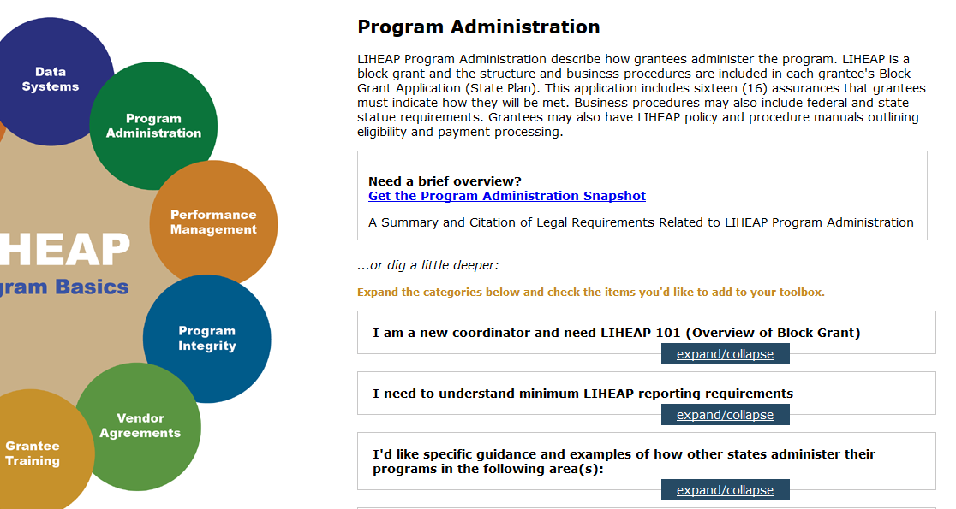
LVL Navigation
Users will notice two ways to explore resources:
Snapshot and Guided Search
Snapshot
Guided Search
Presenter(s):
Lisa Goben

Slide 5
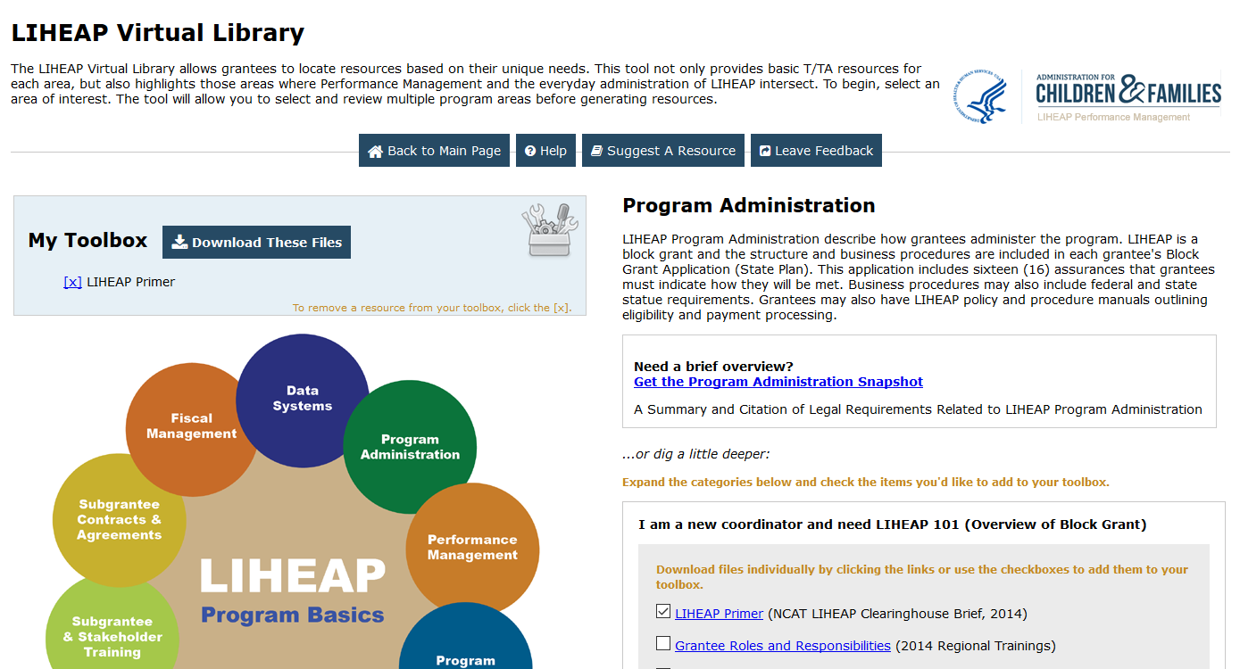
LVL Features
Presenter(s):
Lisa Goben

Slide 6
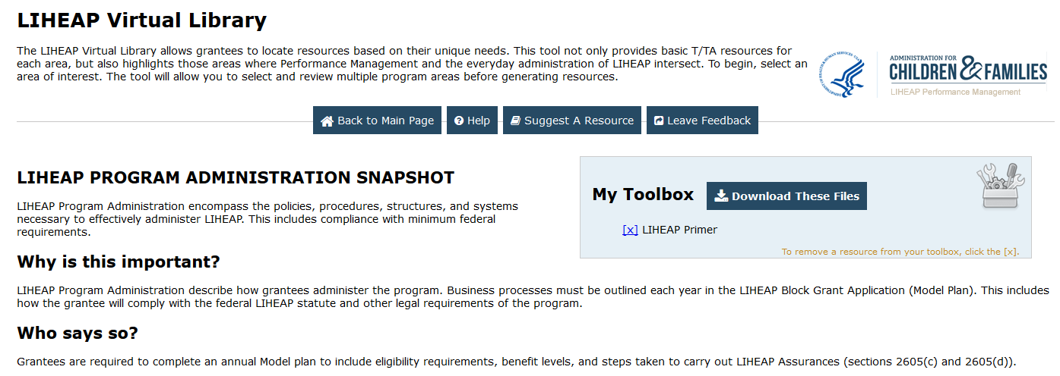
LVL “Snapshot”
Each topic area (bubble) has its own “Snapshot.”
Key elements of each snapshot include:
Presenter(s):
Casey Letran

Slide 7
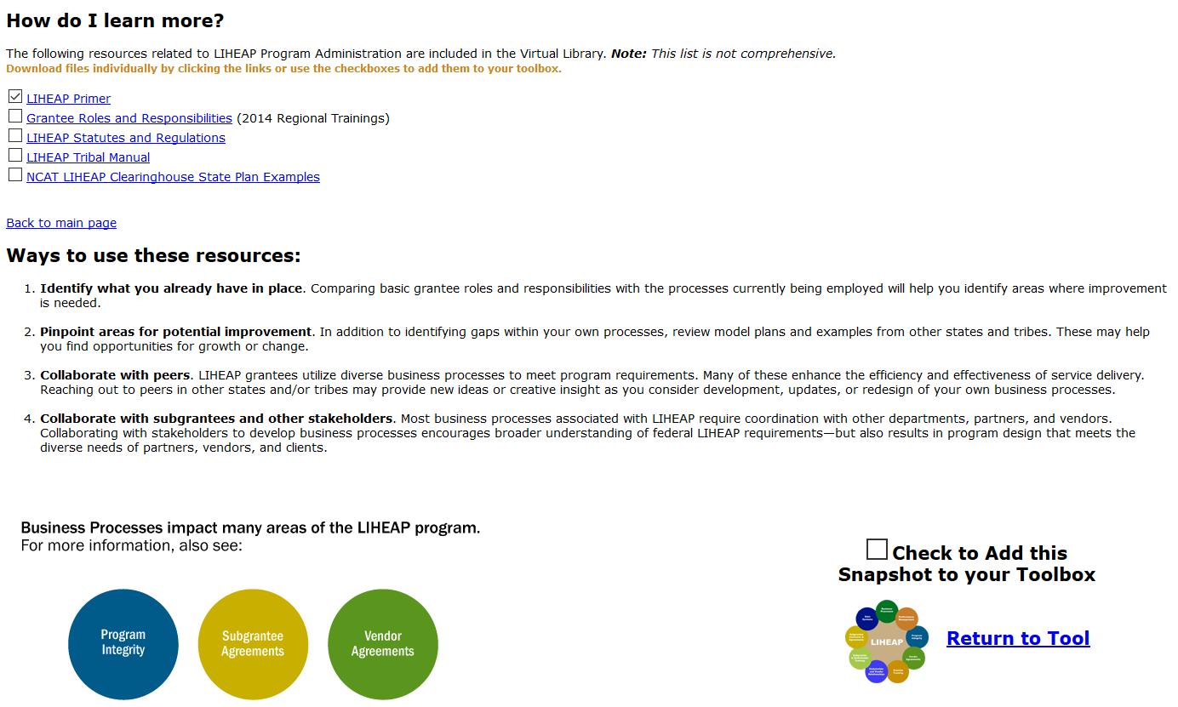
“Snapshot” continued
Presenter(s):
Casey Letran

Slide 8
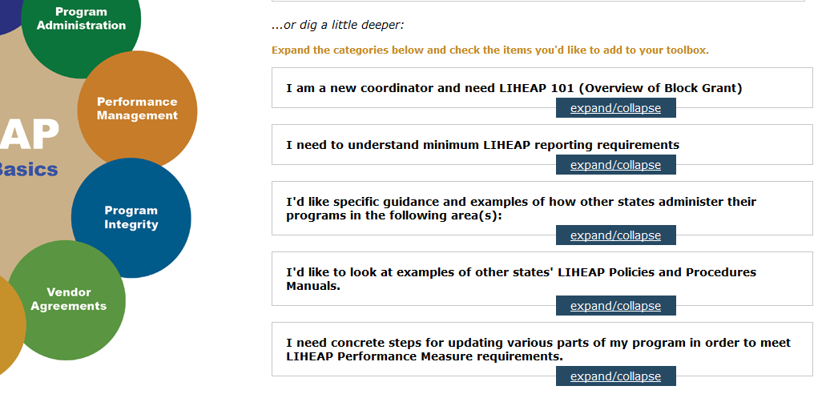
Guided Search
Presenter(s):
Casey Letran

Slide 9
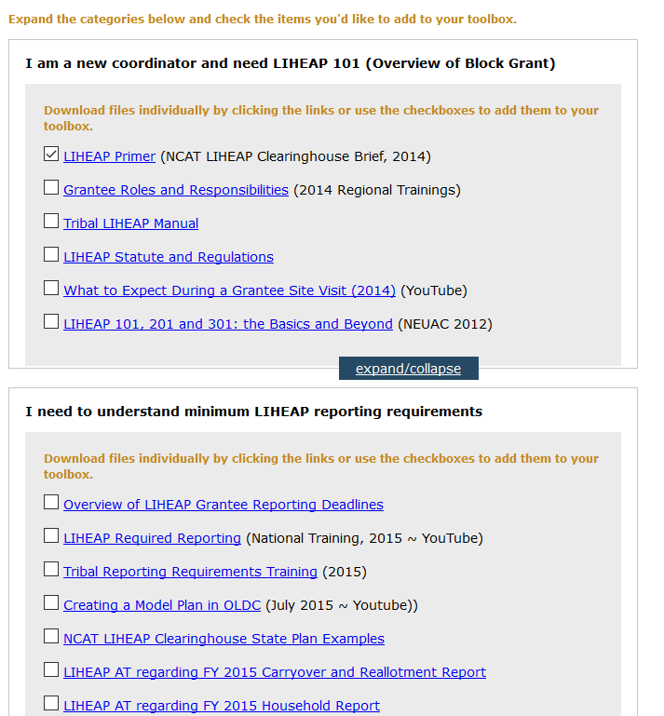
Guided Search
Presenter(s):
Casey Letran

Slide 10
Updates and Future Training Opportunities
New topics added:
Program Basics: LIHEAP Law, Statute, Information Memoranda, Action Transmittals, Dear Colleague Letters, and examples of program lifecycles/timelines developed by OCS and various LIHEAP grantees.
Fiscal Management: Fiscal responsibilities under the law, allowable costs, reporting, tracking funds, and monitoring fiscal integrity of subgrantees and vendors.
LVL Webinar for Grantees: June 20 and June 25, at 3pm (EST)
Presenter(s):
Lisa Goben

Slide 11
Questions?
LIHEAP Virtual Library Website
https://liheappm.acf.hhs.gov/assessment/#nbb

